Slide 1

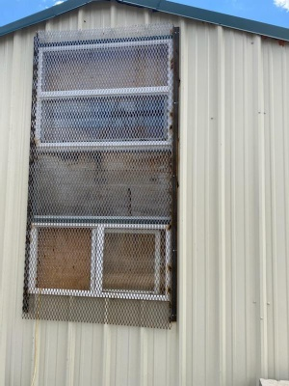
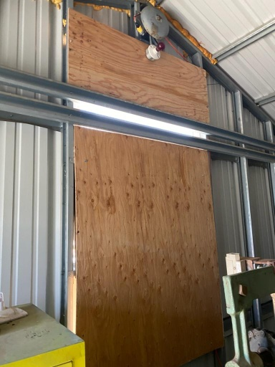
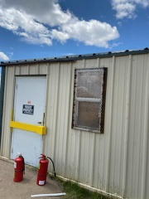
Murphy NOIs Project Photos
TENDERFOOT MINE SITE
Hoist House Window Covered with Expanded Steel
Hoist House Window Covered with Plywood Inside
Steel Bar and Lock Box on Hoist House Door

Slide 2
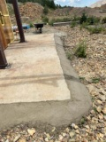
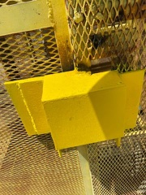
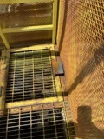
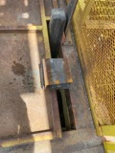
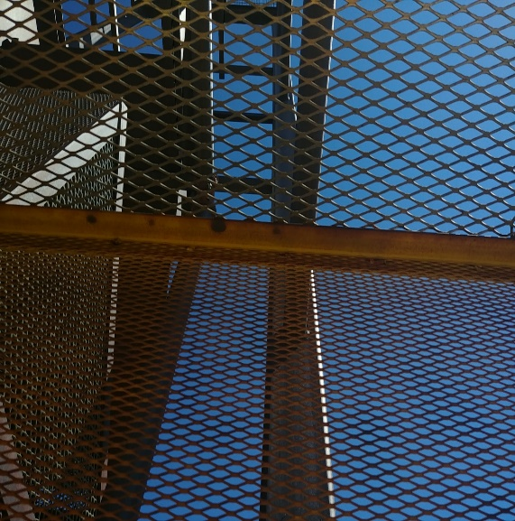
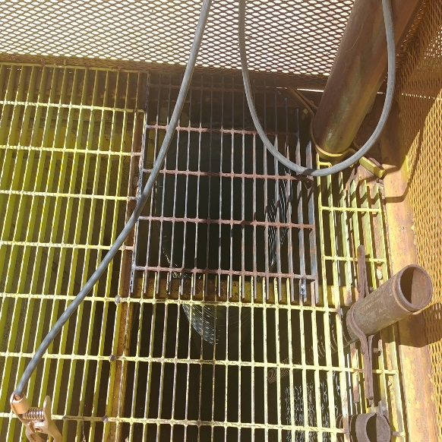
TENDERFOOT SITE CONTINUED
Shaft Collar Repair
Lock Box on Steel Cage
Lock Box on Manway Door
Lock Box on Hoist Door
New Expanded Steel Cover
New Grate on Air Vent

Slide 3
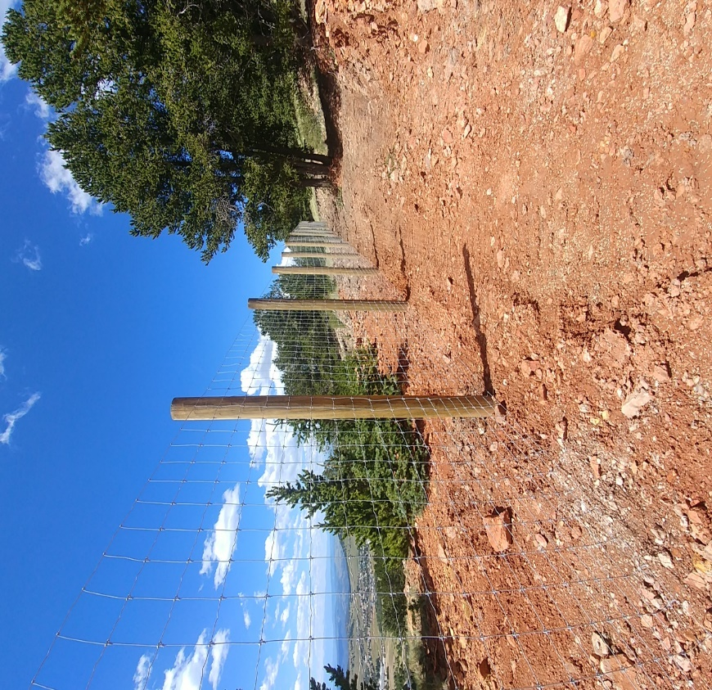
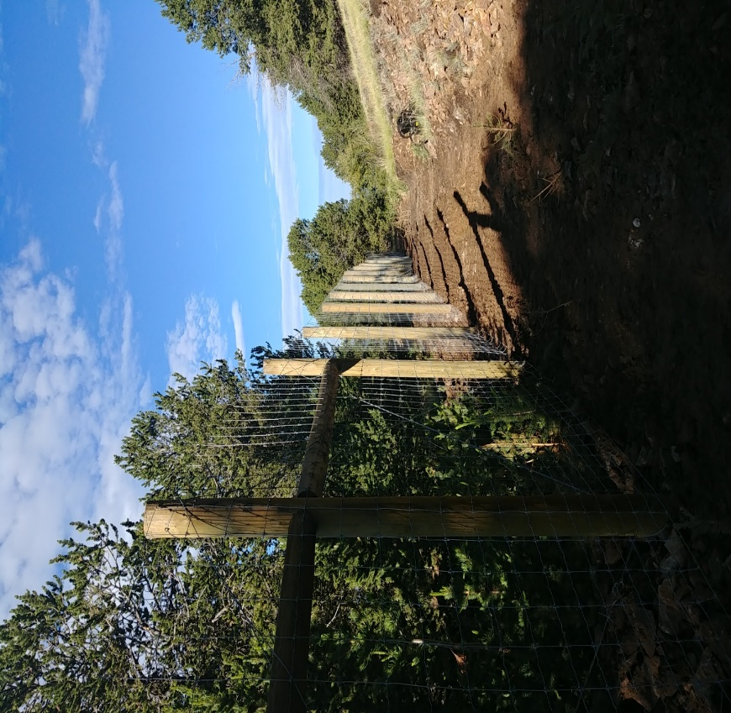
CARBONATE HILL MINE SITE
Exclusion Fence Along Highwall

