Slide 1

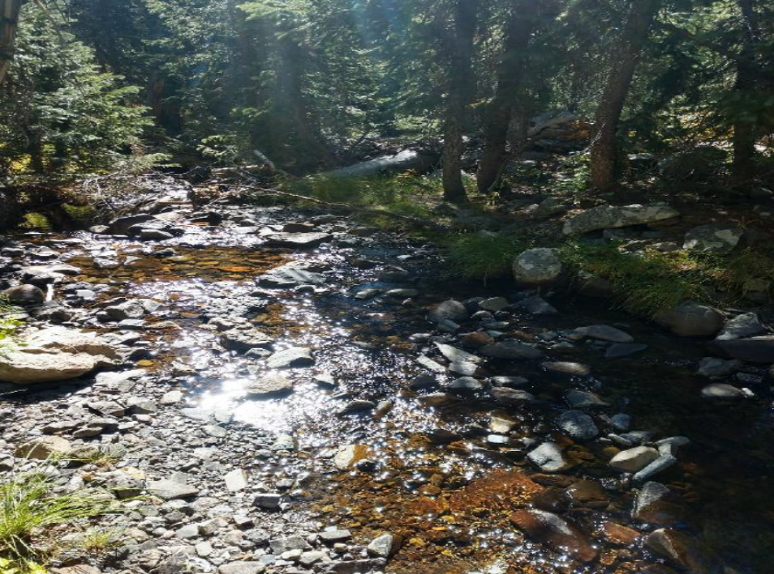
2021 Instream Flow Recommendations
Gunnison County
Robert Viehl & Julie Nania
November 10, 2020

Slide 2
ISF Workshop Agenda
Instream Flow Program Overview – 20 Minutes
Bureau of Land Management Recommendations – 20 Minutes
Colorado Parks and Wildlife Recommendations – 20 Minutes
High Country Conservation Advocates Recommendations – 20 Minutes

Slide 3

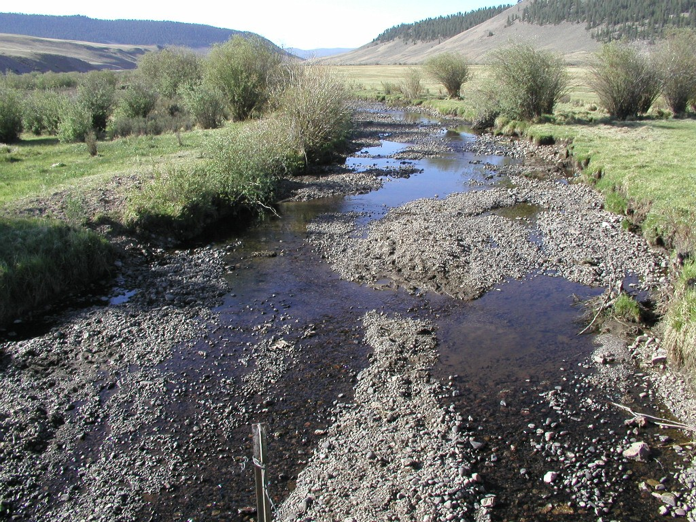
Program History
Public concern over dry stream reaches
No mechanism within the water rights system to keep water within a stream for environmental preservation.
Federal imposition of bypass flows on Fry-Ark project
Threats of ballot initiative to allow private ISFs

Slide 4


Colorado’s Legislature Weighs In
Maintain flows in streams to ensure reasonable preservation of the natural environment and achieve a balance with other beneficial uses of water in the state.
Provide regulatory certainty for water users through continued reliance on the doctrine of prior appropriation.

Slide 5
In 1973, the Colorado Legislature established the
Instream Flow Program with the passage of Senate Bill 97:
Recognized “the need to correlate the activities of mankind with some reasonable preservation of the natural environment”
Vested the Colorado Water Conservation Board with the authority “on behalf of the people of the state of Colorado, to appropriate or acquire… such waters of natural streams and lakes as may be required to preserve the natural environment to a reasonable degree.”

Slide 6
What did the ISF legislation establish?
  ISF and NLL rights are “in-channel” or “in-lake” appropriations of water and are recognized beneficial uses of water.
  Made exclusively by the Colorado Water Conservation Board
  To preserve the natural environment to a reasonable degree
  For “minimum flows” between specific points on a stream, or “levels” on natural lakes
  Administered within the State’s water right priority system
  Entitled to stream conditions existing at time of appropriation
Herman Gulch

Slide 7
ISF Program Statistics
39,479 miles of perennial streams
Appropriated
Instream flow water rights on
1,684 stream segments,
covering 9,720 miles of stream,
and 482 natural lakes
Acquired
Over 43 water right donations or long-term contracts for water totaling
945 stream miles

Slide 8
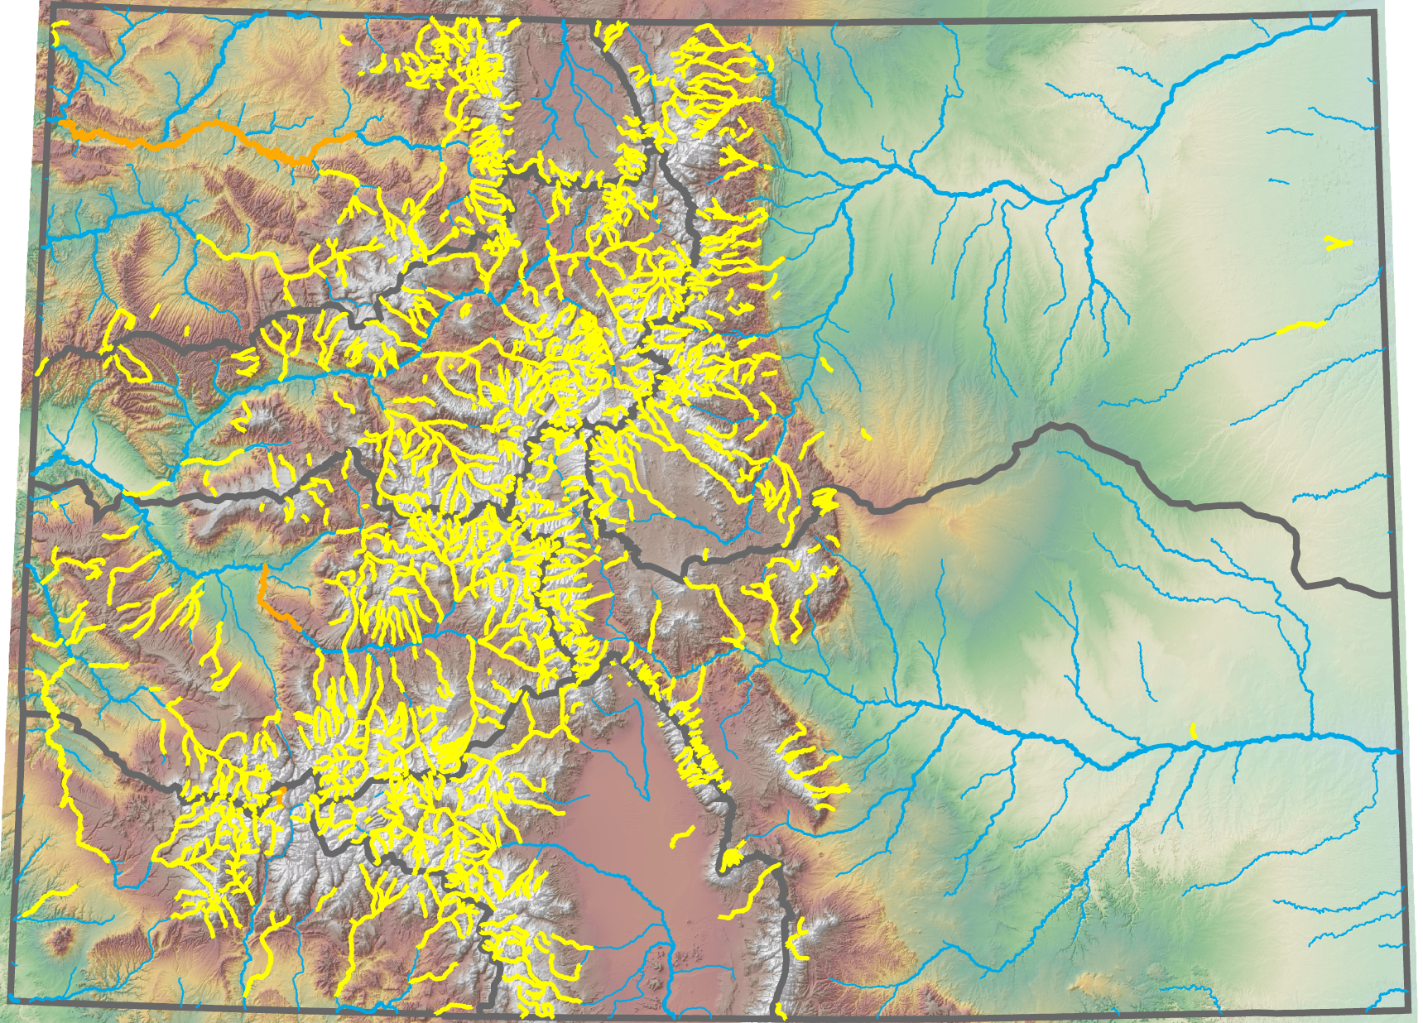
Distribution of Existing ISF Water Rights in Colorado
Hanging Lake and Deadhorse Creek – Riparian vegetation, unique hydrologic and geologic features
Big and Little Dominguez Creeks – Wilderness area… all unappropriated water for fish and riparian vegetation
Gageby Creek – Waterfowl habitat
San Miguel River –
Sensitive Species….
bluehead & flannelmouth sucker & roundtail chub
Mexican Cut Ponds at RMBL – Unique glacial ponds and habitat for salamanders
Horsefly Creek –
Aquatic macroinvertebrates
Yellow lines = Appropriations
Orange Lines = Acquisitions
Notes:
Deadhorse Creek & Hanging Lake – All unappropriated water
Salamanders - Mexican Cut Ponds
Republican and Arikaree Rivers - warm water species
Gageby Creek - Ducks
Little Dry Creek – Minnow Species

Slide 9
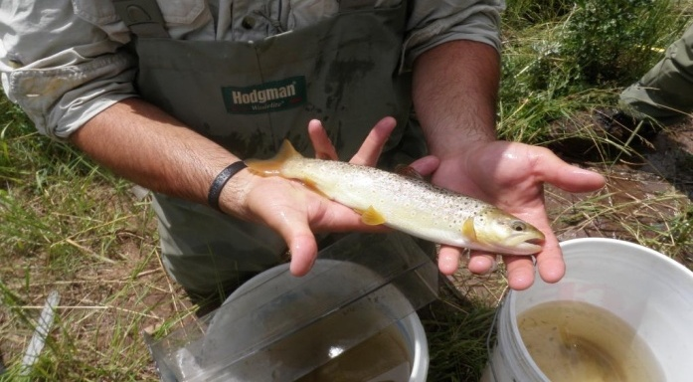
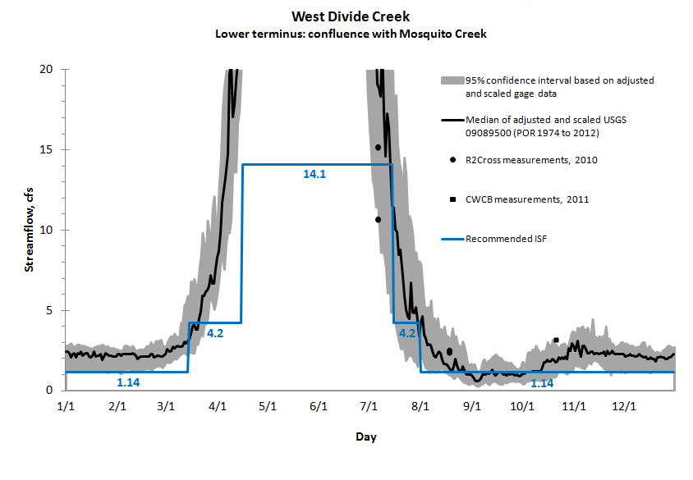
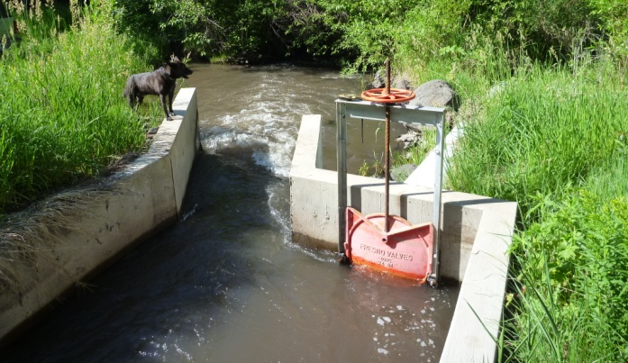
Required Board Findings
  A natural environment exists
    Typically identified by the presence of a fishery, but other indicators can be used
    Note: Quantification of the amount of water needed is provided by the recommending entity.
  Natural environment will be preserved by the water available for appropriation
    Determined by water right and hydrologic investigations
    Daily Median hydrology when available – general CWCB policy to show water available 50% of time
  No material injury to other rights
    New appropriations are junior water rights and have no effect on existing senior appropriations
    37-92-102(3) b. Recognition of existing undecreed uses and exchanges

Slide 10
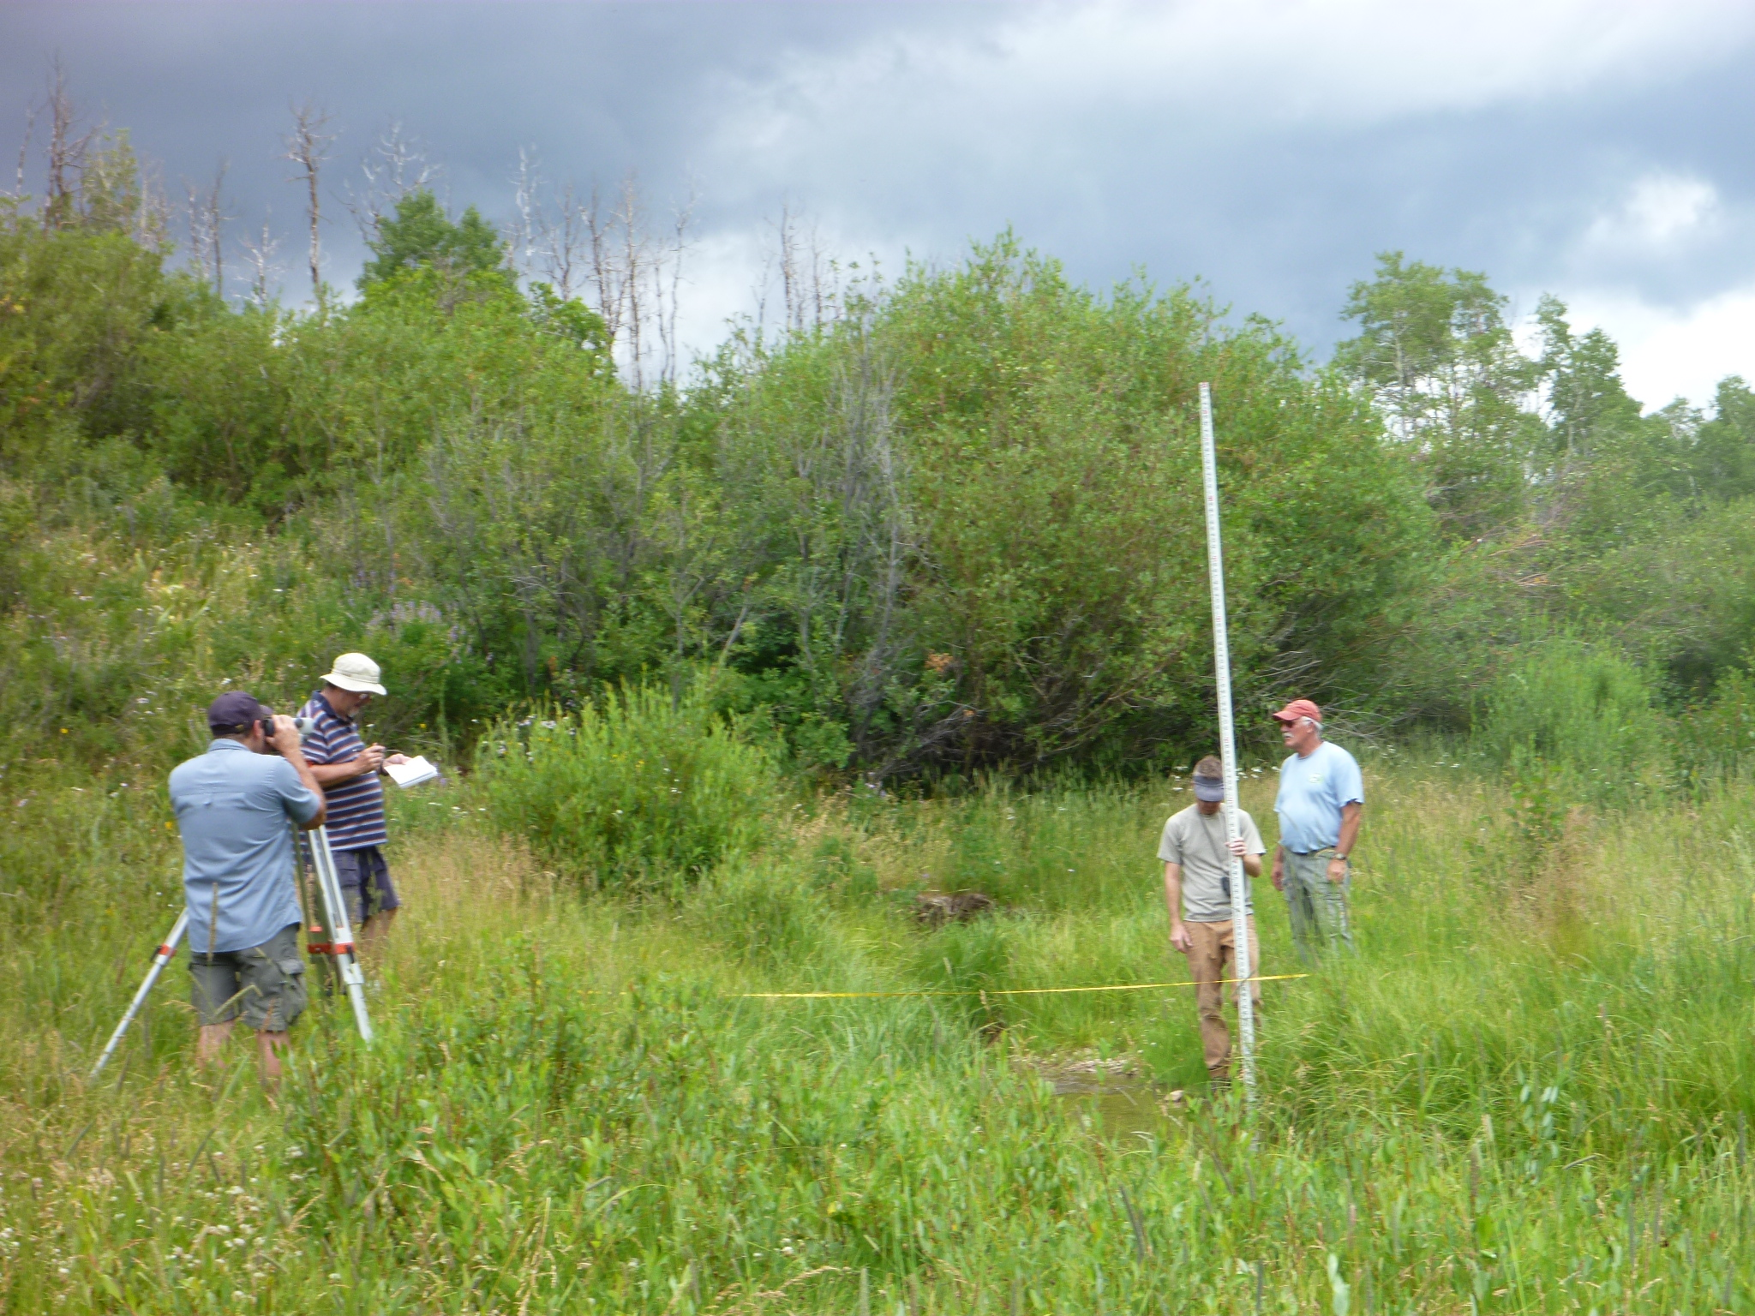
R2Cross
Collect streamflow measurements &
channel geometry to model hydraulic
parameters of average depth, velocity,
and percent wetted perimeter
Kelso Creek

Slide 11

Site Selection
Plan View
pool
point bar
point bar
pool
Riffle Cross Section
Profile View
pool
pool

Slide 12
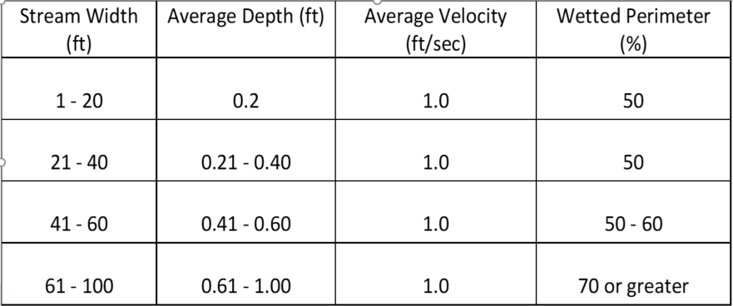
  Biological R2CROSS recommendation based on maintaining hydraulic parameters related to stream habitat preferences for fish.
  3 of 3 required for summer flow; 2 of 3 required for winter flow
  Many original R2Cross recommendations were based solely on 2 of 3
R2CROSS Parameters

Slide 13
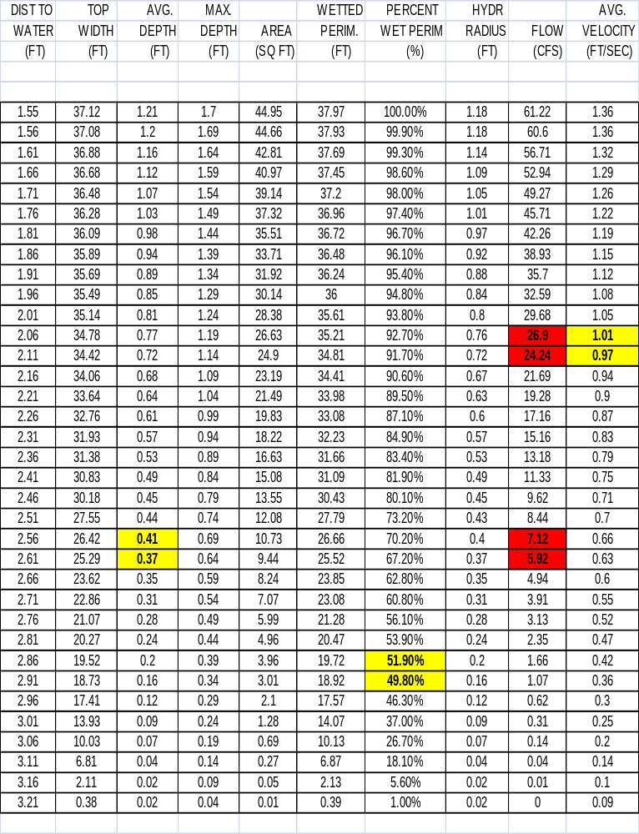
Computations
Manning’s Equation
2/3
1/2
Q = 1.486 * A * R * S
n
Q = discharge (cfs)
A = cross-sectional area (ft )
R = hydraulic radius (ft)
S = slope (ft/ft)
n = Manning’s n, a coefficient of roughness
where:
+ Fish Biologist Expertise

Slide 14
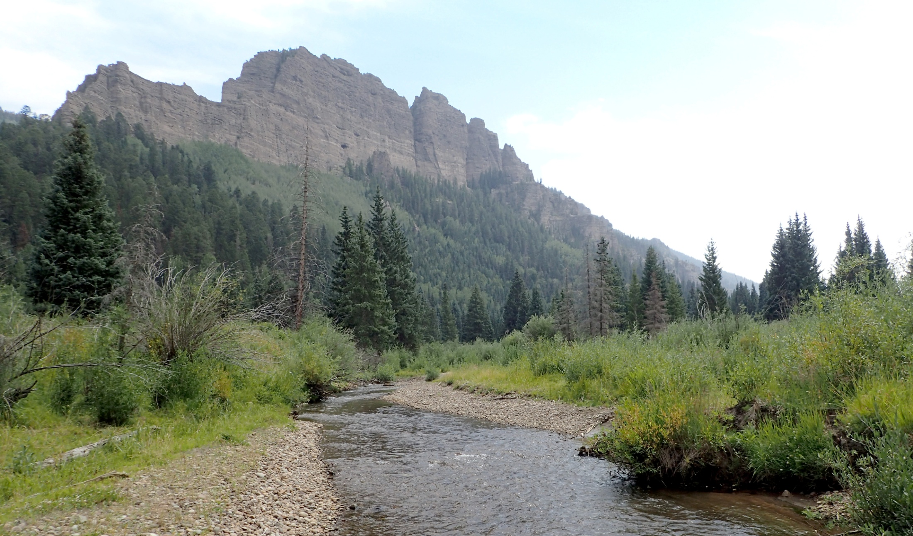
WHAT DOES AN ISF LOOK LIKE?
Little Cimarron River
3 of 3 criteria = 13 cfs
Measured flow = 13.5 cfs

Slide 15
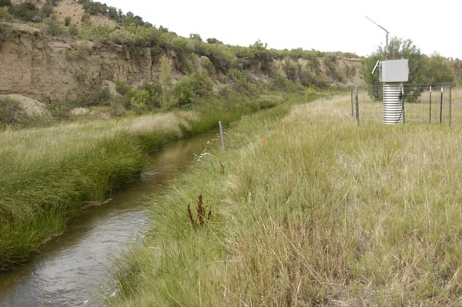
Water Availability
Water Balance approach, driven by best available data
    Statistical analysis of data to provide median daily flow hydrograph when possible.
    Gage Records +20 years, short term gages, temporary gages, spot flow measurements, diversion records.
    StreamStats analysis to provide mean monthly hydrograph when data is limited.
    Detailed CDSS modeling on larger streams.
    Additional information from water commissioners, land owners, ditch or reservoir operators, resource managers.
USGS 0930622 (Piceance Creek near White River, Co) Approximately 47 years of record
Water availability can be viewed as a necessary refinement that may impose limitations on biological quantification model findings.

Slide 16
Water Availability
Biological R2CROSS recommendation based on maintaining hydraulic parameters related to stream habitat preferences for fish.
average depth, % wetted perimeter, average velocity
R2CROSS Summer Flow Rate
(Goal – 3 of 3 hydraulic parameters)
R2CROSS Winter Flow Rate
(Goal – 2 of 3 hydraulic parameters)

Slide 17
Water Availability

Slide 18
Water Availability

Slide 19
Water Availability

Slide 20
Water Availability

Slide 21
Water Availability

Slide 22
ISF TIMELINE
Recommendation Development
Staff Analysis & Public Outreach
Board Decisions & Hearing Process
Jan | Feb | Mar | Apr | May | Jun | Jul | Aug | Sep | Oct | Nov | Dec
Jan | Feb | Mar | Apr | May | Jun | Jul | Aug | Sep | Oct | Nov | Dec
Jan | Feb | Mar | Apr | May | Jun | Jul | Aug | Sep | Oct | Nov | Dec
Water
Court
Final Action
Uncontested Recommendations
ISF Workshop
Public Notice (Mar & Nov)
Public Comment
Hearing & Final Action
Contested
Recommendations
Intent to Appropriate
Timeline shows typical recommendation process, but the exact dates can vary. Please see ISF Rules and CWCB website for more detailed information and important dates.
Notes:
Notice to Contest by March 31 or the 1st business day after. Notice for Party status by the end of April
Goals of this process are to provide Sound Technical basis for the recommendations, transparent open, and fair process that respects existing water rights and uses.

Slide 23
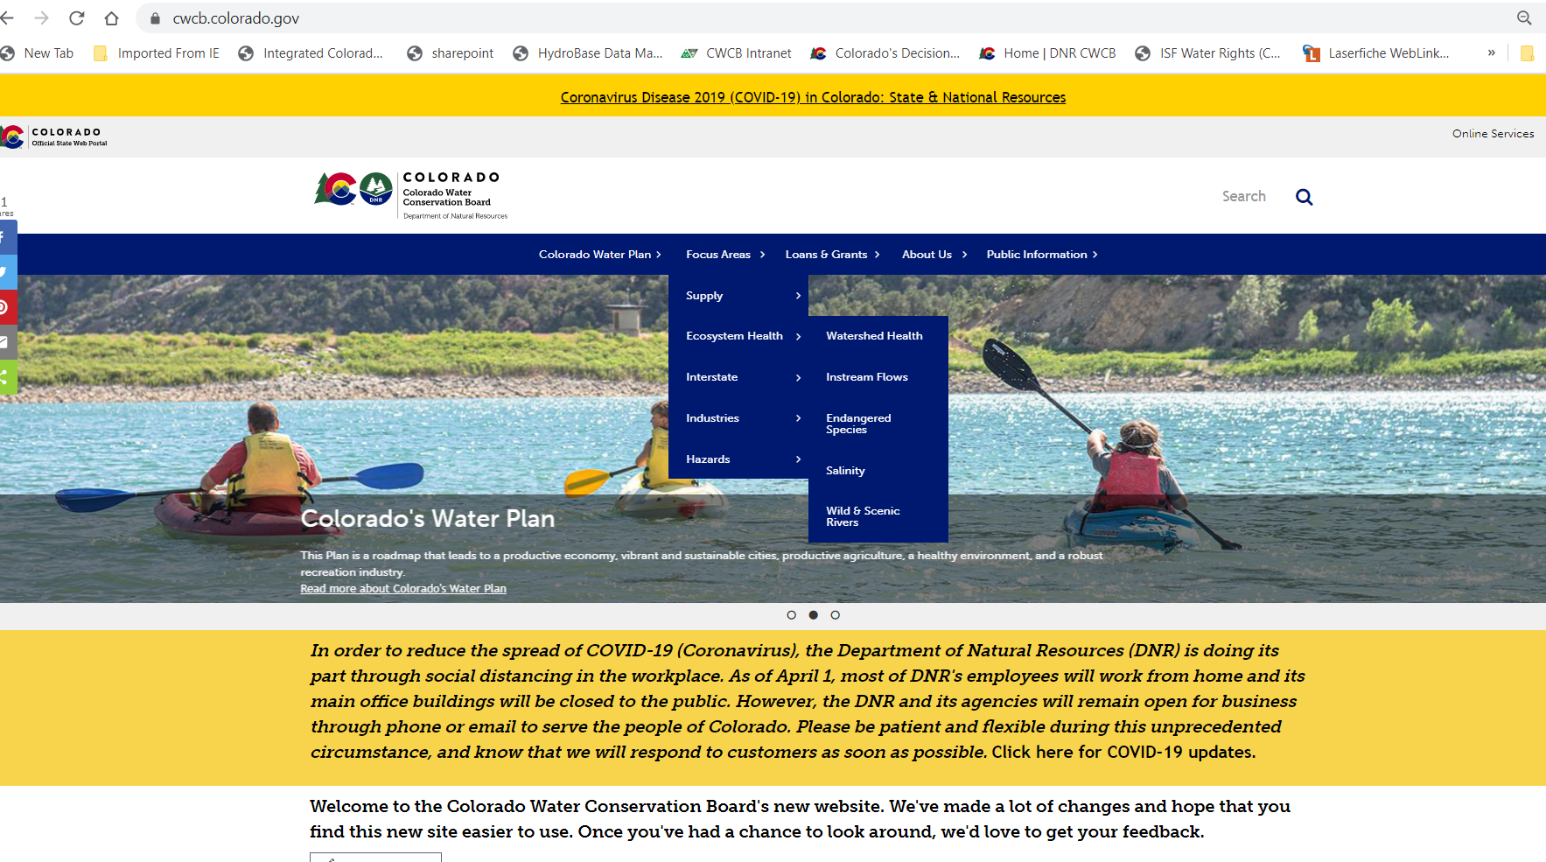

Slide 24
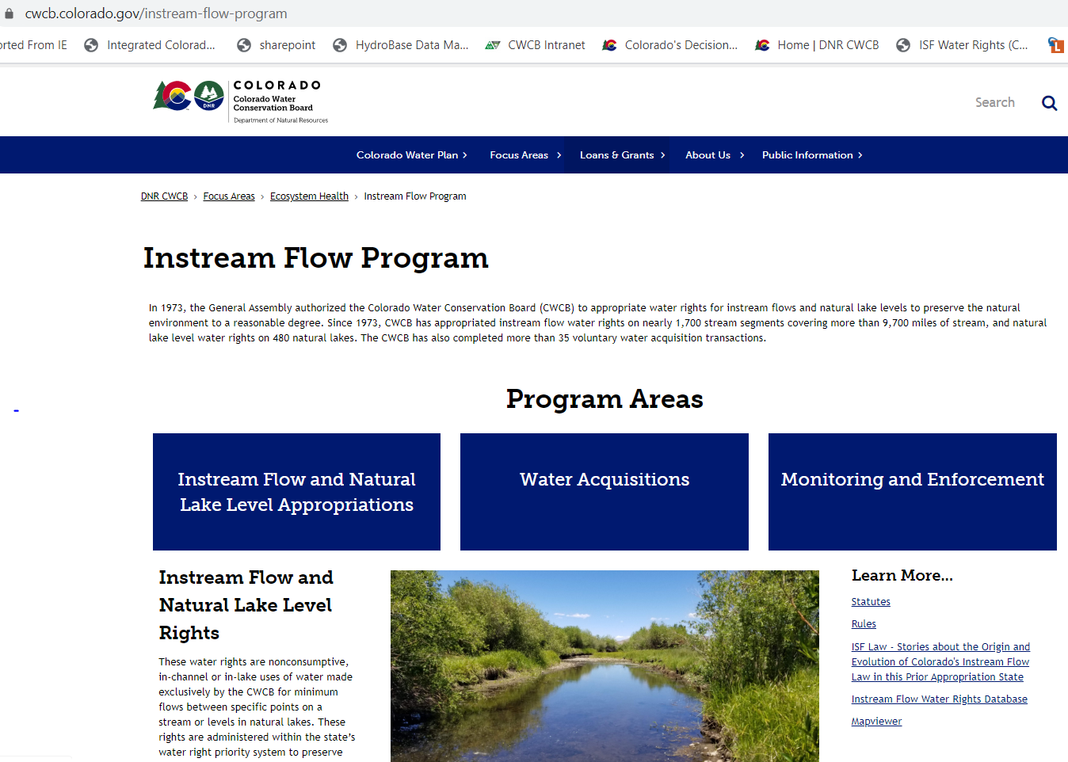

Slide 25
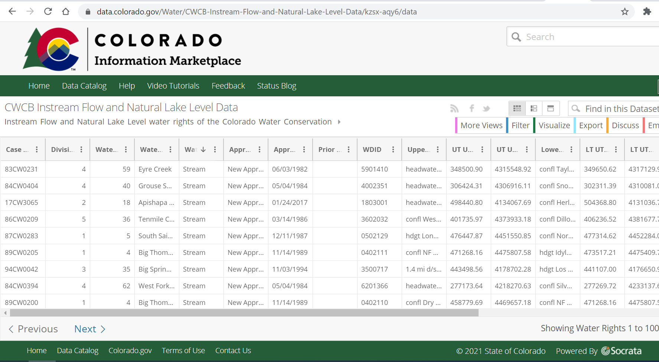

Slide 26
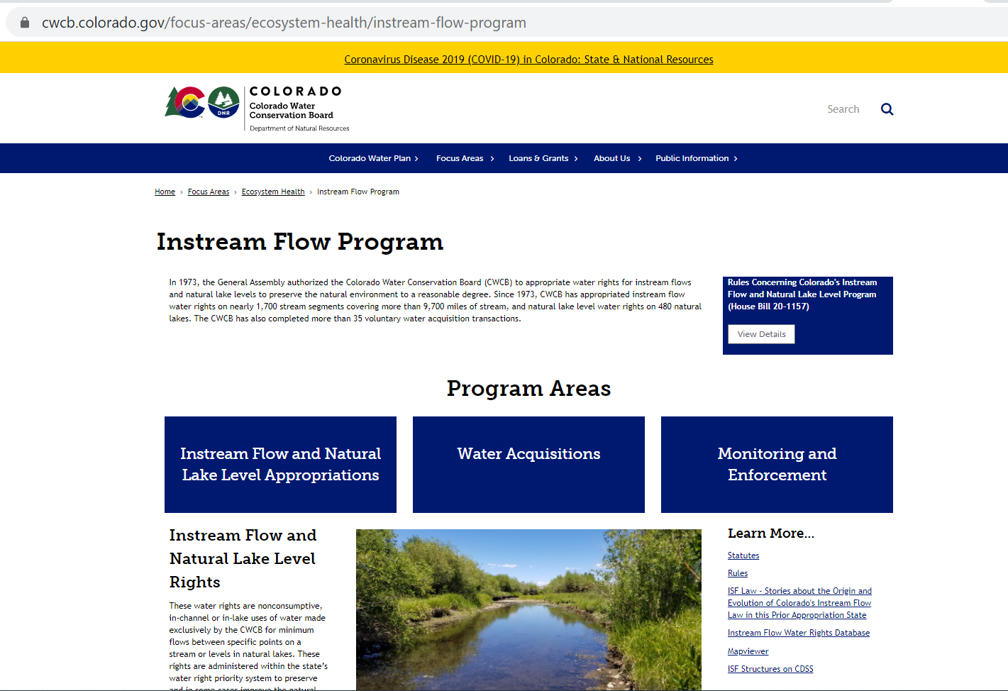

Slide 27
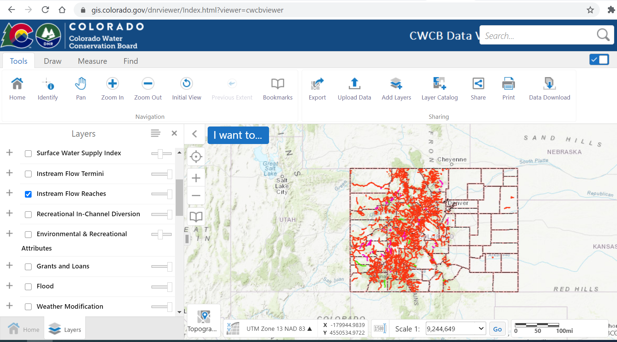

Slide 28
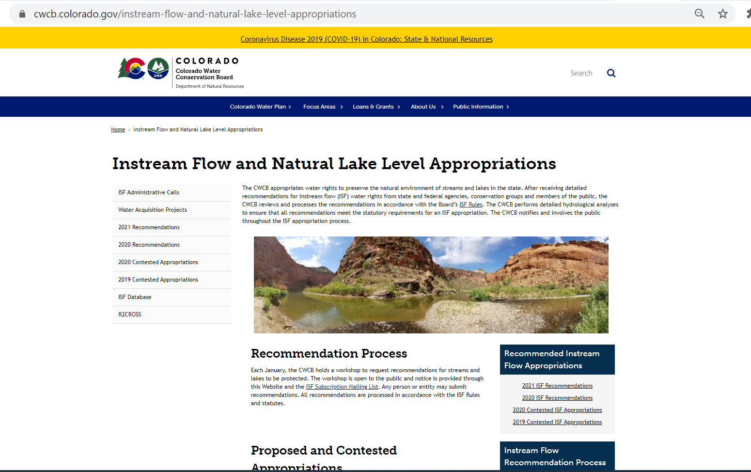

Slide 29
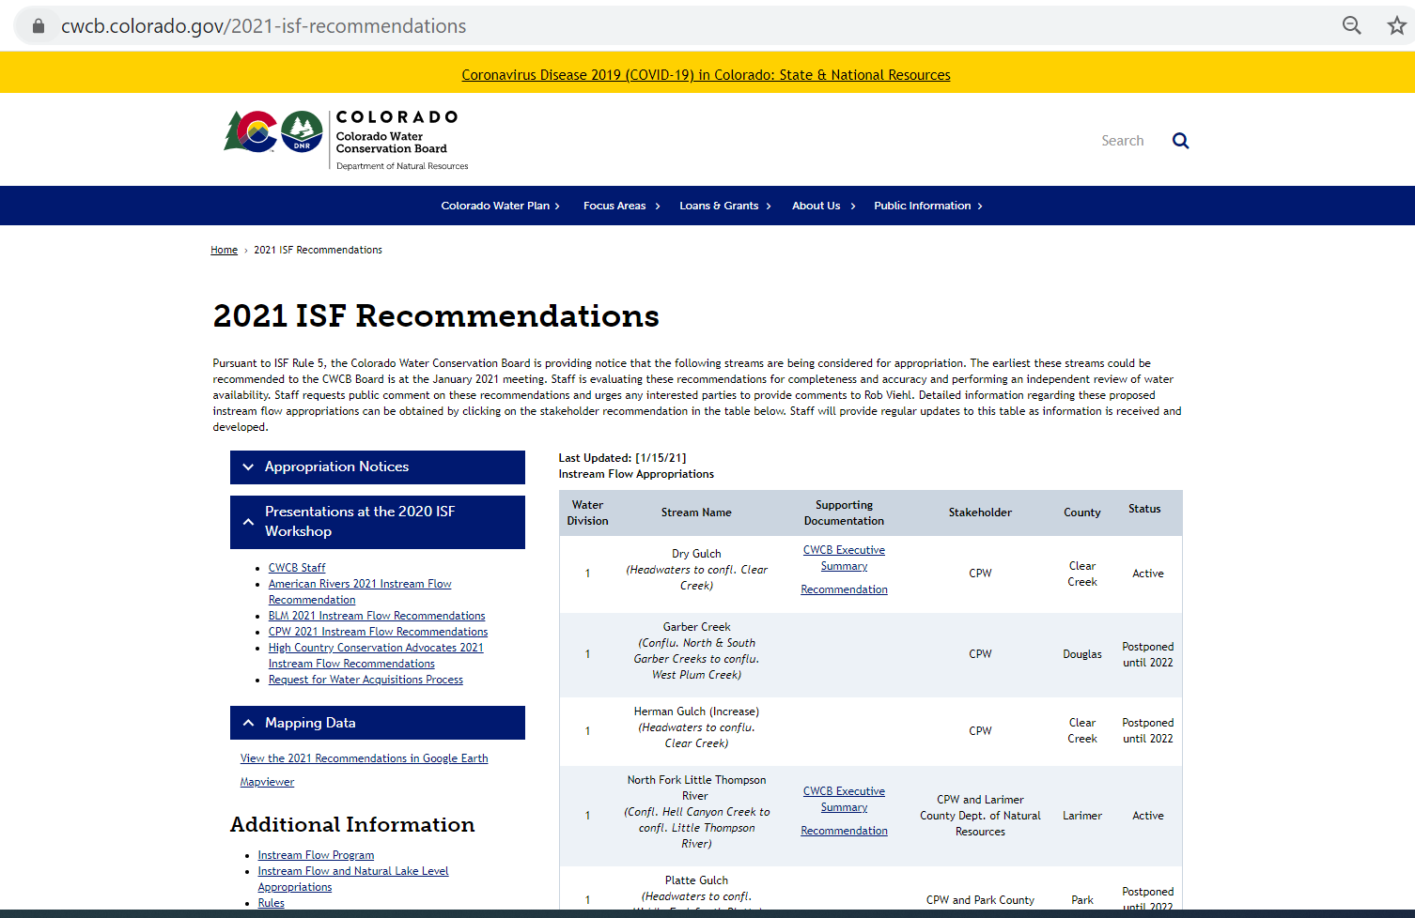

Slide 30
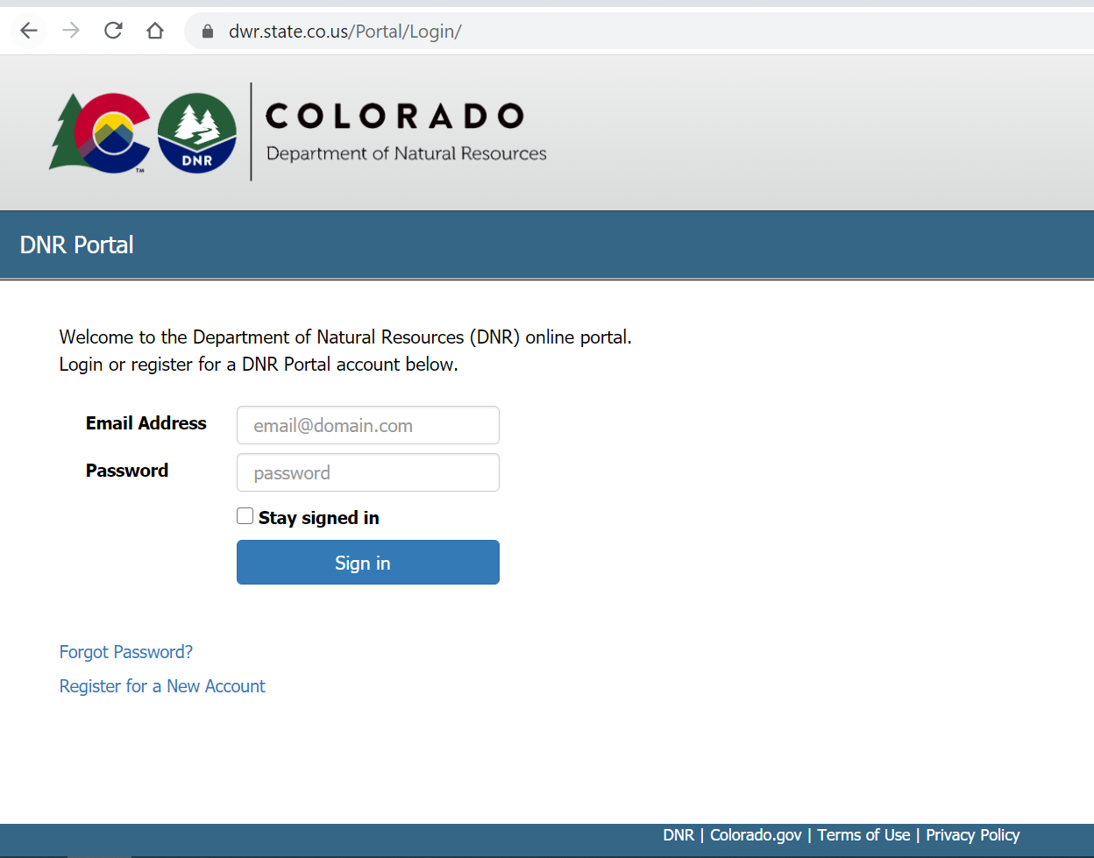

Slide 31
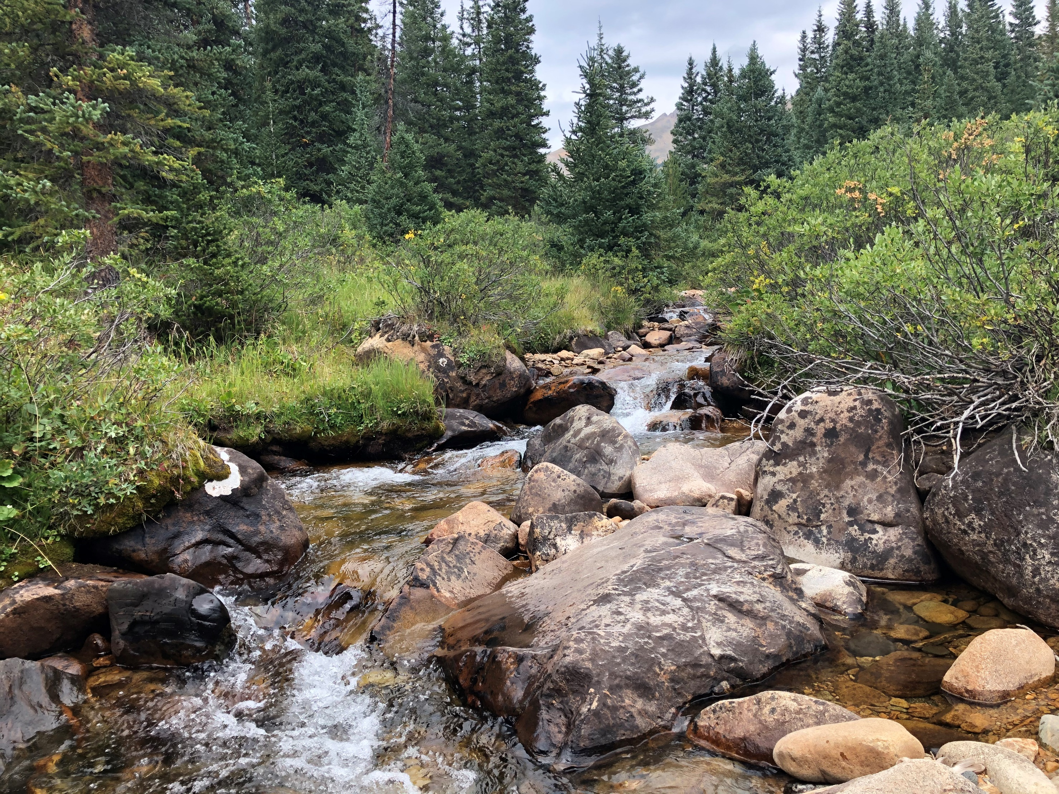

Questions/Concerns/Comments?
Robert Viehl
CWCB Water Resource Specialist
303-866-3441
rob.viehl@state.co.us

