Slide 1


GROUP
Implementation
WORKING
WORKING GROUP
GREG JOHNSON – MEGAN HOLCOMB – RUSS SANDS

Slide 2


Slide 3

AGENDA
PURPOSE
LOGISTICS
GOALS

Slide 4
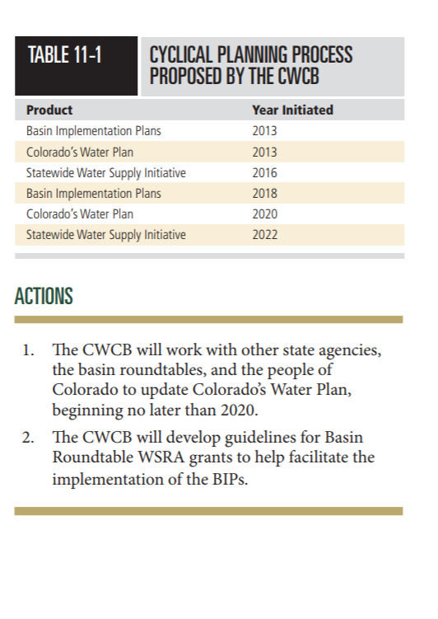



Slide 5
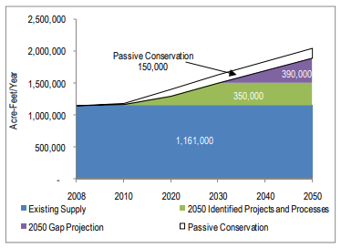
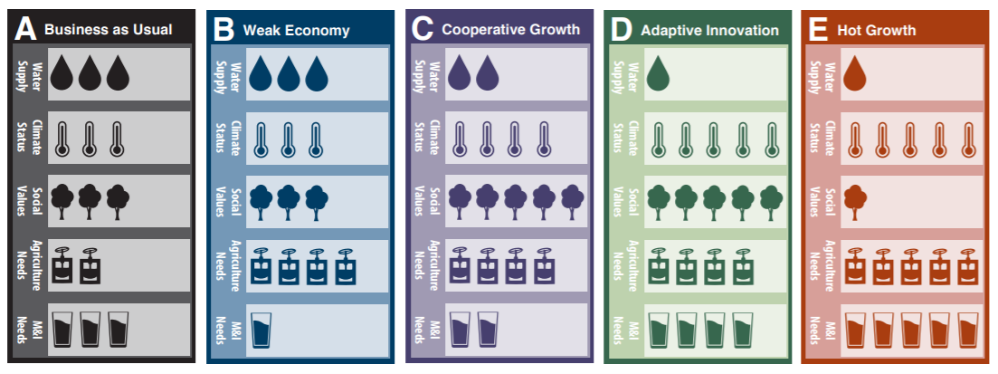
New Stakeholder-Driven Methodologies
2050 Demand Projections
- IPPs
_____________________
= 2050 M&I Gap
Hydrologic Modeling
Municipal Modeling
Agricultural Modeling
Environmental Modeling
Scenario Planning Across Major Drivers

Slide 6
TECHNICAL
WEBINARS
February 19 SWSI Methodologies Overview and Population Data
March 19 Municipal and Industrial Data & Methodologies
April 23 Agricultural Data & Methodologies
May 21 Environmental Data & Methodologies
June 25 SWSI Tools & Next Steps
LOGISTICS
GOALS

Slide 7
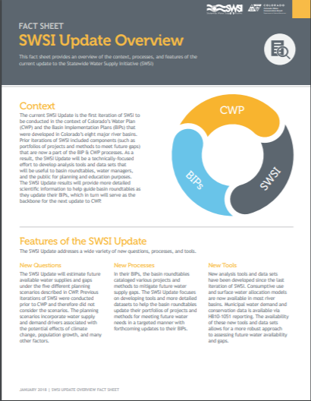
INTEGRATED
PLANNING
SWSI update goals:
A consistent statewide framework
for examining future water supply
and demand scenarios.
Tools and data for roundtables
to update their basin plans
(e.g. identify local solutions).
1
2

Slide 8
BASIN
FEEDBACK
Want to spend WSRF money on projects
BIPs took time and presented a challenge
Strong desire to utilize and Integrate SWSI findings

Slide 9
ROUNDTABLE
POLLING
61% see a need for improved metrics
65% favor a working group to discuss BIP updates
89% favor CWCB support and funding for updating BIPs and IPPs

Slide 10
$5.5M
Intent to provide about
half of these dollars to fund roundtable BIP updates
~ 65% of the average
cost of the 2015 BIPs.

Slide 11
PROVIDES ALMOST
About 2 X the cost of SWSI to
update BIPs and the Water Plan
$3M
Informed by known SWSI,
BIP and Water Plan costs.
TO SUPPORT
ROUNDTABLES
WITH BIP UPDATES
And OVER $4M COLLECTIVELY TO
UPDATE BIPS + THE WATER PLAN
Fills critical data and reporting
needs for HB1051 and IPPs.

Slide 12
WORKING
GROUP
BRANDING
Communications, Tools & Messaging
BIP UPDATES
IPP Database Inputs, Critical BIP Updates & Contracting
SWSI GUIDANCE
Recommendations, Insights and Integration with BIPs
LOGISTICS
GOALS

Slide 13

LOGISTICS

Slide 14

MONTHLY
CALLS
1.5 Hour Meetings
Fourth Tuesday of Each Month
January - July

Slide 15
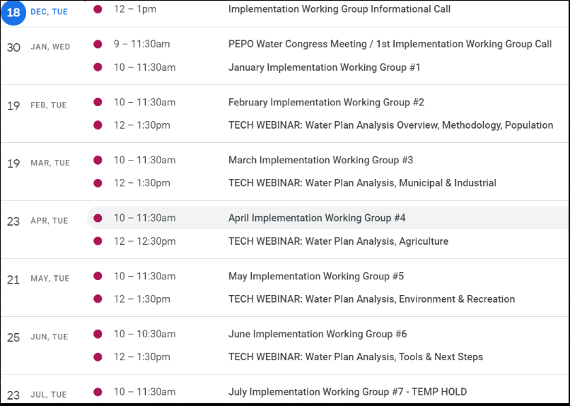
18

Slide 16

MEETING
MANAGEMENT

Slide 17

DECISION
MAKING

Slide 18
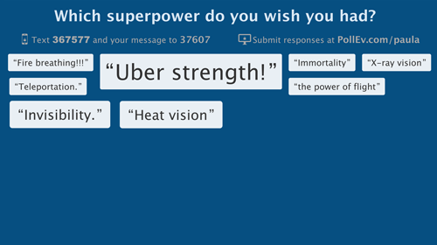
POLLING, PREP &
OUTPUTS

Slide 19
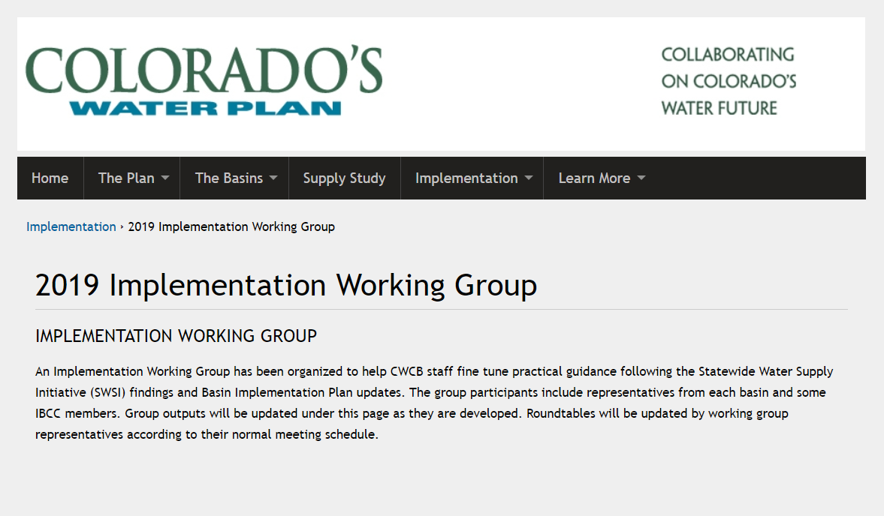
OUTPUTS
CHECK-IN ON WORKING GROUP EFFORTS

Slide 20

REPORTING BACK TO THE
3 Roundtable Members
Some IBCC Representatives
Members Approved by Chairs
ROUNDTABLES

Slide 21


Slide 22
A TRANSPARENT, BASIN-DRIVEN
PROCESS
BUY-IN
DIRECTION
REVIEW
BASIN A

Slide 23
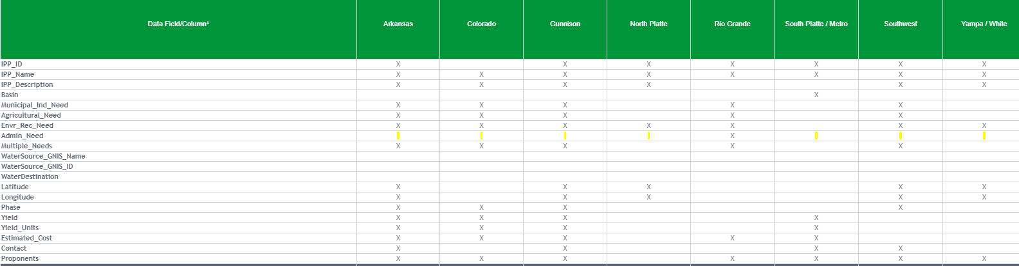
BASIN
BUY-IN
Example
IPP DATA FIELDS
BASIN A
BASIN B
BASIN C
BASIN D
BASIN E
BASIN F
BASIN G
BASIN H
BASIN H

Slide 24
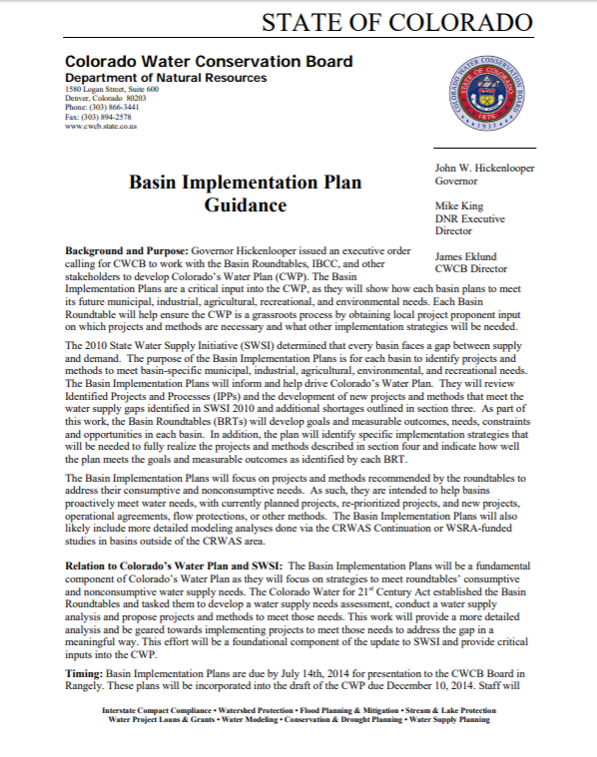
BASIN
DIRECTION
Consolidating group outputs
to help inform the next
BIP guidance document.

Slide 25
What Chapters Need to be Updated?
What Timeline is Reasonable?

Slide 26
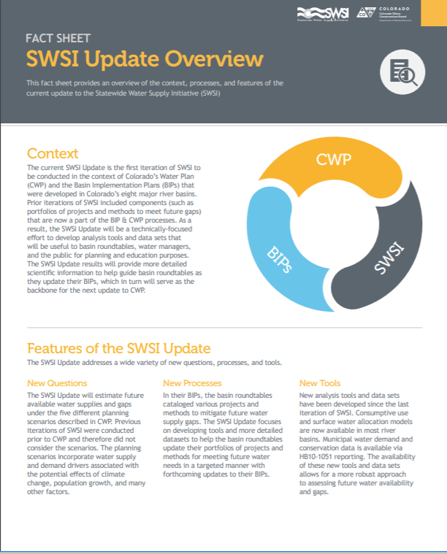
BASIN
REVIEW
Technical Analysis (or SWSI) will include:
  Insights
  Suggested Next Steps
  Recommendations
Working Group input can help ensure these
are on track and align with BIP update goals.

Slide 27
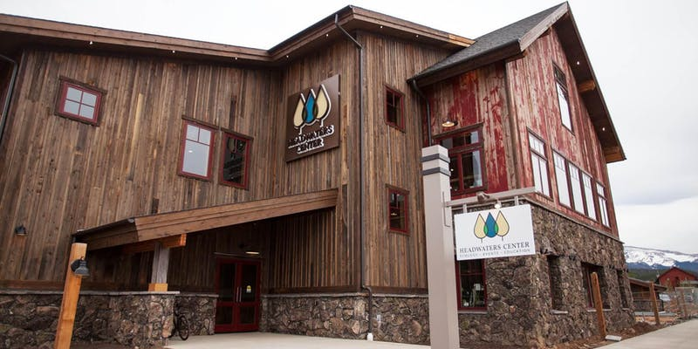
BASIN ROUNDTABLE
SUMMIT
SAVE THE DATE
SUMMIT
SEPTEMBER 25 + 26 2019

Slide 28


Slide 29

THOUGHTS, COMMENTS OR
QUESTIONS ?

