Slide 1
Economics of Water Lease Offers by NPPD and CNPPID
George Oamek, CH2M HILL
August 18, 2014

Slide 2
Considerations and Methods
Considerations:
Reasonableness of lease price, $/acre and $/acre-foot
Use of groundwater as a 1:1 replacement supply for leased surface water
Length of lease and proposed price escalation rate
Methods:
Irrigation water evaluation model, developed for this purpose
Other economic principles

Slide 3
Platte Basin Irrigation Water Evaluation Model
Estimates net return to parcel of land under irrigated and dryland crop production
Estimates $/acre and $/acre-foot return at the NRD level, considering underlying county average yields, prices, cropping patterns, and cost of production
Considers costs of alternative irrigation water sources and application methods
County-level irrigation water requirements “borrowed” from Crop Optimizer model from UNL
Can compare the $ impact of irrigated to dryland conversion, or conversion from surface water to groundwater, or any combination of the two

Slide 4
NPPD lease offer
Basis for the price is consistent with DNR’s PBHEP method:
Impact of converting from irrigated to dryland production: $142-$169/acre, measured as the difference between irrigated and dryland cropland rental rates
10% incentive
“Performance factor”: 0.94 - 1.21
Cost of delivery infrastructure: $7.29/acre
Total offer: $155 - $232 /acre

Slide 5
NPPD lease offer, cont’d
Observations:
The $142-$169/acre range is comparable to results from evaluation model: $220/acre impact for conversion from irrigated to dryland for production in CPNRD
No basis for doubting performance factors or infrastructure costs
If groundwater simply replaces surface water, the actual impact is near $20/acre due to additional pumping costs, not $142-$220 per acre

Slide 6
CNPPID Lease Offer
Major points:
$250/acre-foot
Escalation at 4% per year through 2037
Quantities and other terms yet to be negotiated
Observations:
$250/acre-foot is comparable to $242/acre-foot calculated for TBNRD
Having water in storage adds to its potential value
Escalation rate appears somewhat high

Slide 7
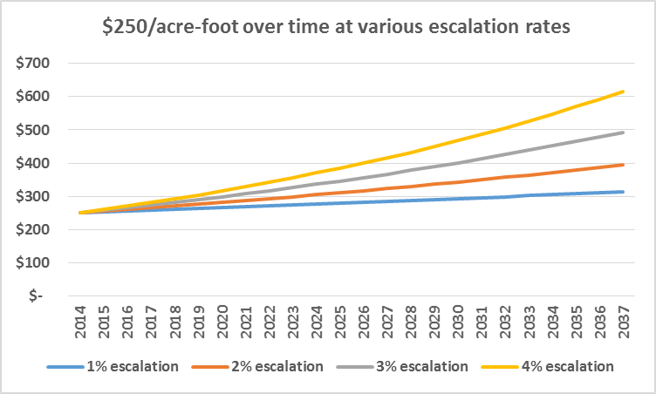
CNPPID lease offer, cont’d
The escalation rate is important!

Slide 8
CNPPID lease offer, cont’d
Escalation Rate:
A 4% rate would appear more reasonable if the alternative use was municipal water supply
Municipal water rates and impact fees have increased at annual rates exceeding 4% over the last 20 years
C-BT units have increased at even higher annual rates, especially since 1980

Slide 9
CNPPID lease offer, cont’d
Profitability of irrigated agriculture does not increase at such a steady and high rate:
Using corn price as a proxy, long-term escalation rates are in the 1.9% - 3.1% range, depending on how measured
2%-3% would seem to be a more supportable escalation rate for the lease
Is there a way to periodically re-evaluate/adjust the escalation rate during the course of the lease?

Slide 10
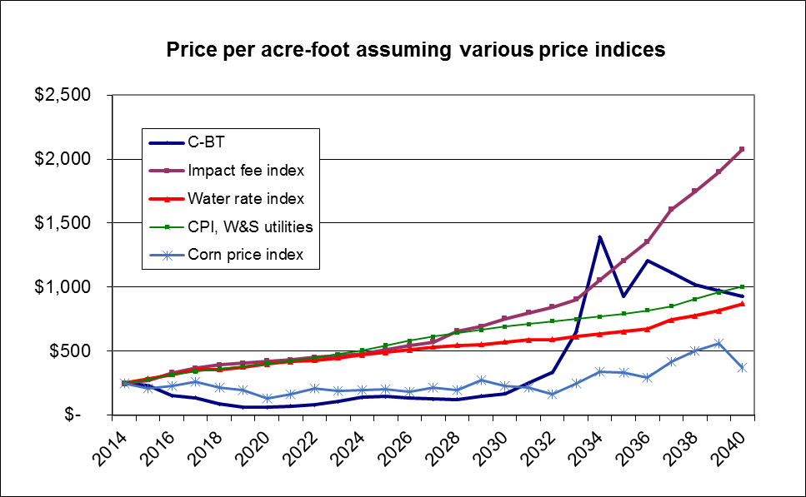
CNPPID water lease price assuming historical trends for alternative price indices, 1980-2006, applied from 2014-2040

