Slide 1
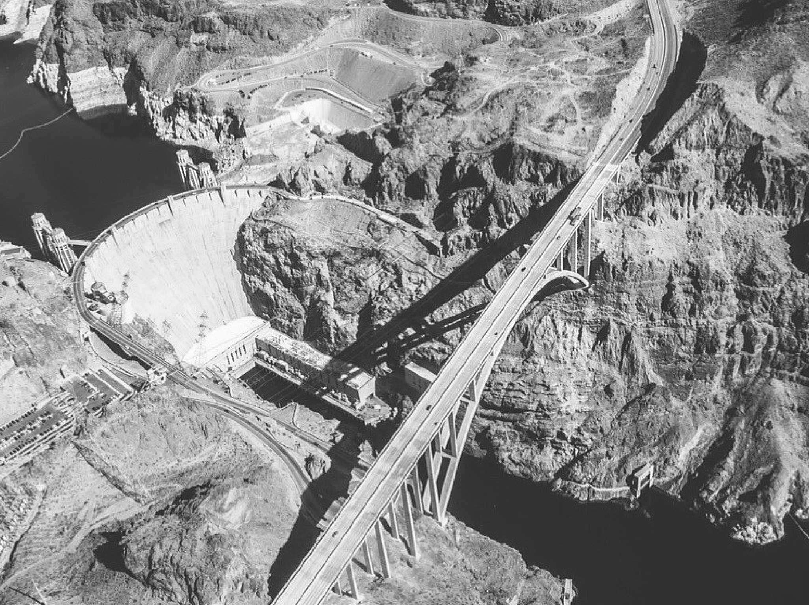


WATERSTART. COM

Slide 2


WaterStart is a cluster of global leaders in the implementation of water innovation
WATERSTART. COM

Slide 3

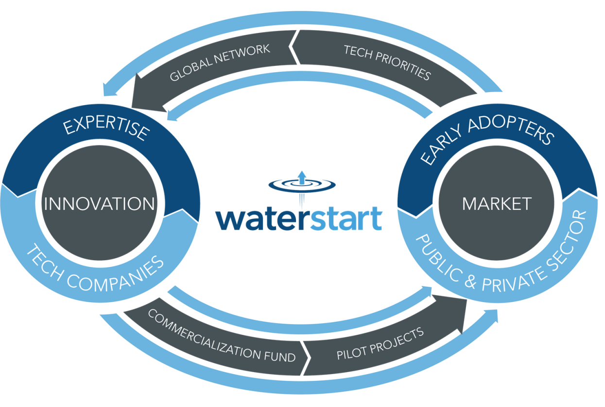
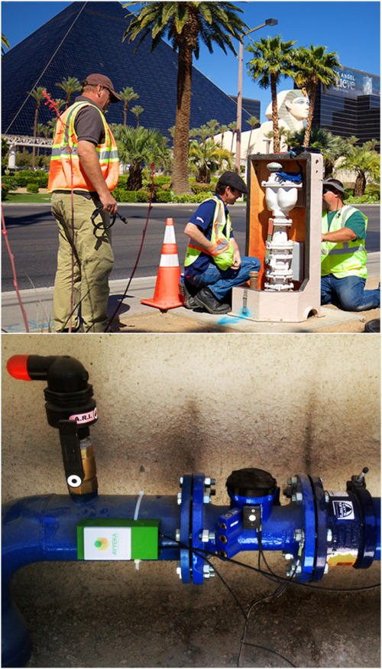
Nevada’s largest utilities, water consumers and employers
Define market demand locally to recruit innovation globally
De-risk & incentivize water innovation
WATERSTART. COM

Slide 4











Evaluated 160+ proposals from tech. companies
Funded $1,200,000 in Pilot Projects
Recruited 11 new companies to the State
96 new jobs projected over the next 2-3 years
WATERSTART. COM

Slide 5
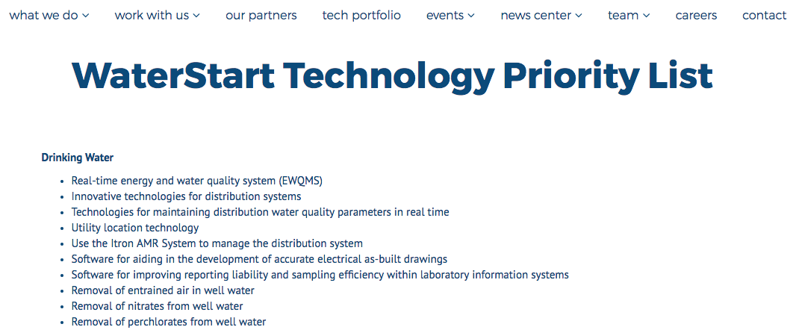

Demand Driven Innovation
WATERSTART. COM

Slide 6
Demand Driven Innovation
WATERSTART. COM

Slide 7

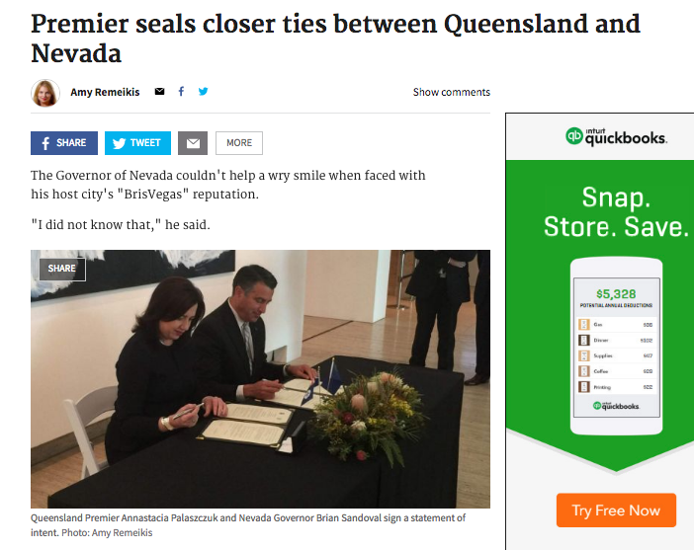

Nevada Trade Mission
August 2016
WATERSTART. COM

Slide 8
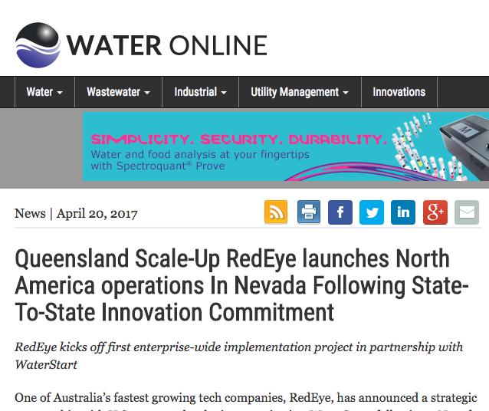


WATERSTART. COM

Slide 9
WATERSTART. COM

Slide 10
WATERSTART. COM

