Slide 1
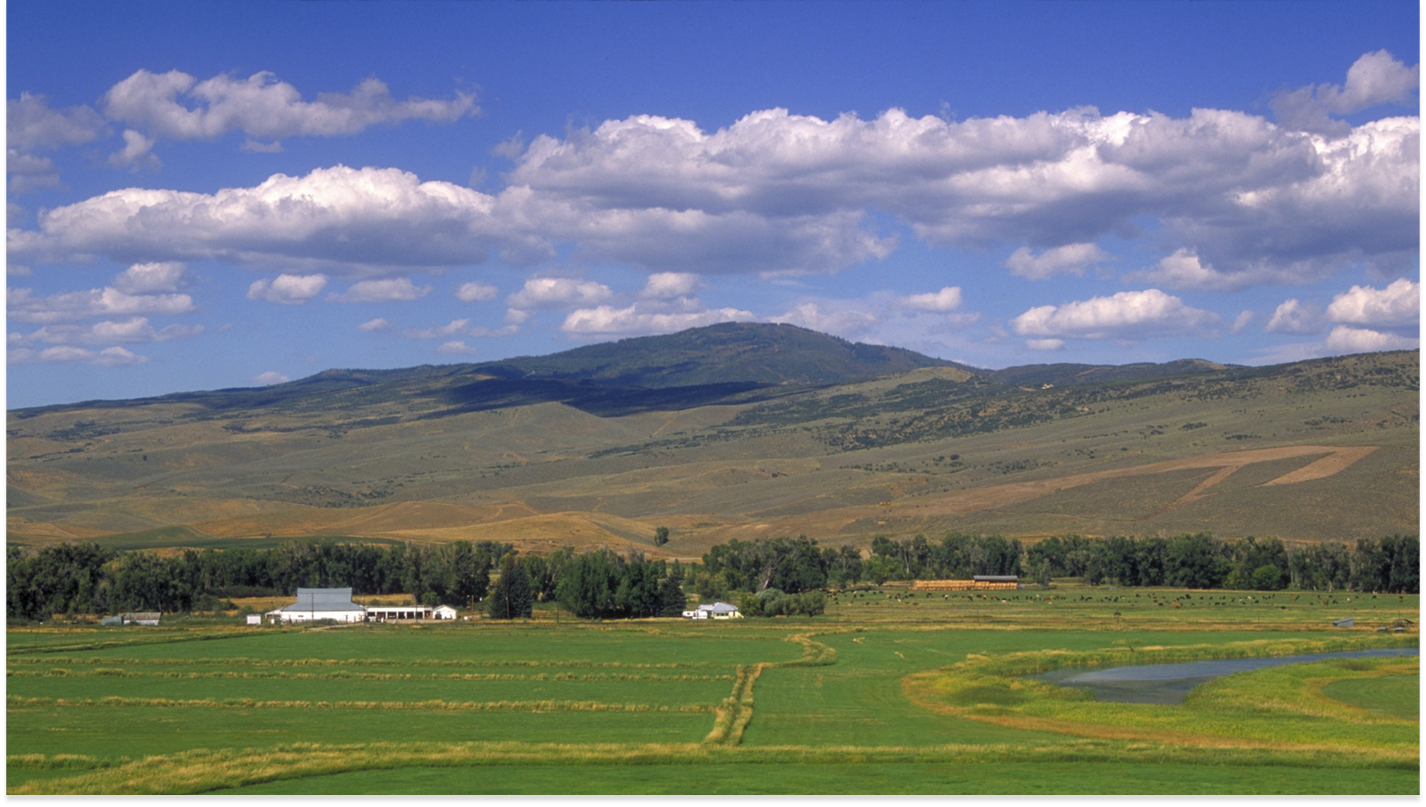

How might we make it easier for farmers to transition to USDA Organic?
Notes:
The problem we need your help with is making it easier for farmers to transition to organic by making the market more transparent

Slide 2
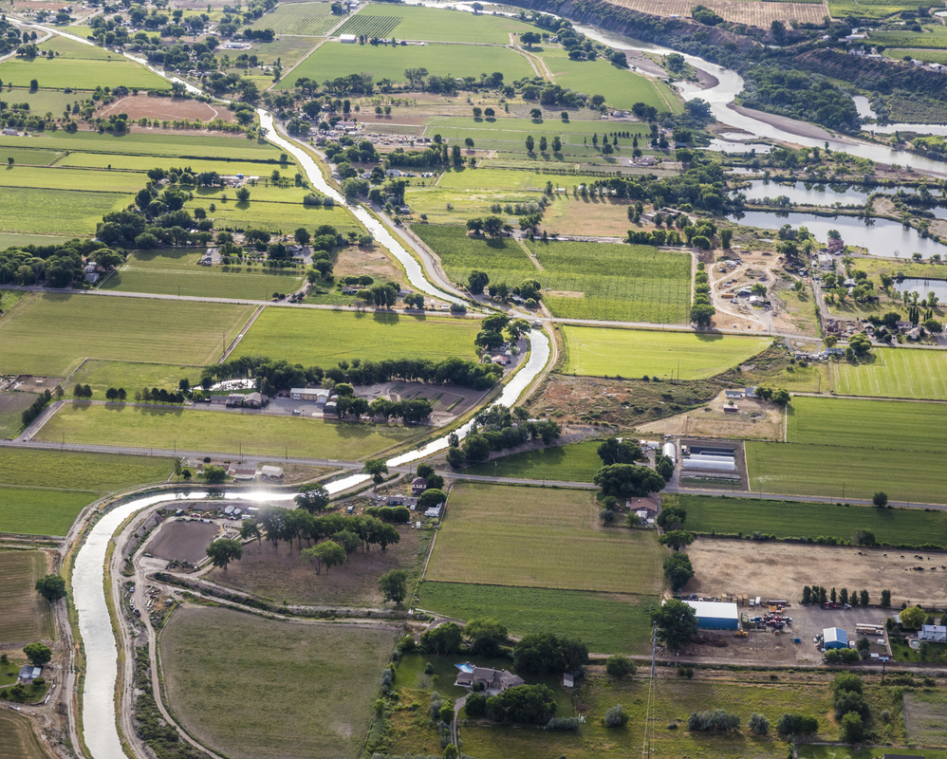


75-80%
of water is consumed
by agriculture
the river needs water
people
need food
© Ken Geiger/The Nature Conservancy
Notes:
Talking points:
Around the west, during the driest month 50% of the flow is removed from half of all western rivers.
The Colorado River alone irrigates nearly 5.5 million acres of land, which grow 15 percent of the nation’s crops.
In the upper basin, Irrigated ag accounts for the majority of the water use, producing food for the nation and sustaining rural communities and landscapes, including Colorado’s more than $7 billion ag economy.
Further declines in the river’s supply are predicted to occur as the climate gets drier and warmer and demands on the river continue to increase
While the river needs water, people need food, which is why the ag community is one of our most important partners in restoring flows in Colorado’s rivers.

Slide 3
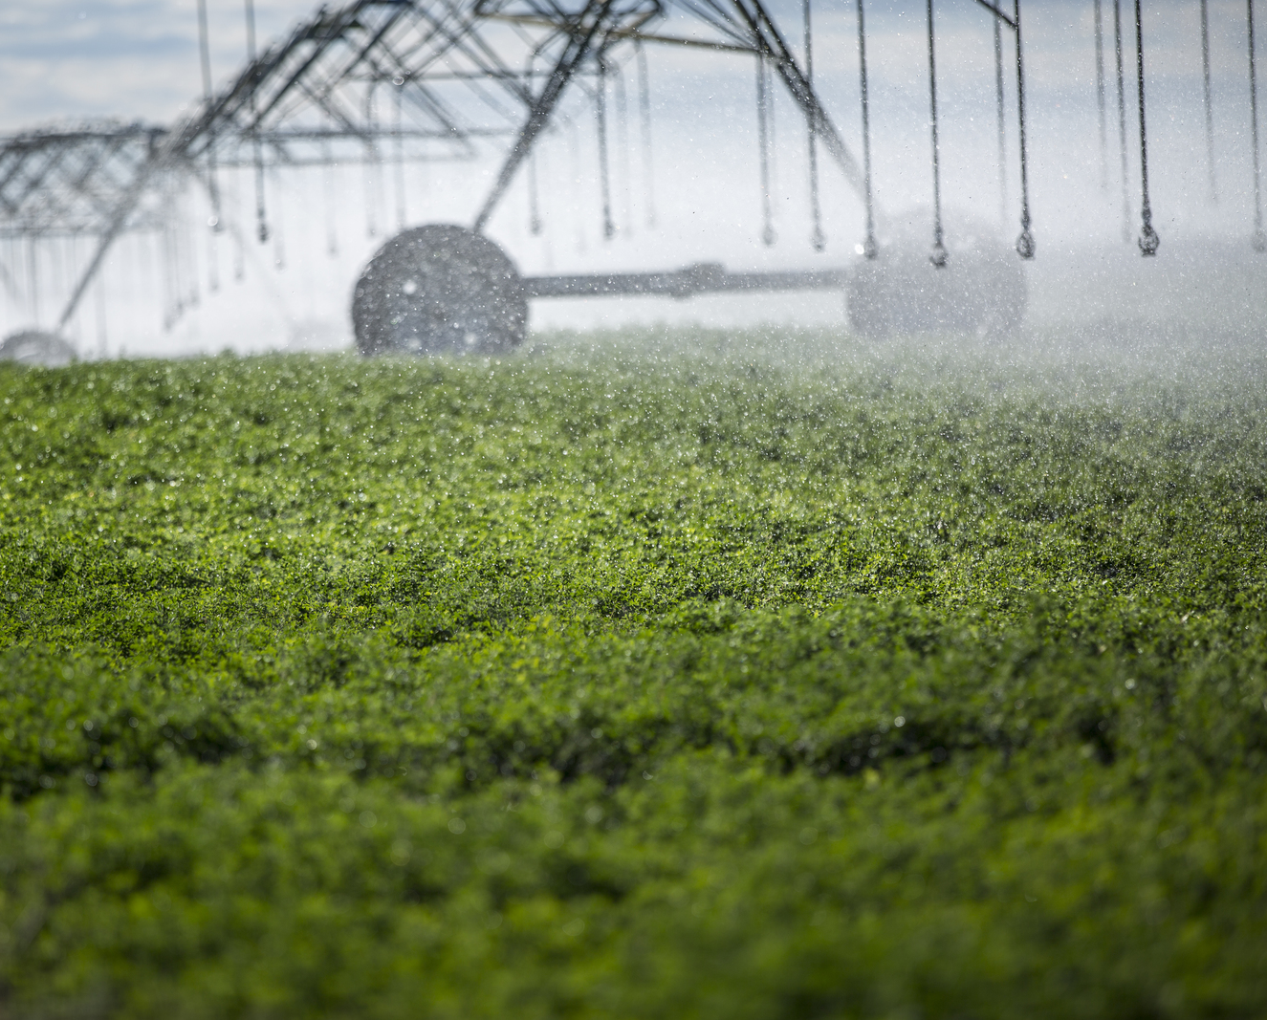





Our Challenge
help farmers transition to crops that use less water…
…and produce at least
as much value
© Nick Hall/The Nature Conservancy
Notes:
One approach is to find less water intensive crops and support farmers in making a switch.
This creates a economic challenge with alfalfa providing a prime example. Colorado’s second most prolific crop, it’s as thirsty as it is profitable consuming between 3 and 5 acre feet of water per acre

Slide 4
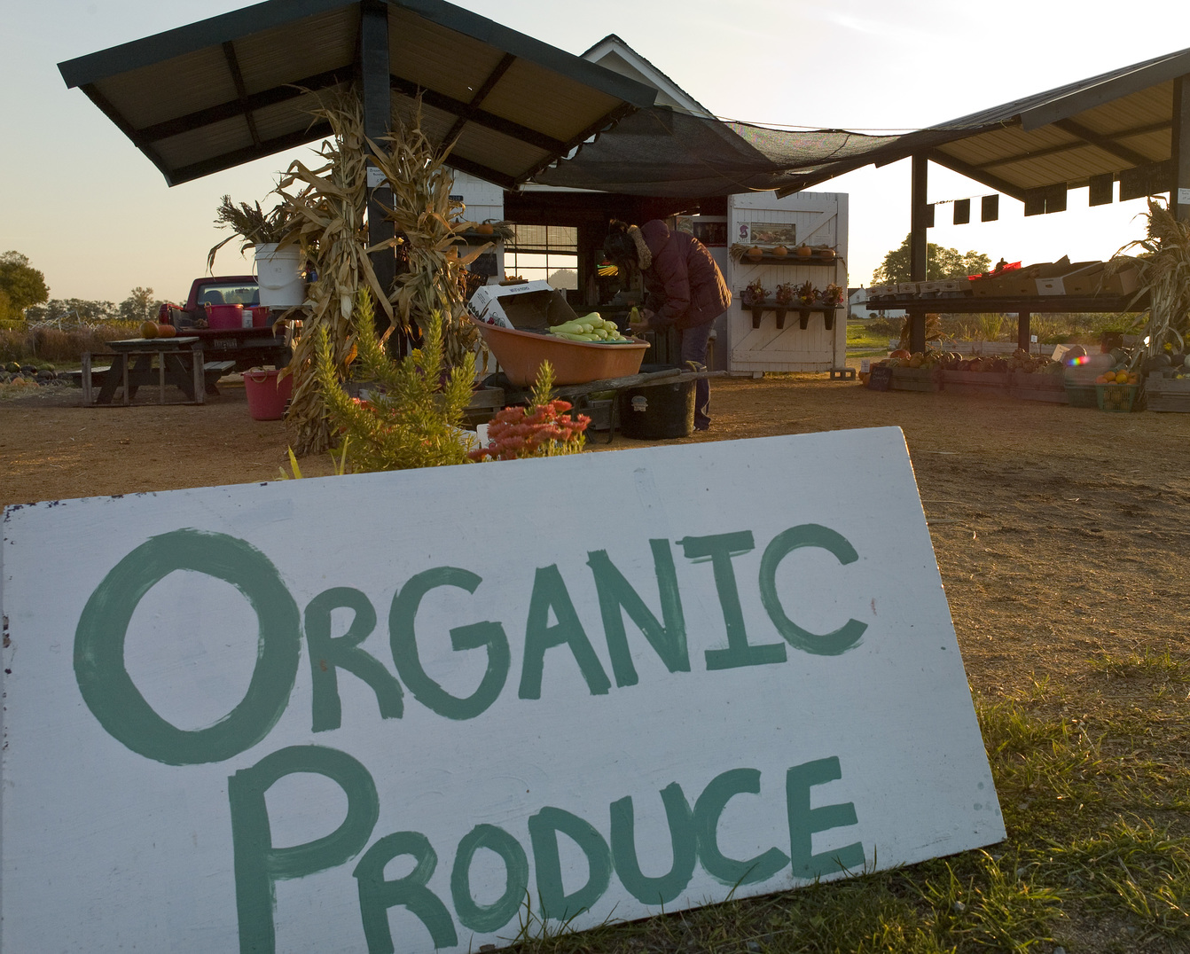

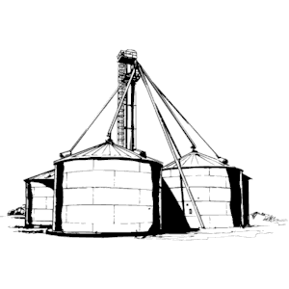
USDA Organics
organic crops have
a higher premium…
…BUT the market is
difficult to access
© Kevin Arnold/The Nature Conservancy
Notes:
Organic crops of all types command an average of 30% higher prices with economic returns above costs around 60%. Organic production methods have well documented soil-health benefits and are proven to raise incomes for farmers who can successfully transition and access a $47 Billion industry
We hear about two primary barriers farmers face in converting. One is the cost and risk of conversion. The other is knowing how to access the market. Where once you only had to go to your local grain elevator to find contracts for your product, navigating the current organic market can be nebulous at best for producers. And one of the fastest ways to reduce risk and make financing an organic conversion easier is by helping farmers identify as many buyers as possible.

Slide 5
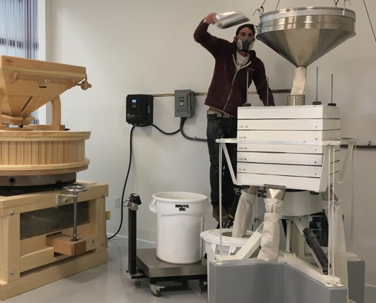

How it Happens Today
I’m an organic grower of produce…how do I find buyers?
“Very easy, local ads in your newspaper. Go to Farmers Markets and set up a small stand. Visit your local grocery store and see if they have any interest. Try a small stand in front of your house.”
Notes:
Growers around Austin, TX were looking to find crops that could hold up to drought. At the same time, Barton Springs Mill owner James Brown struggled to locally source the organic and heirloom wheats their area customers demanded. Brown had to drive door to door asking farmers to grow wheat for him. For those farmers that were willing to talk to him, he could guarantee prices that made converting to a new crop economically attractive. But it literally took him knocking on doors to find willing growers. Along with being more profitable, many of these grains are more drought tolerant and require less water
Likewise, we hear from farmers

Slide 6
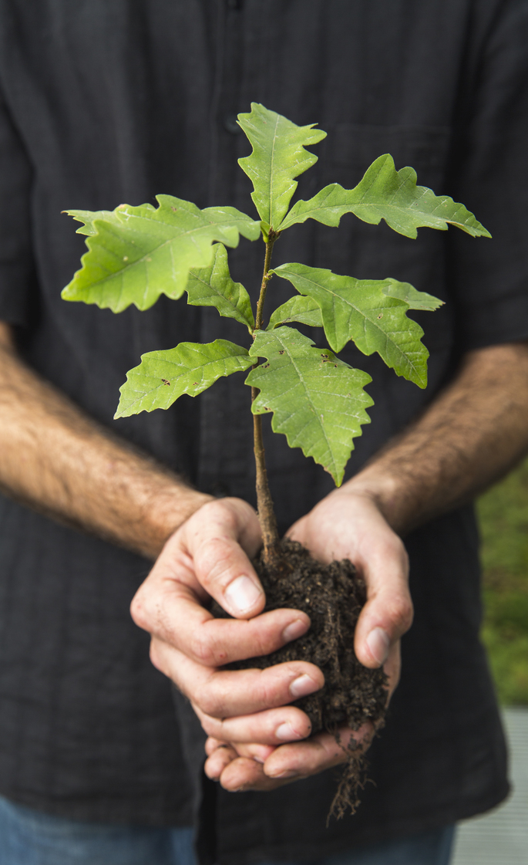
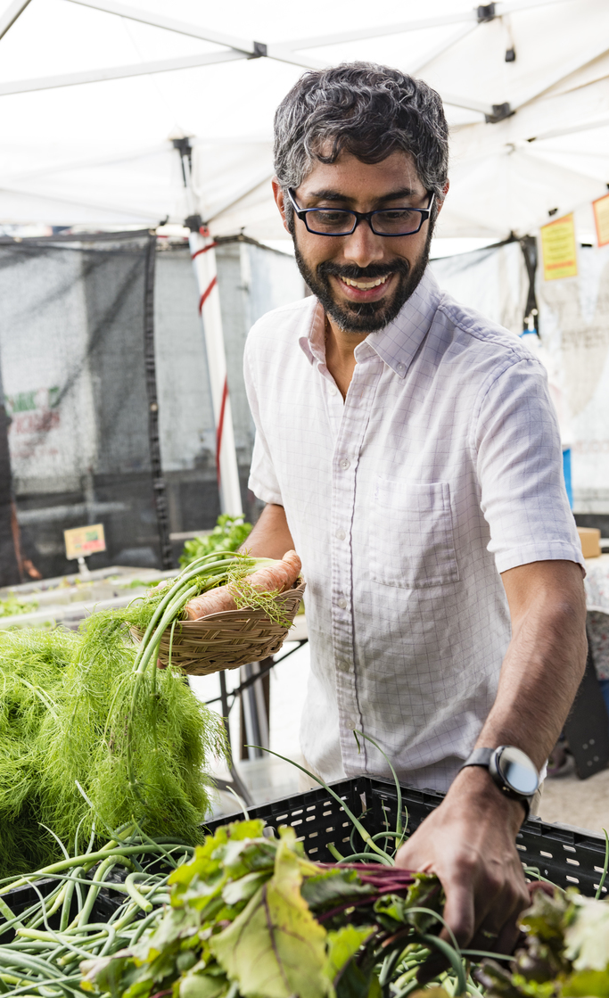

Solution
make connecting buyers
and sellers…
…as easy as going to the
local grain silo
© Karine Aigner/
The Nature Conservancy
© Kevin Arnold/
The Nature Conservancy
Notes:
There challenge is ripe for a platform service that connects suppliers, producers, and buyers across the organic value chain. Just as farmers will benefit from seeing more potential buyers, we believe food and organic product companies would benefit from more readily identifying local, reliable suppliers. We believe that users of this platform will happily accept a small transaction fee for deals executed over this platform as it will provide more opportunity and less risk for all parties involved.

Slide 7
The Entrepreneur
Transactions
Data
User-base
The Farmer
30%
Rural & Agriculture economies
$2000
1.35%
Water
Notes:
This solution could generate a profit by monetizing transactions, data, or a platforms user-base
Farmers recognize an average price premium on organic crops of 30%, with an average net cost increase of 0%-10% source: USDA (with returns above costs in most crops surveyed)
The Organic Trade Association found that counties with high concentration of organic production or processing (not organic consumption) had an average of a $2000 high median family income and a 1.35% decline in the poverty rate compared to neighboring counties
Water savings example

Slide 8
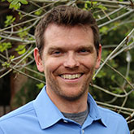

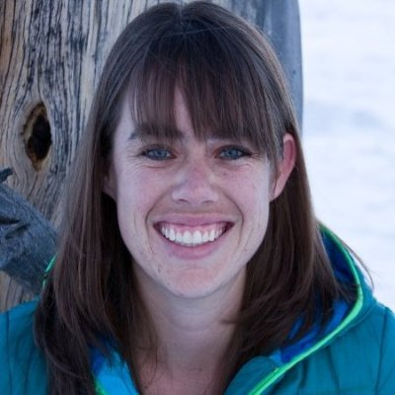
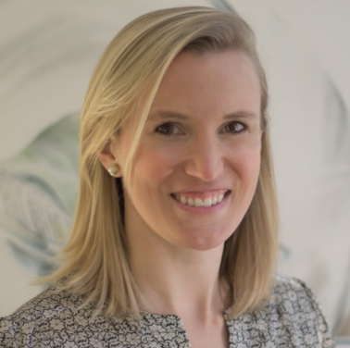
Jake Davis
Manager, Freshwater Transaction Origination
Season Martin
CO River Water Projects Director
Emily Powell
Water Markets Program Manager

