Slide 1
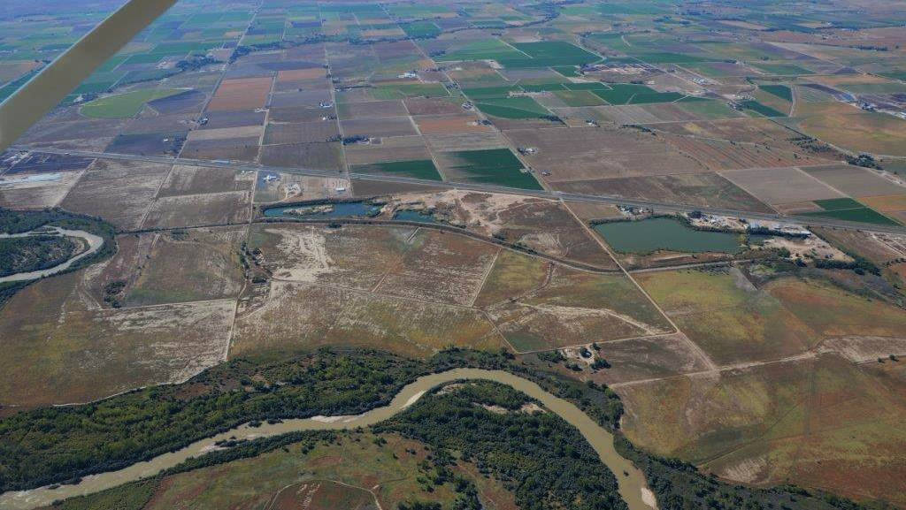
Western Water Partnerships
Helping cities and agriculture coexist
a public benefit corporation

Slide 2
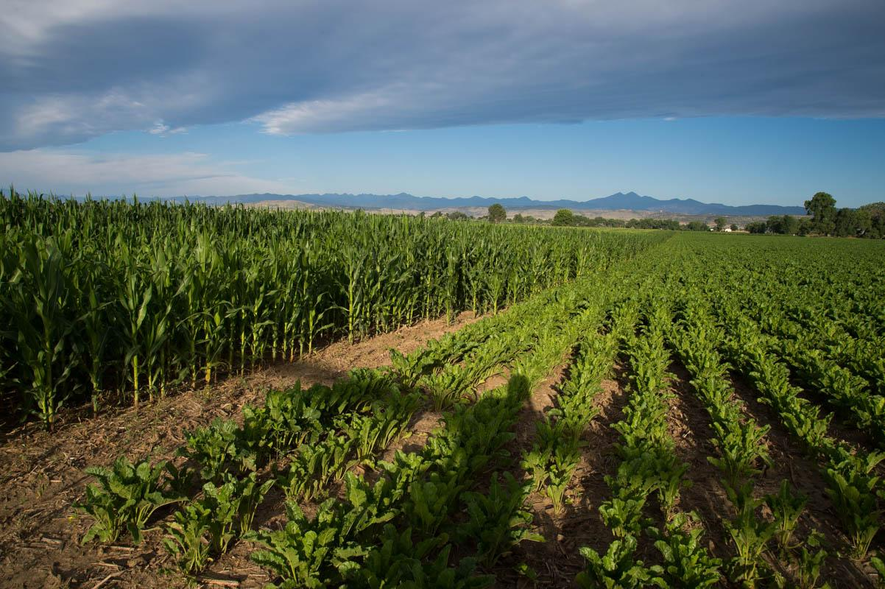
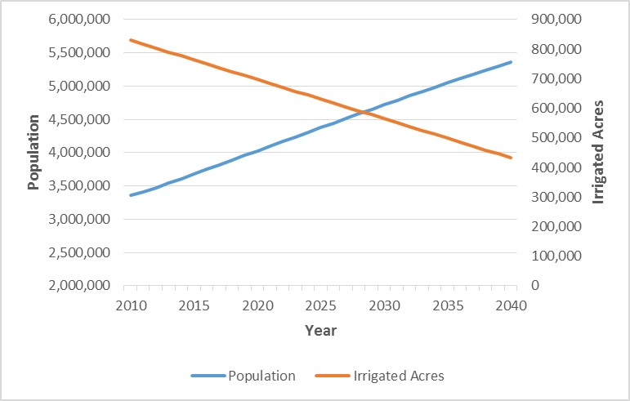
Denver Metro/Northern Colorado Population
versus Irrigated Acres

Slide 3
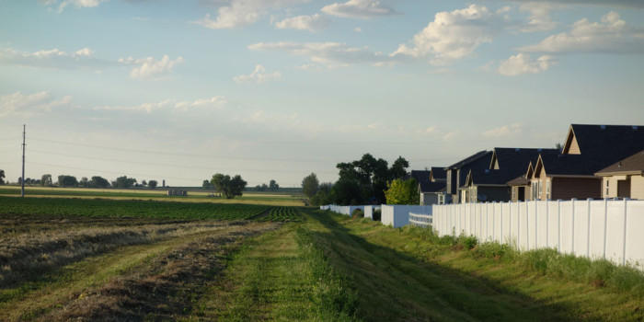
“Buy and Dry” Business as Usual
Developer/Broker
Buys land, sells water to M&I users, changes water in court
FARMS
CITIES
Farmers sell water rights to city
Municipalities buy water rights and dries up the farm

Slide 4
ATMs--A New Paradigm
Secure water sharing agreement between Ag and M&I users.
FARMS
CITIES
The farm uses water most years
The cities use the water in dry years

Slide 5
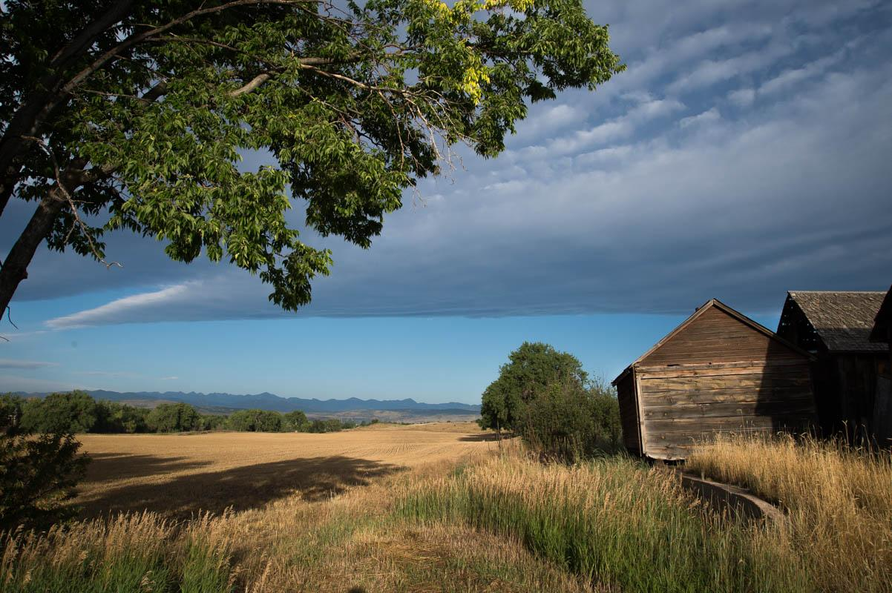
Larimer County & Broomfield Agriculture-Municipal ATM Project

Slide 6
Ag Producer
Local Government and/or Land Trusts
Irrigated Farmland
Funding
Local Open Space Funds
Impact Investors
State and Federal Grants and Loans
Foundations—Grants and Loans
Water Provider

Slide 7

How can you help?
Assistance in fundraising and potentially creating an ATM Fund to allow the rapid acquisition of a farm or ranch to be used as an ATM.
Spread the word! If you know of someone (farmer, rancher, municipality or land conservation community) interested in exploring ATMs, please send have them contact Western Water Partnerships.
todd.doherty@westernwaterpartnerships.com
303.518.4741

