Slide 1
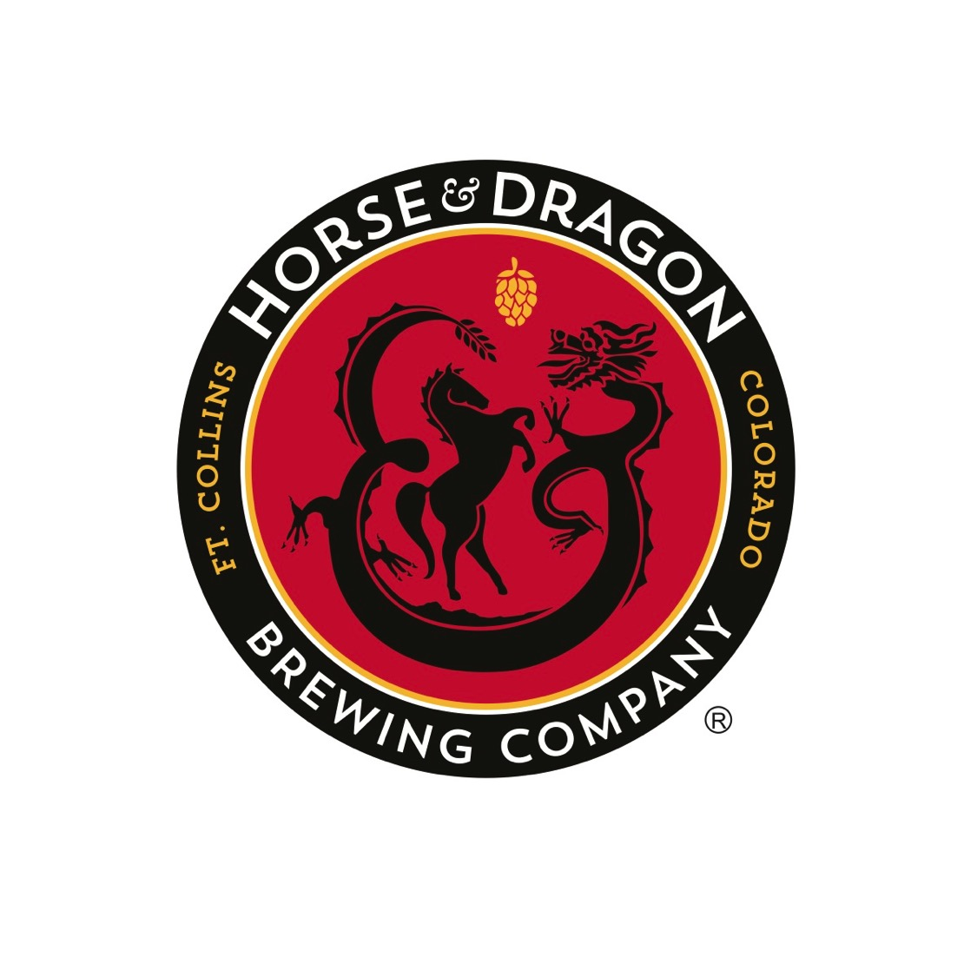

Slide 2
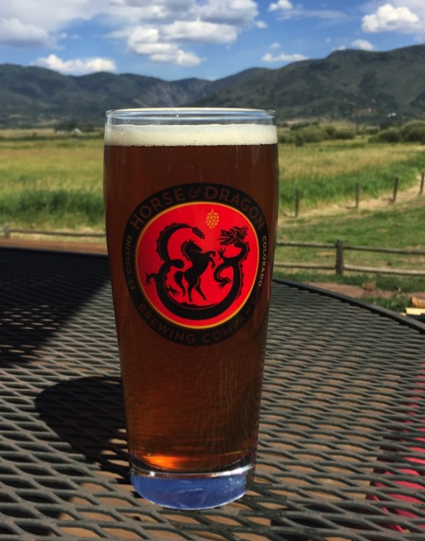
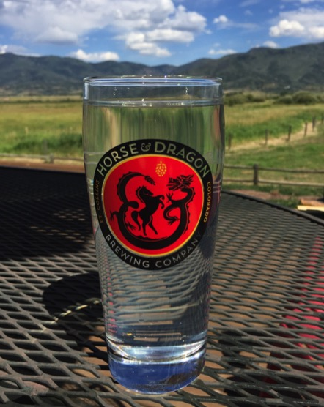
=
Notes:
Number of beers in the room right now – we’re bringing a half bbl – but this represents 3.5 bbls which is how much – 108 gallons = what?
Anyone doing this in the food industry? Doesn’t seem like it.
HOW TO GET LOGO IN FOOTER?

Slide 3
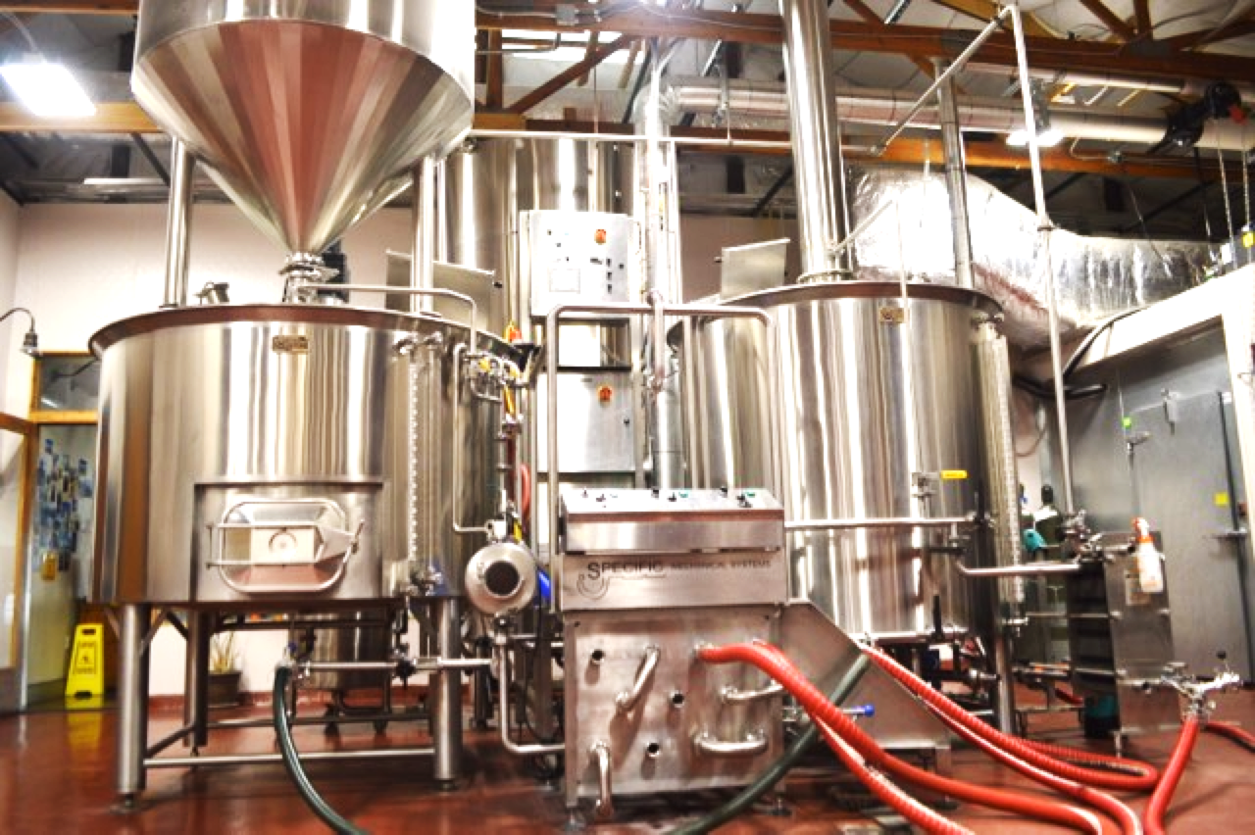
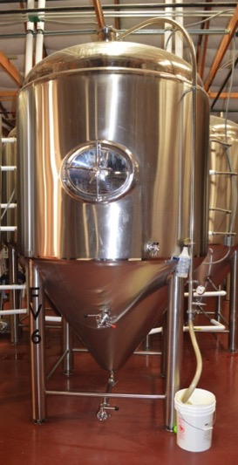
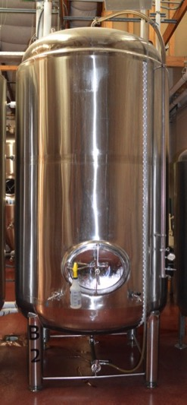
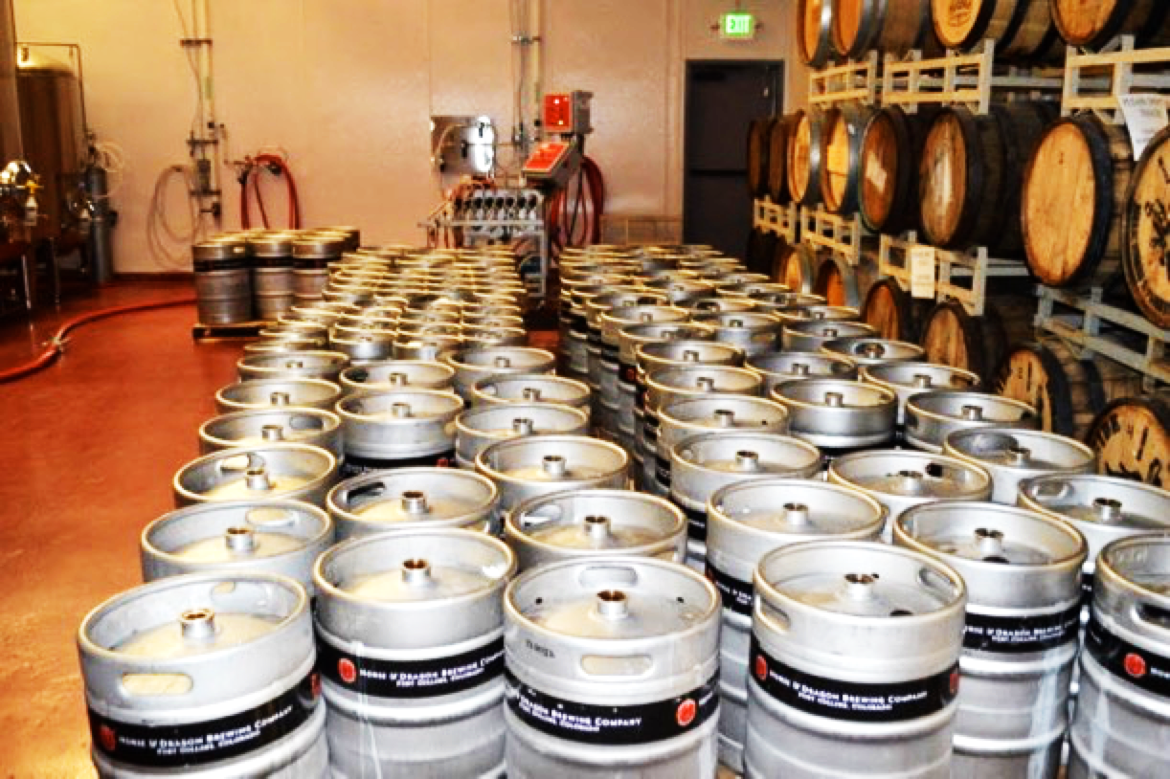
Notes:
What is economic impact of craft brewing industry in CO and in US?
How much water do we use?
How is H&D, and why are we concerned about water use?

Slide 4
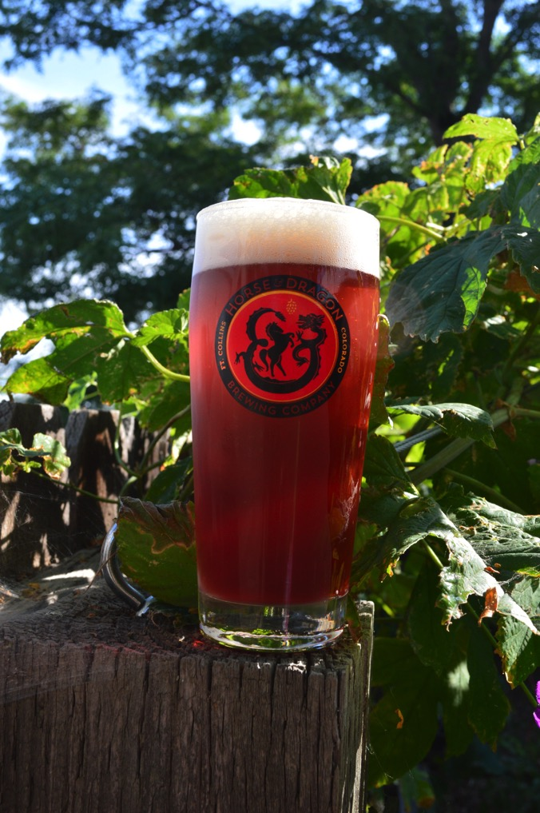





=
Notes:
Look at beer in hand.
ADD CLOCK

Slide 5
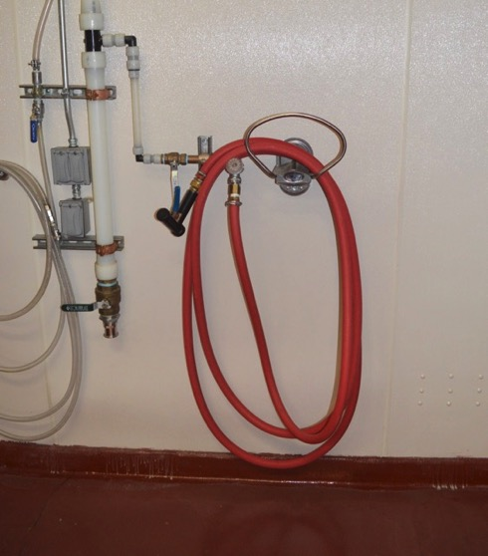
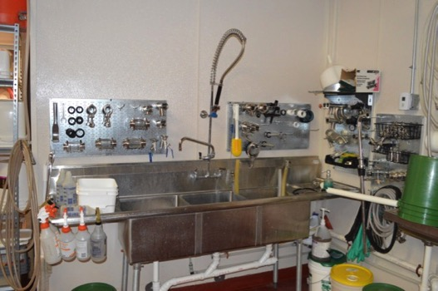
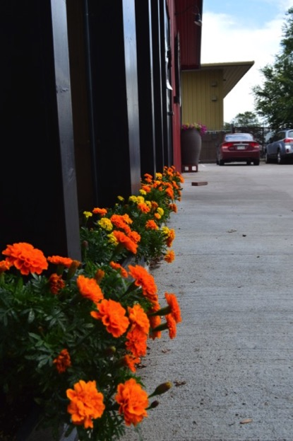
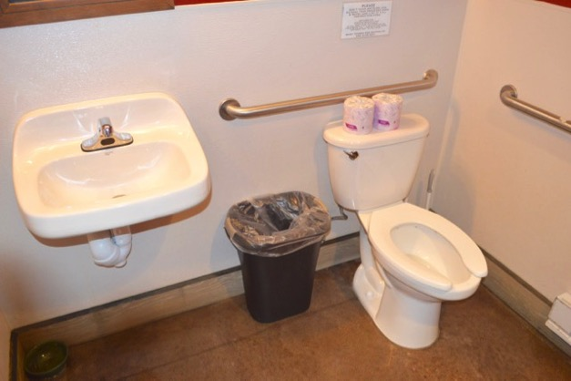
Notes:
PIC OF CIP BALL, PIC OF TAPROOM GLASSES
What is our use now?

Slide 6
3.7 gal : 1 gal
7:1
Notes:
# OF SMALLER BREWERIES UNDER 50,000 BBLS VS. LARGE IN US
Extrapolate to breweries in CO – sizes
What is this at scale? - if we can trim this, show the difference between how much water we’re using as a fraction of the beer industry (compare to AB use in FoCo). Size of the market.
Let’s say ON AVERAGE (being generous) that breweries use 7:1. * 350 15% reduction would be down just over 1 gal per gal of beer produced. Potential water savings of 1.5m bbls of water = 46.5m gals of water/year.

Slide 7
Craft Breweries in FoCo
21
6
2
Notes:
Single meter vs. shared meter (6/21), even if have single meter, brewery vs. taproom vs. landscape, let alone drilling down to individual processes.

Slide 8
You can’t change what you don’t measure.
-- Andrew Cole
:
Notes:
ANDREW’S NAME AND TITLE. Industry problem.
Because it’ll help us understand where we are using and where we are losing water. Watch for unexplained variations and detect leaks or inefficience in operations.
Obviously once we can measure this, we can start making changes – and any small change – demonstrate how this .

Slide 9




Why do we want to measure?
1.
2.
3.
$
Notes:
GOOD CORPORATE CITIZENS – generally true across the craft industry (In May we spent $1000 on electricity, $1000 on yeast, $13,500 on grain, who knows how much on hops, and $125 on water.)
OUR CUSTOMERS WANT US TO
$$
Currently no $ incentive to breweries to do this, so must be low-cost and must appeal to our altruistic desire to lessen impact on environment. But time is coming (with development & climate) when water for biz is likely to be $$$ -- so develop this now and you’ll be poised to sell when those hikes happen.
Breweries not currently eligible for many rebate programs because cannot measure impact.
Water cost to biz is bound to go up.

Slide 10

Flow meters
Current options:
  In-line flow meters
  External flow meters (ultrasonic)
Notes:
Ask: some way to measure our water use in processes.
(Suggestion: external to pipe flow meters?)
Current cost of in-line flow meters is extravagant ($1900 + ~$375 installation per meter for our sized pipes – 2”), disrupts production, permanent (some brewhouses don’t have space for them).
External (ultrasonic) meters cost $5000 and up. And can’t measure water as pure as ours unless we add chunks, gas, or ripples. Notoriously inaccurate.
Breweries should buy 1-3 of them, that’s it. Portable to measure different processes.
Need bubbles or eddies in flow (can we create these reliably?)
Problems:
Must measure water, not just chunky stuff or gasses
Would help if can clamp on hot pipes (up to 215°F or so)
Would help if easily moved to different sites.
Needs to be inexpensive!

Slide 11
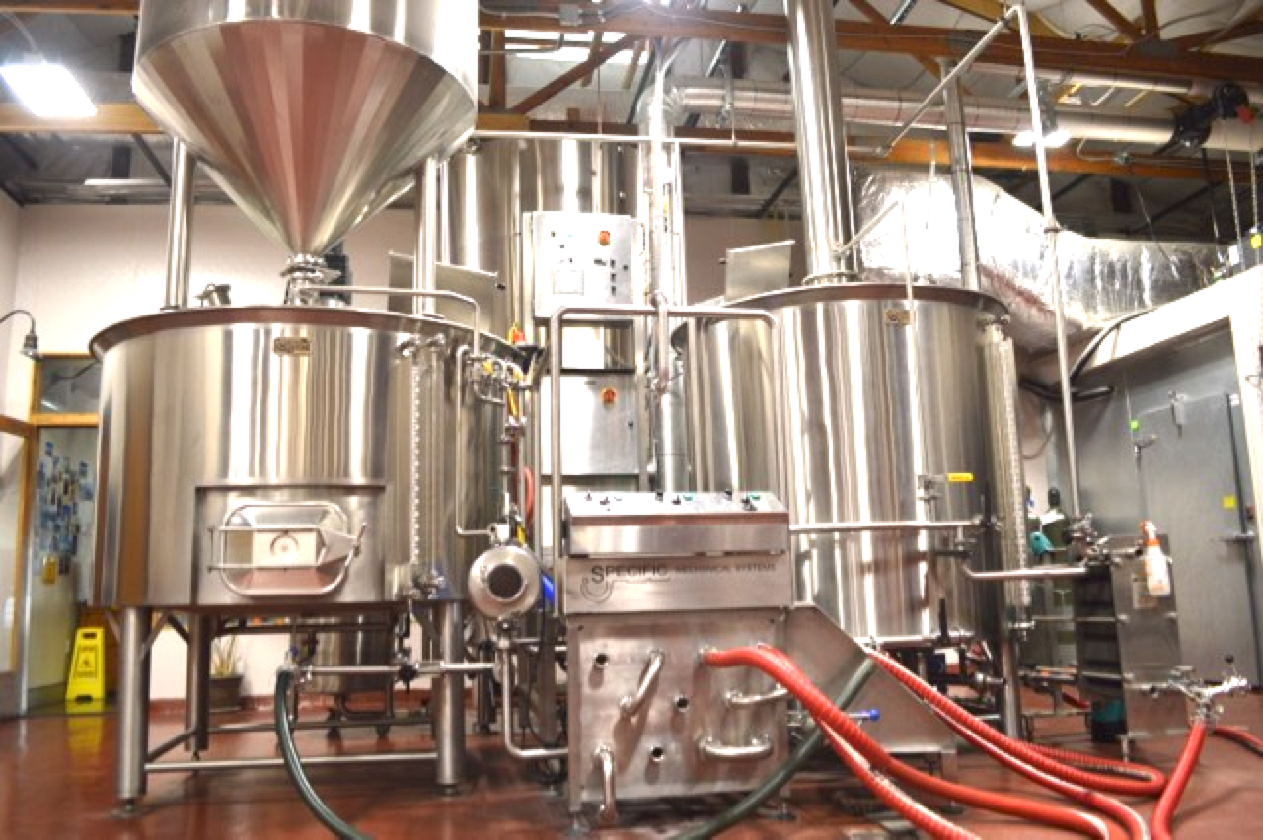

BUT HOW MANY CAN I
$ELL (and for how much)?
X 350
Notes:
Slide that pulls together how many breweries. We would buy 10, some would buy 0. Average 1-3, multiply by # of breweries in CO, US, give $ figure
Also international if you want to travel!
So say 1000 in CO breweries to start. At $200, $200,000. With current water prices, would take a brewery our size 11 months to pay one off.
We’d like to buy 7 (so make ‘em inexpensive, but not cheap, please).
Get yourself poised for when water is more $ for biz. When it does, we’ll be willing to pay quite a lot more.
Angel.co/water

Slide 12

X 5300
Notes:
*3 is almost 16,000, @$200 each = $3,180,000.

Slide 13
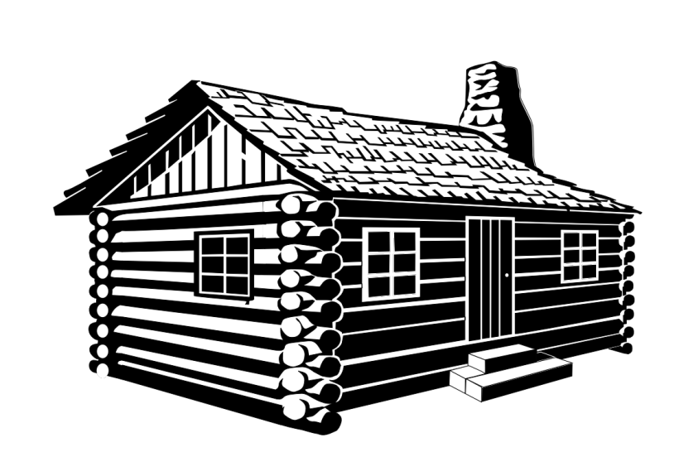




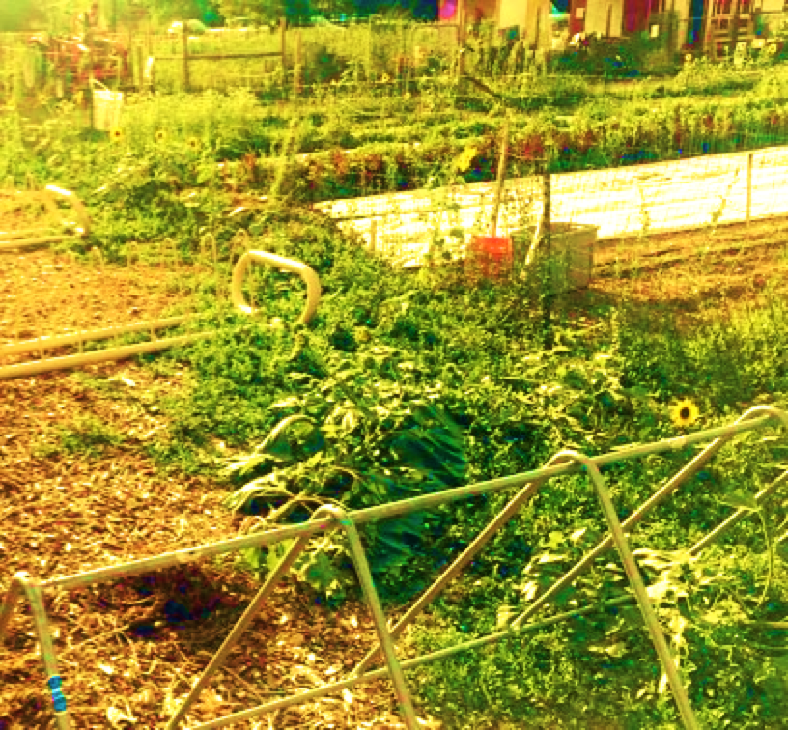
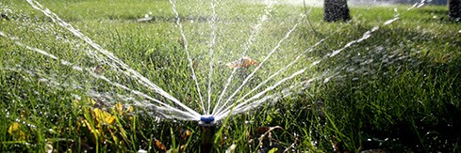
Notes:
Other industries: small scale farms, distilling, coffee roasters, cheesmakers,, residential applications, off-the-grid homes, municipalities.

Slide 14

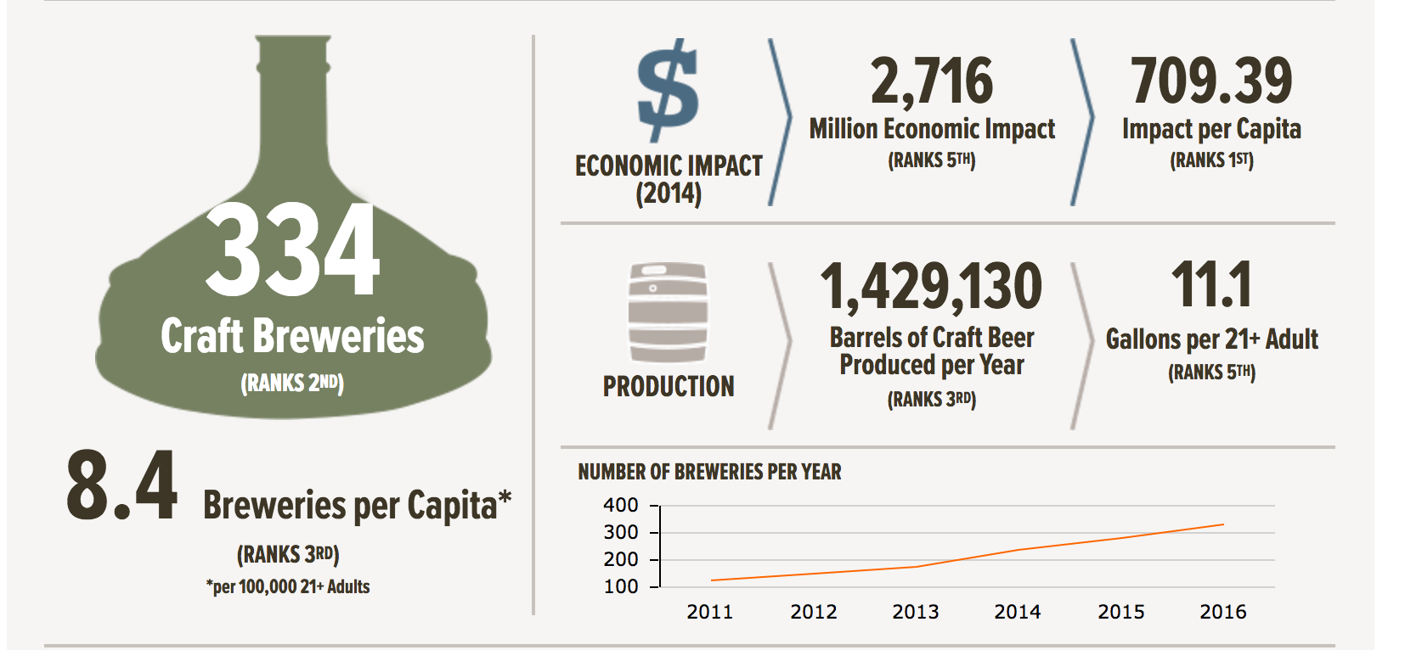
Saving drops of water/bbl.
X 350+ breweries in CO
Source: www.brewersassociation.com
Notes:
HOW MANY GALLONS OF WATER PER PERSON SAVED?
Any savings/bbl – multiply by 1.5m. Matt estimates 15% savings.
In our case, this would be 9300 gallons of water a year. But for all the breweries in CO, it would mean saving 6,975,000 gallons of water a year.
BRING CONNECTOR AND RED FLEX PIPE.

Slide 15
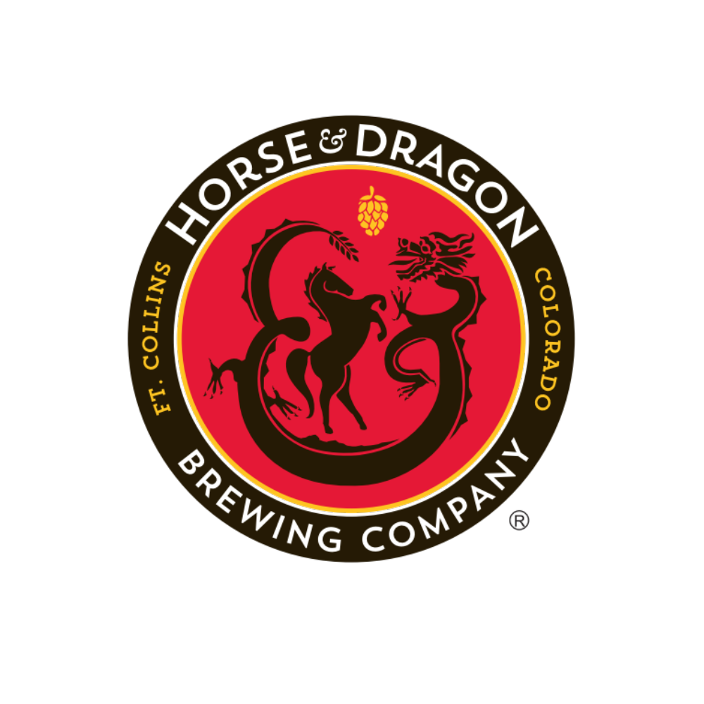
PLEA
+
THANKS
Notes:
Andrew Cole with the CO Dept of State’s Business Intelligence Center Go Code CO
Nina Sharma, with Project X-ITE at University of Denver

