Slide 1

FOREST COFFEE TRADING COMPANY
Mark Tebben – Production Coordinator

Slide 2
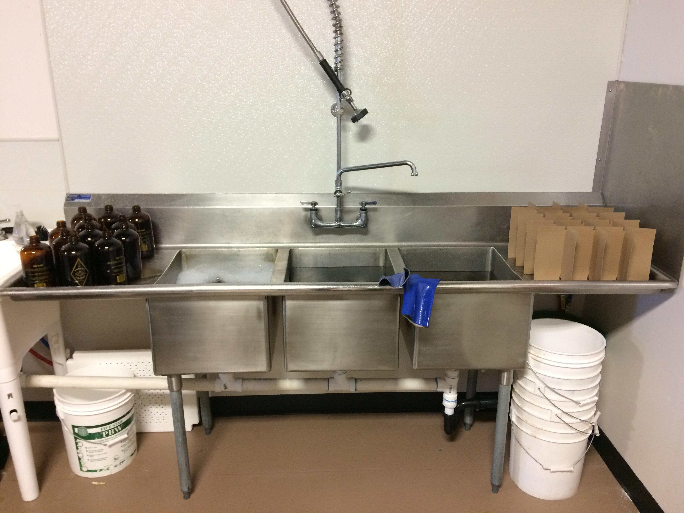

Slide 3
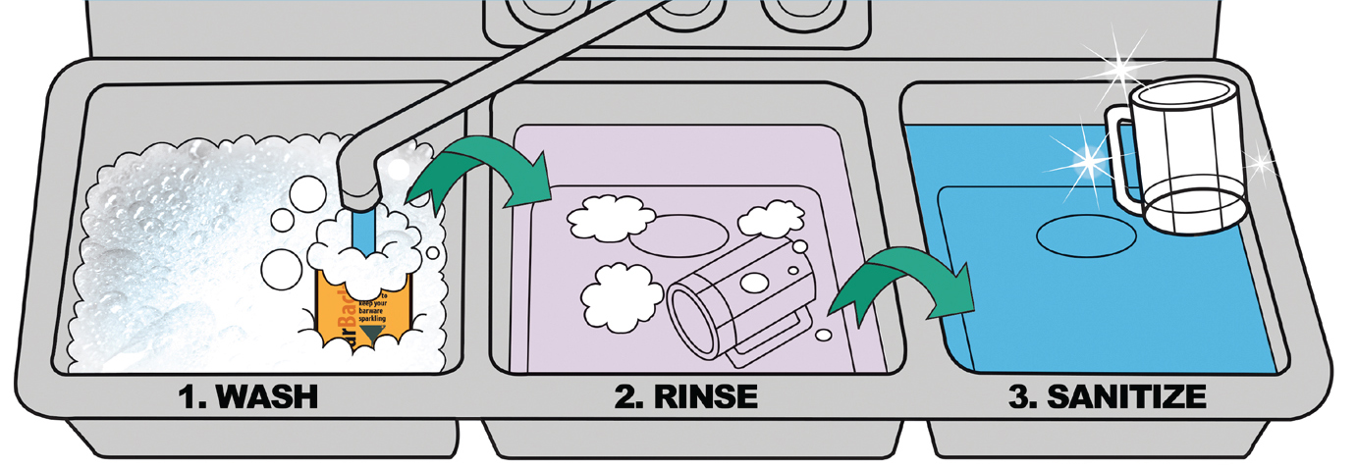

Slide 4


Slide 5

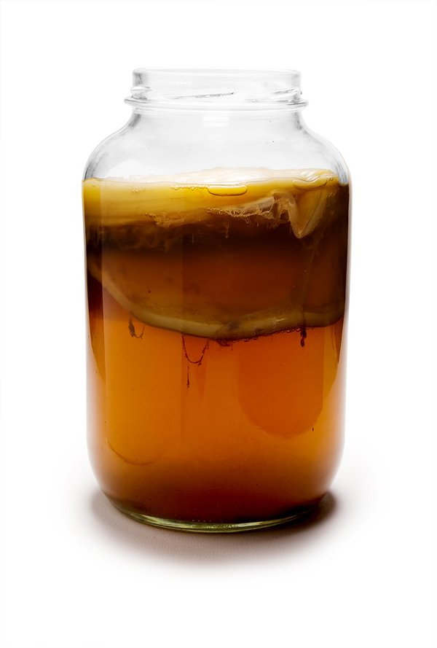









Slide 6
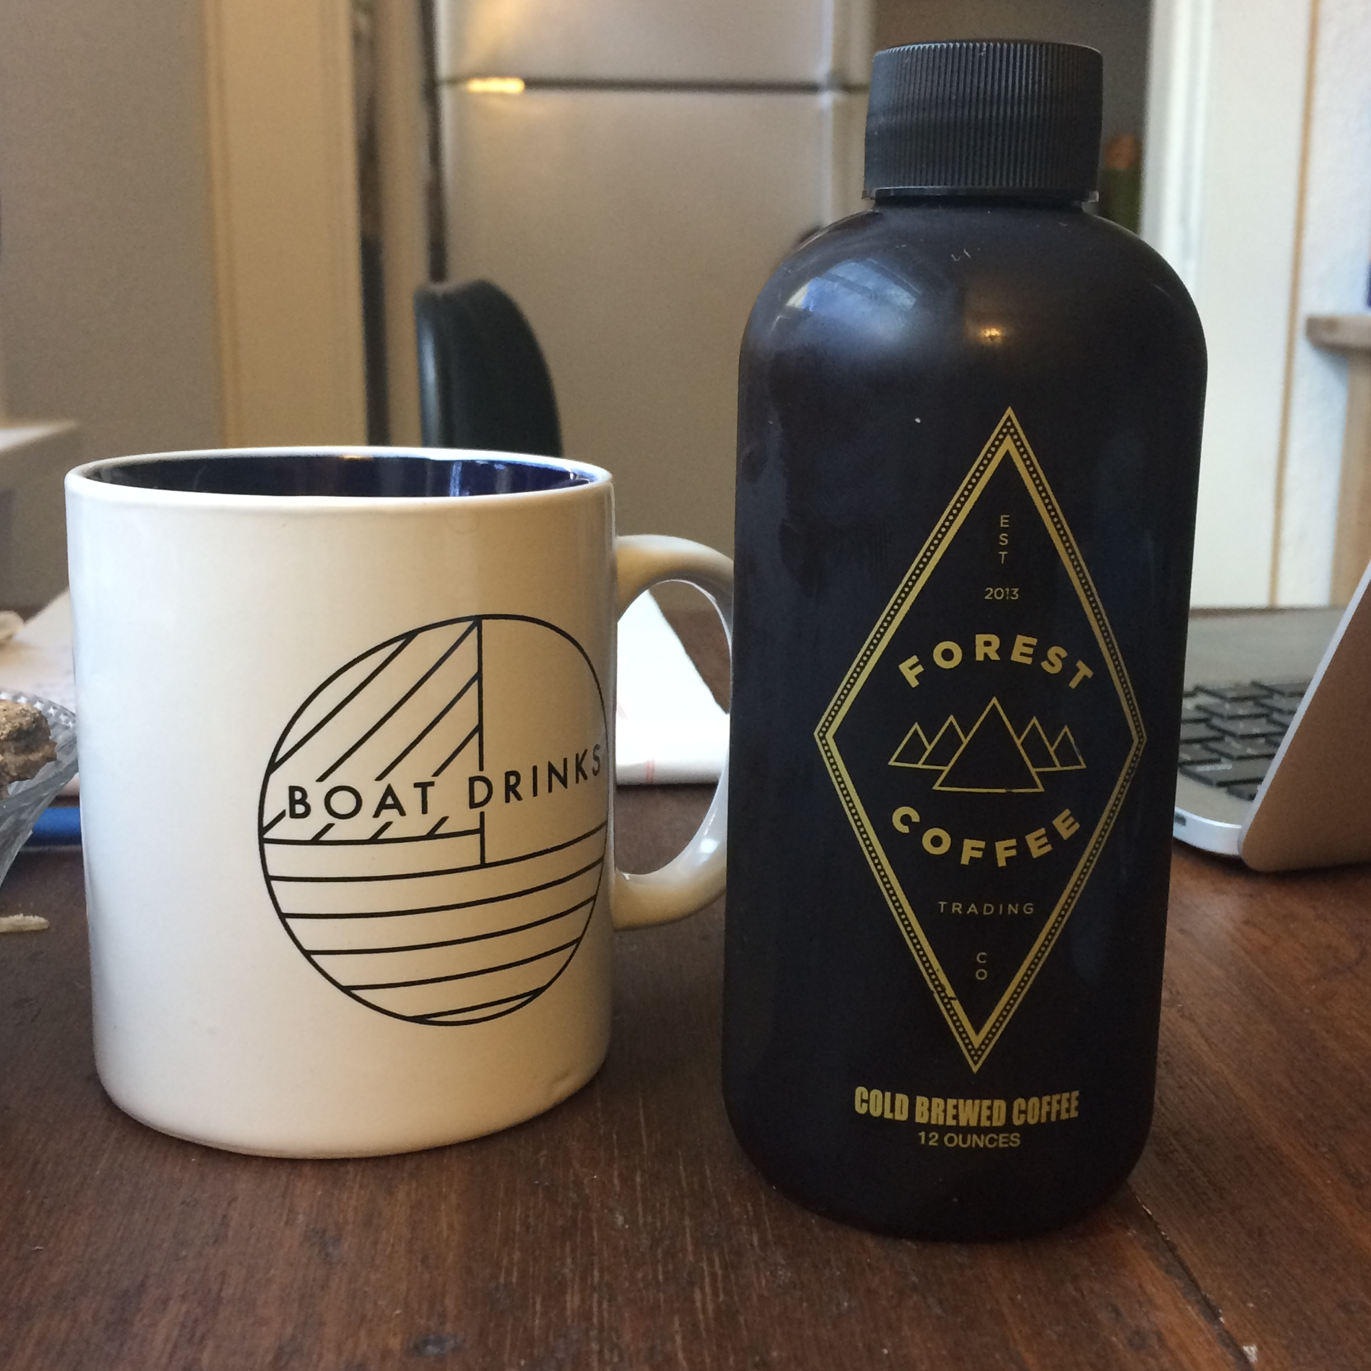

Slide 7
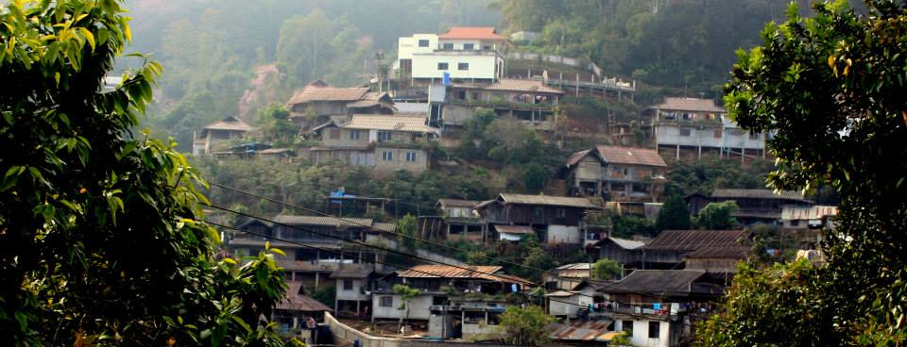
ABOUT FOREST COFFEE
Direct Trade, Wholesale
Roasting
Cold Brew

Slide 8
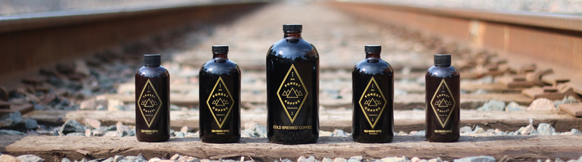
FOREST COFFEE COLD BREW
12oz, 16oz, 32oz bottles; 5gal kegs
250 gallons of cold brew per week
250-350 gallons of water for cleaning per week

Slide 9
FOREST COFFEE COLD BREW
Problem:
Cleaning more than doubles our water consumption

Slide 10
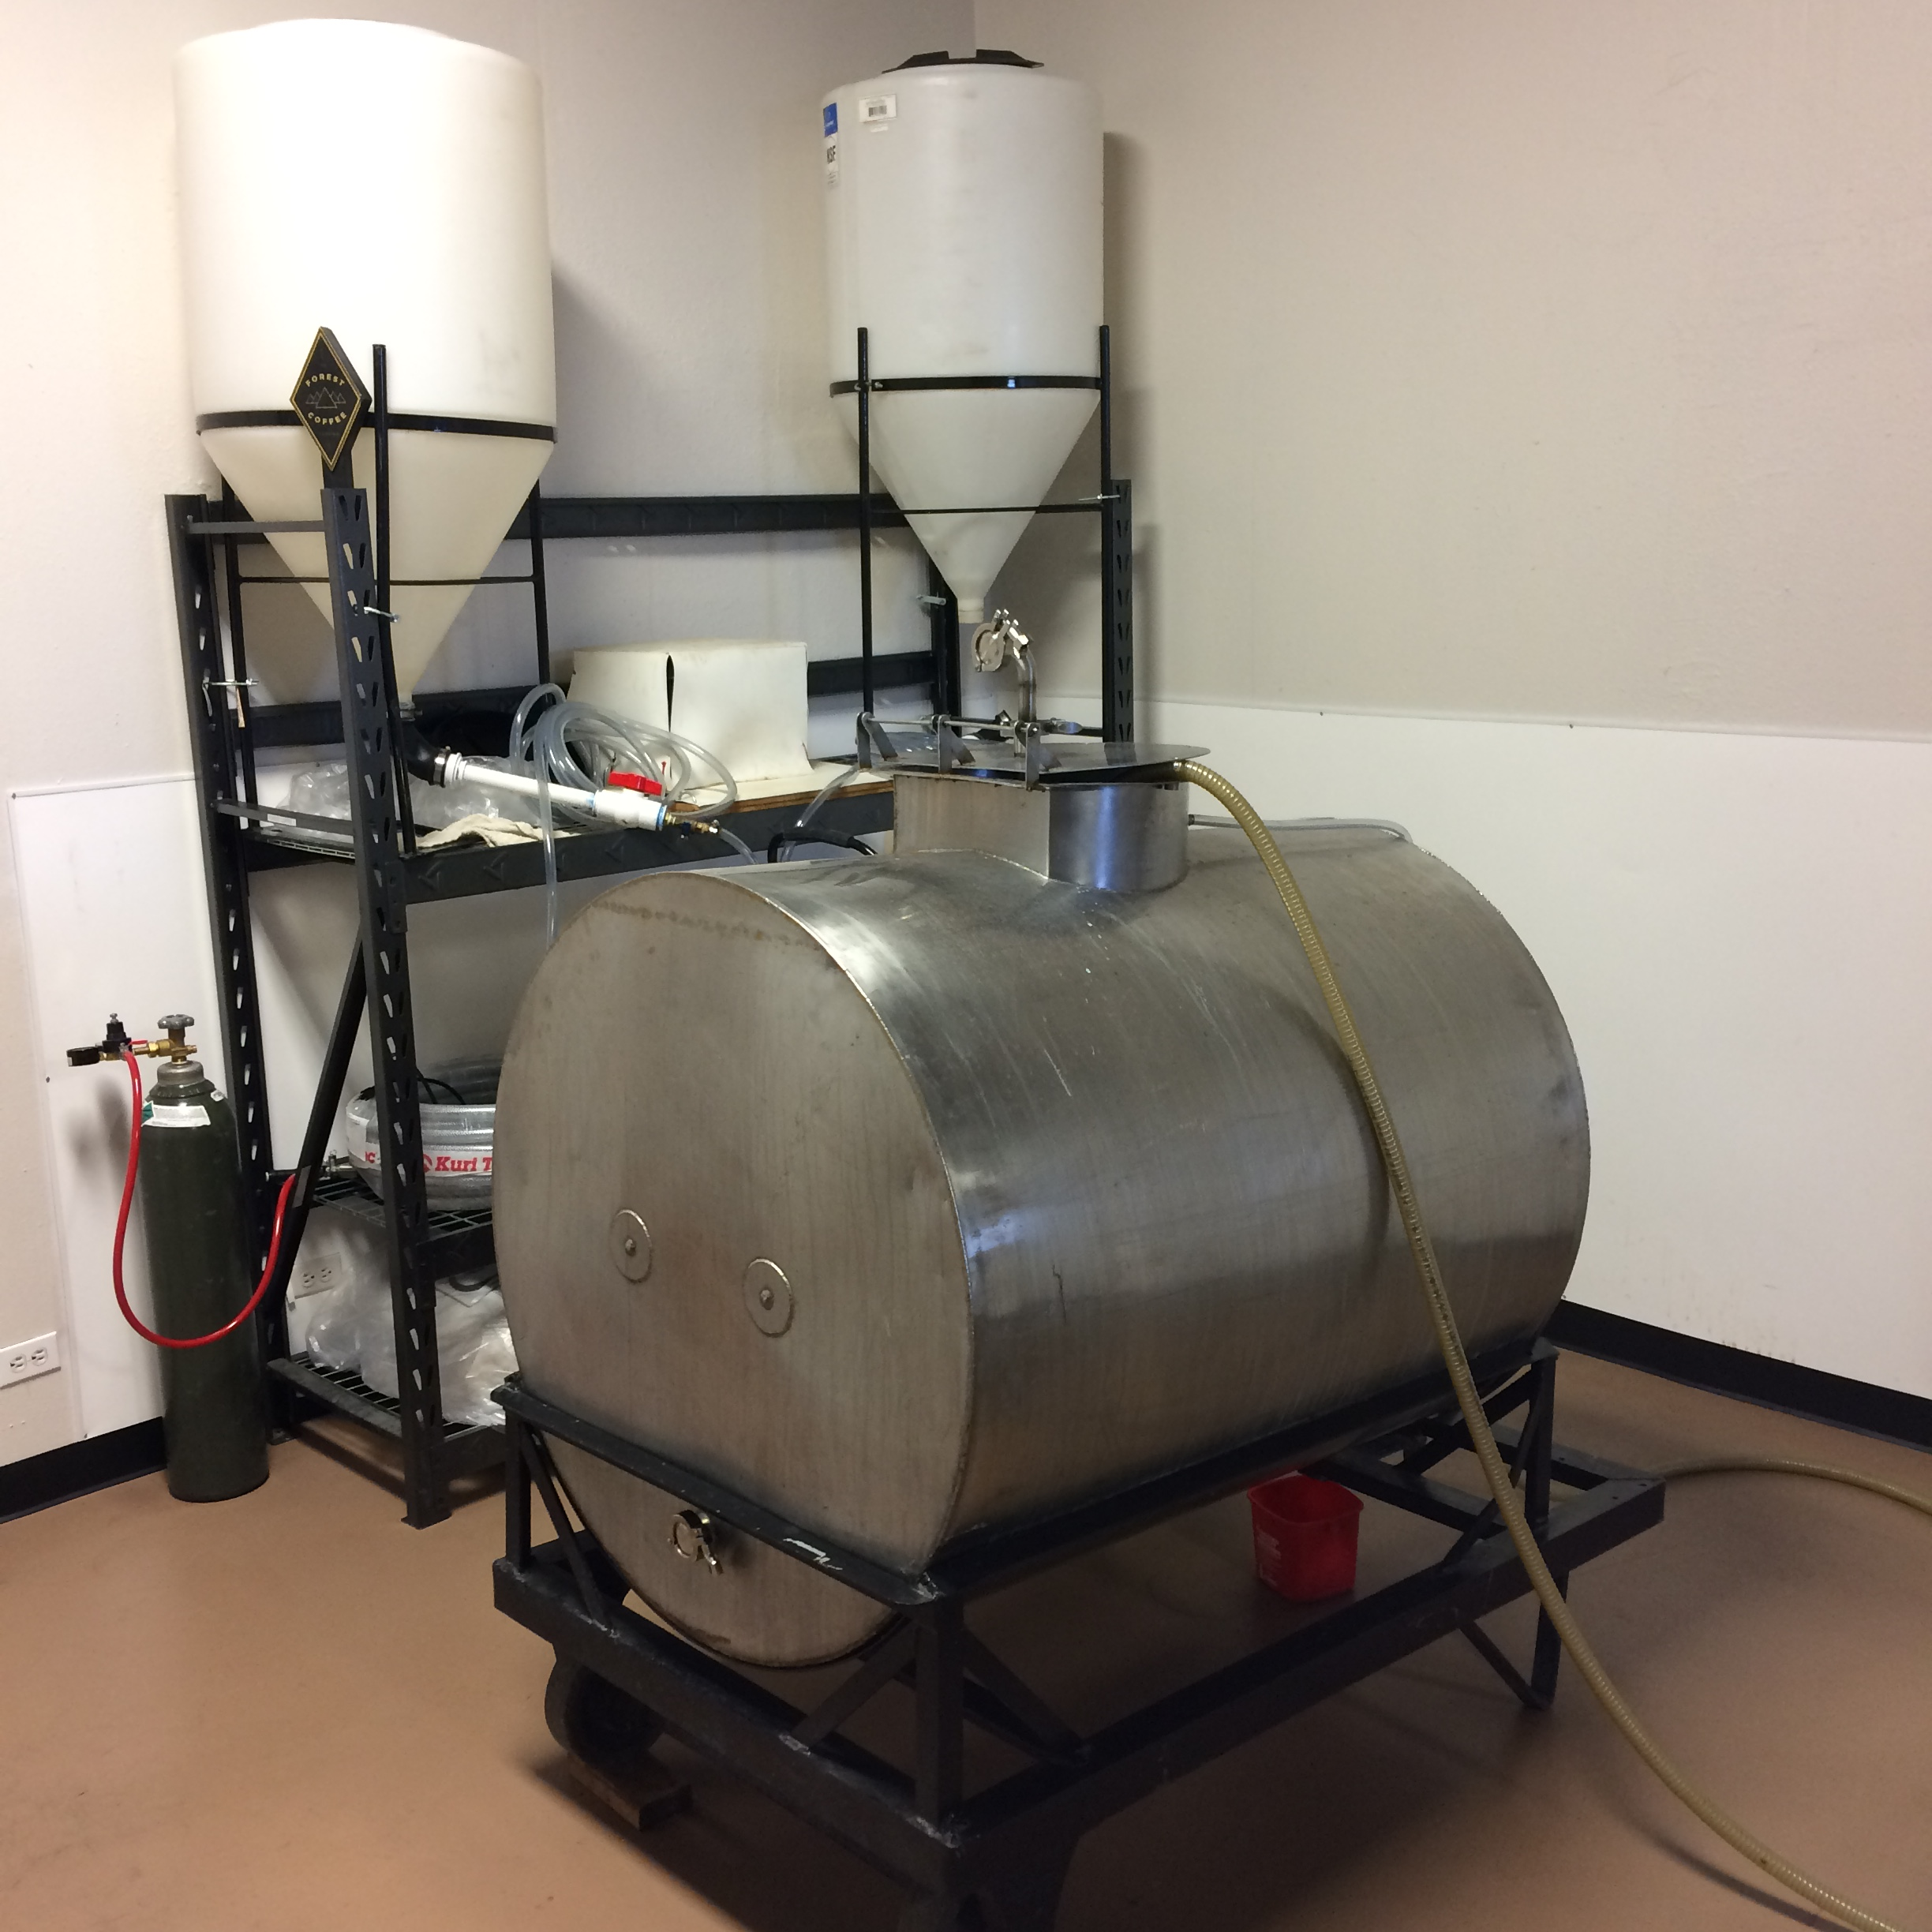
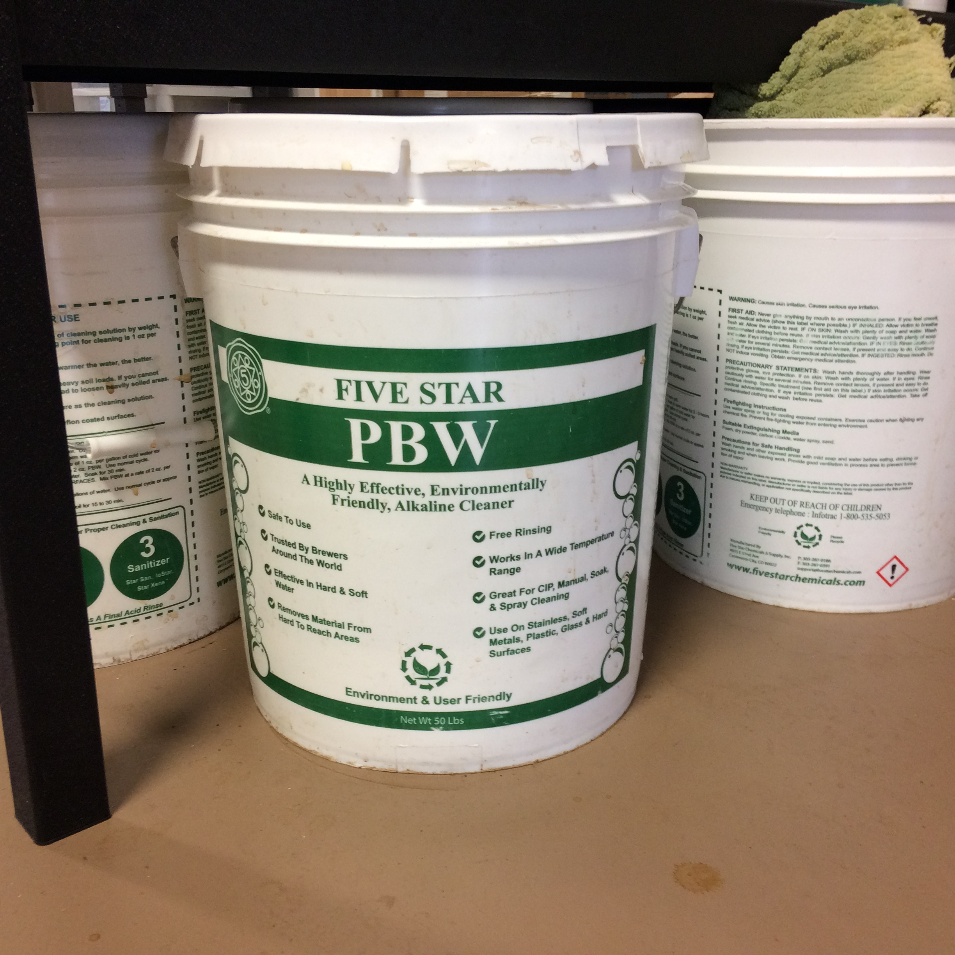
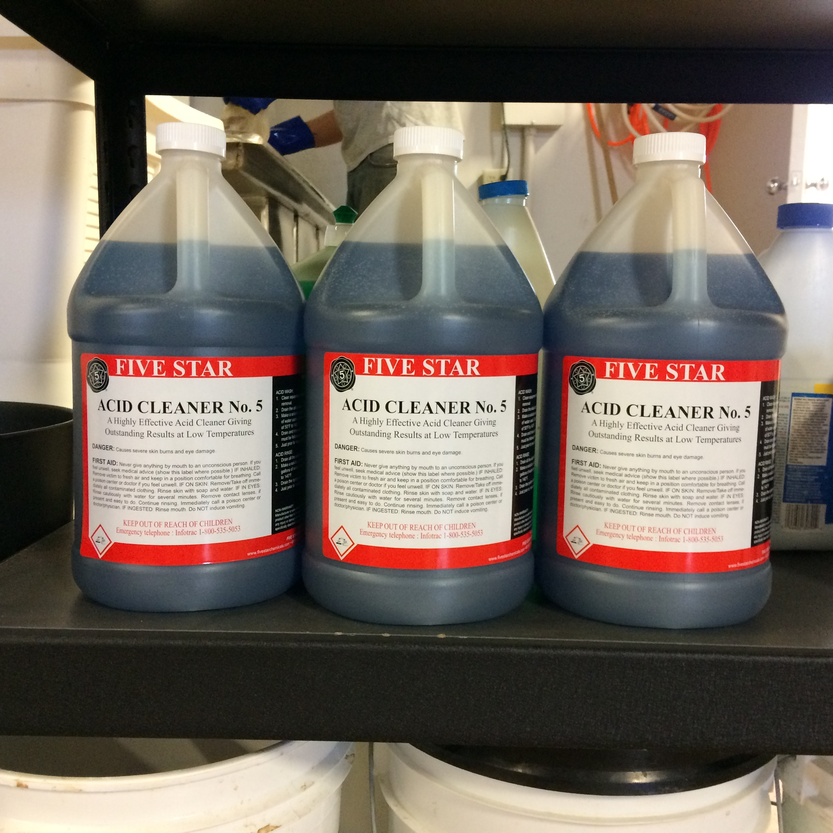
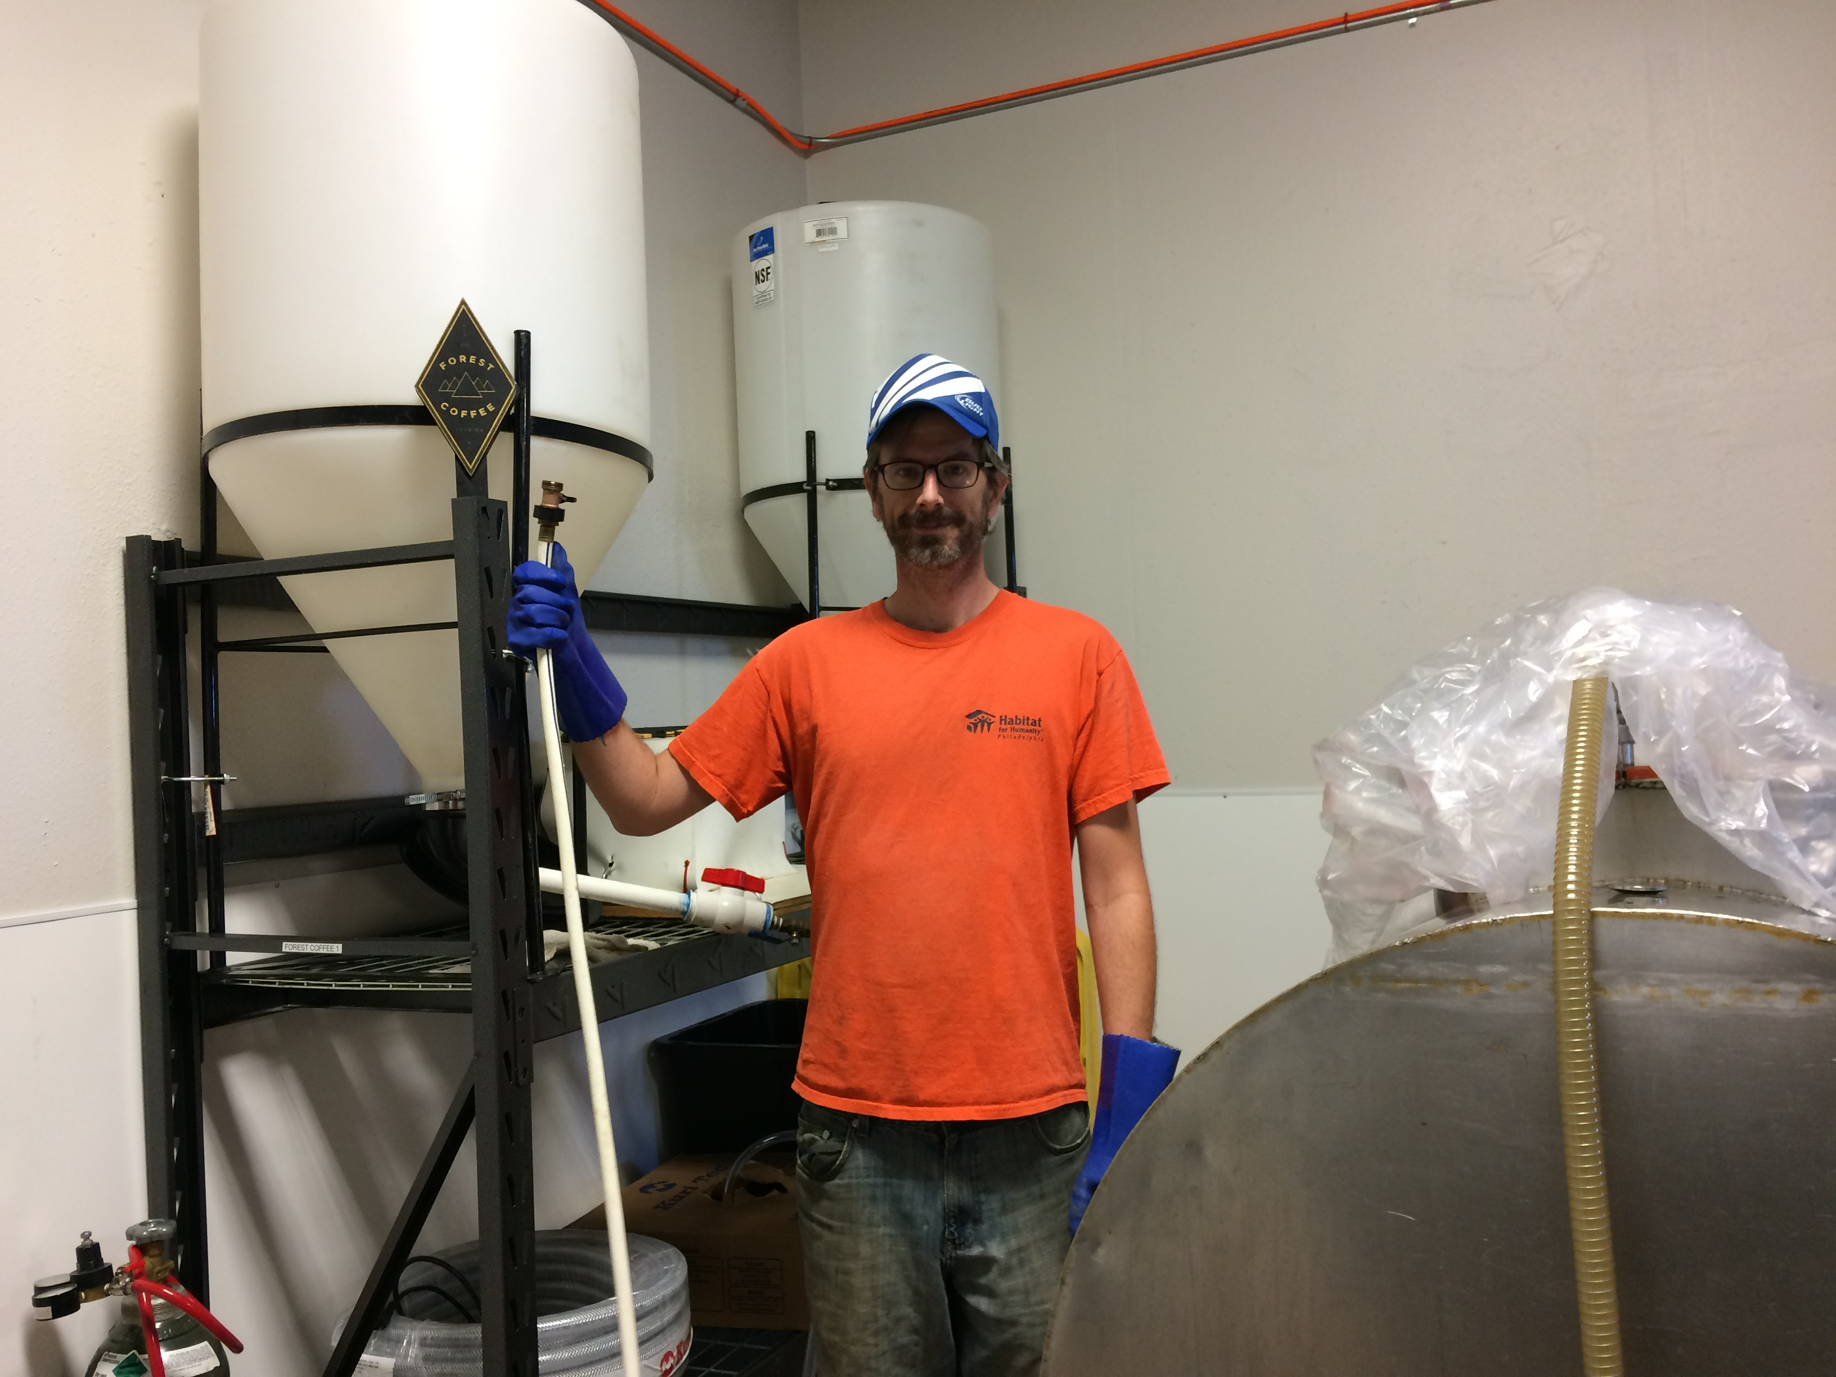
TANKS AND KEGS: 180-300 gallons

Slide 11
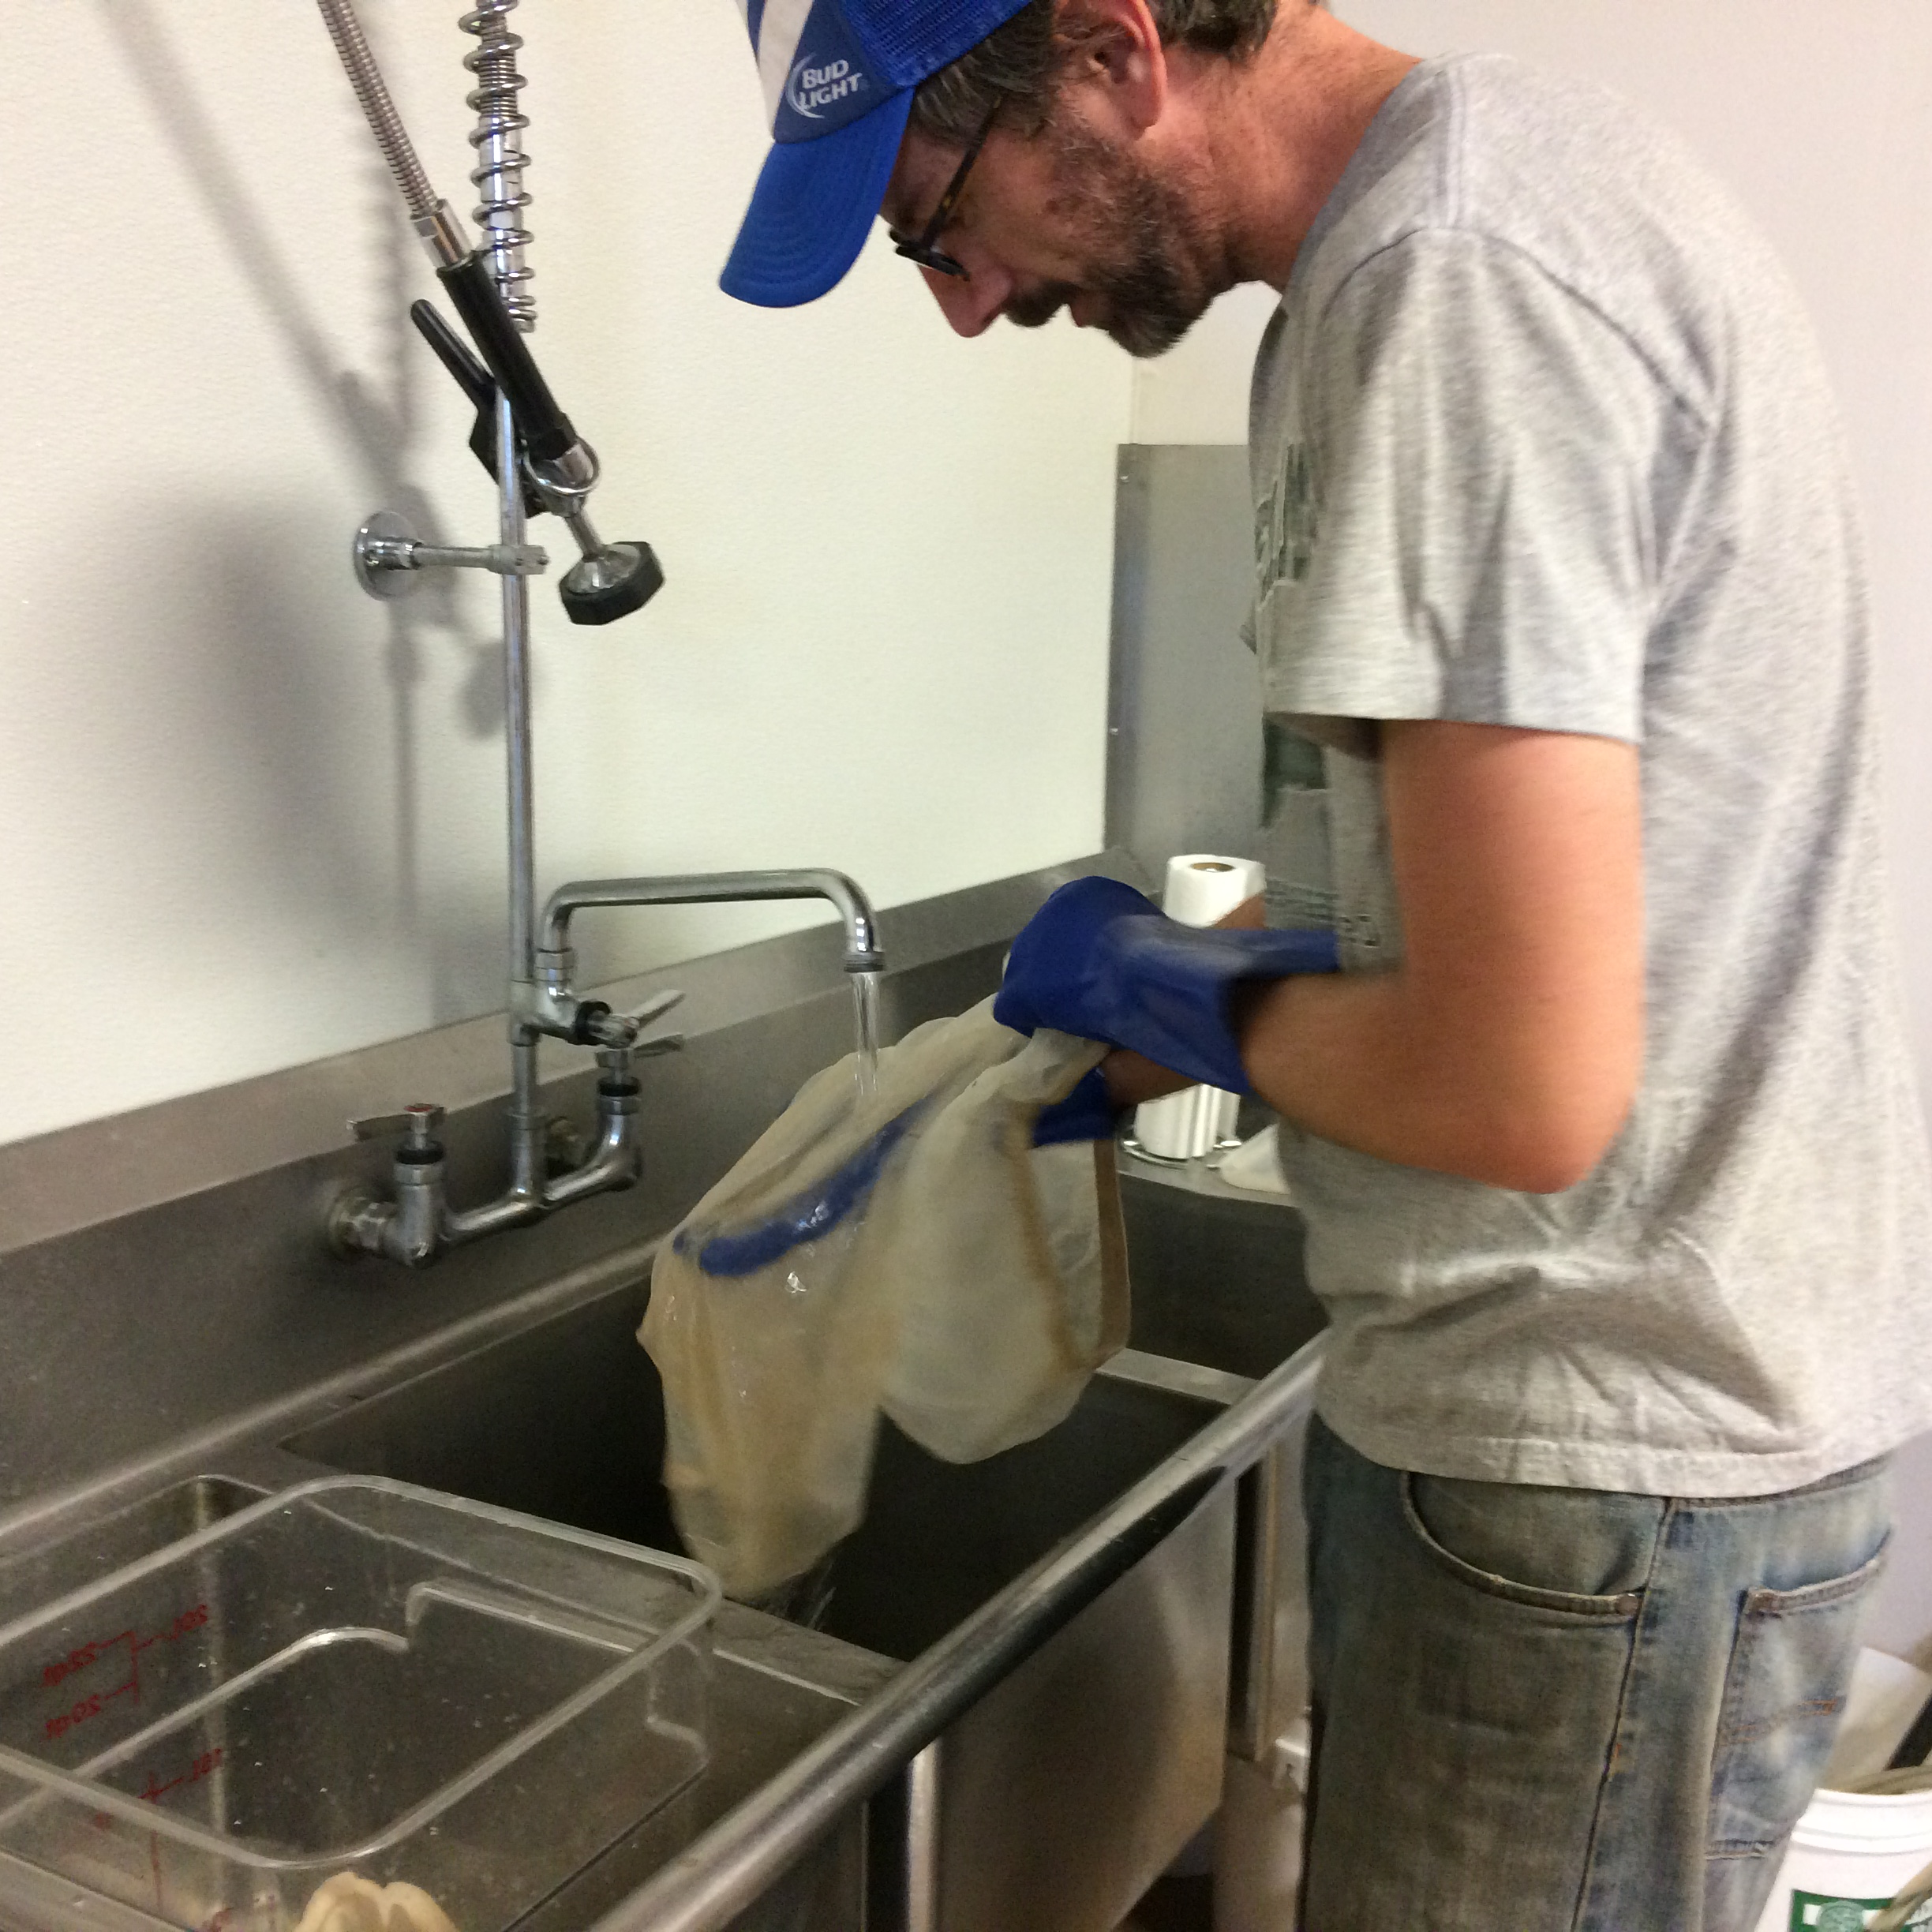
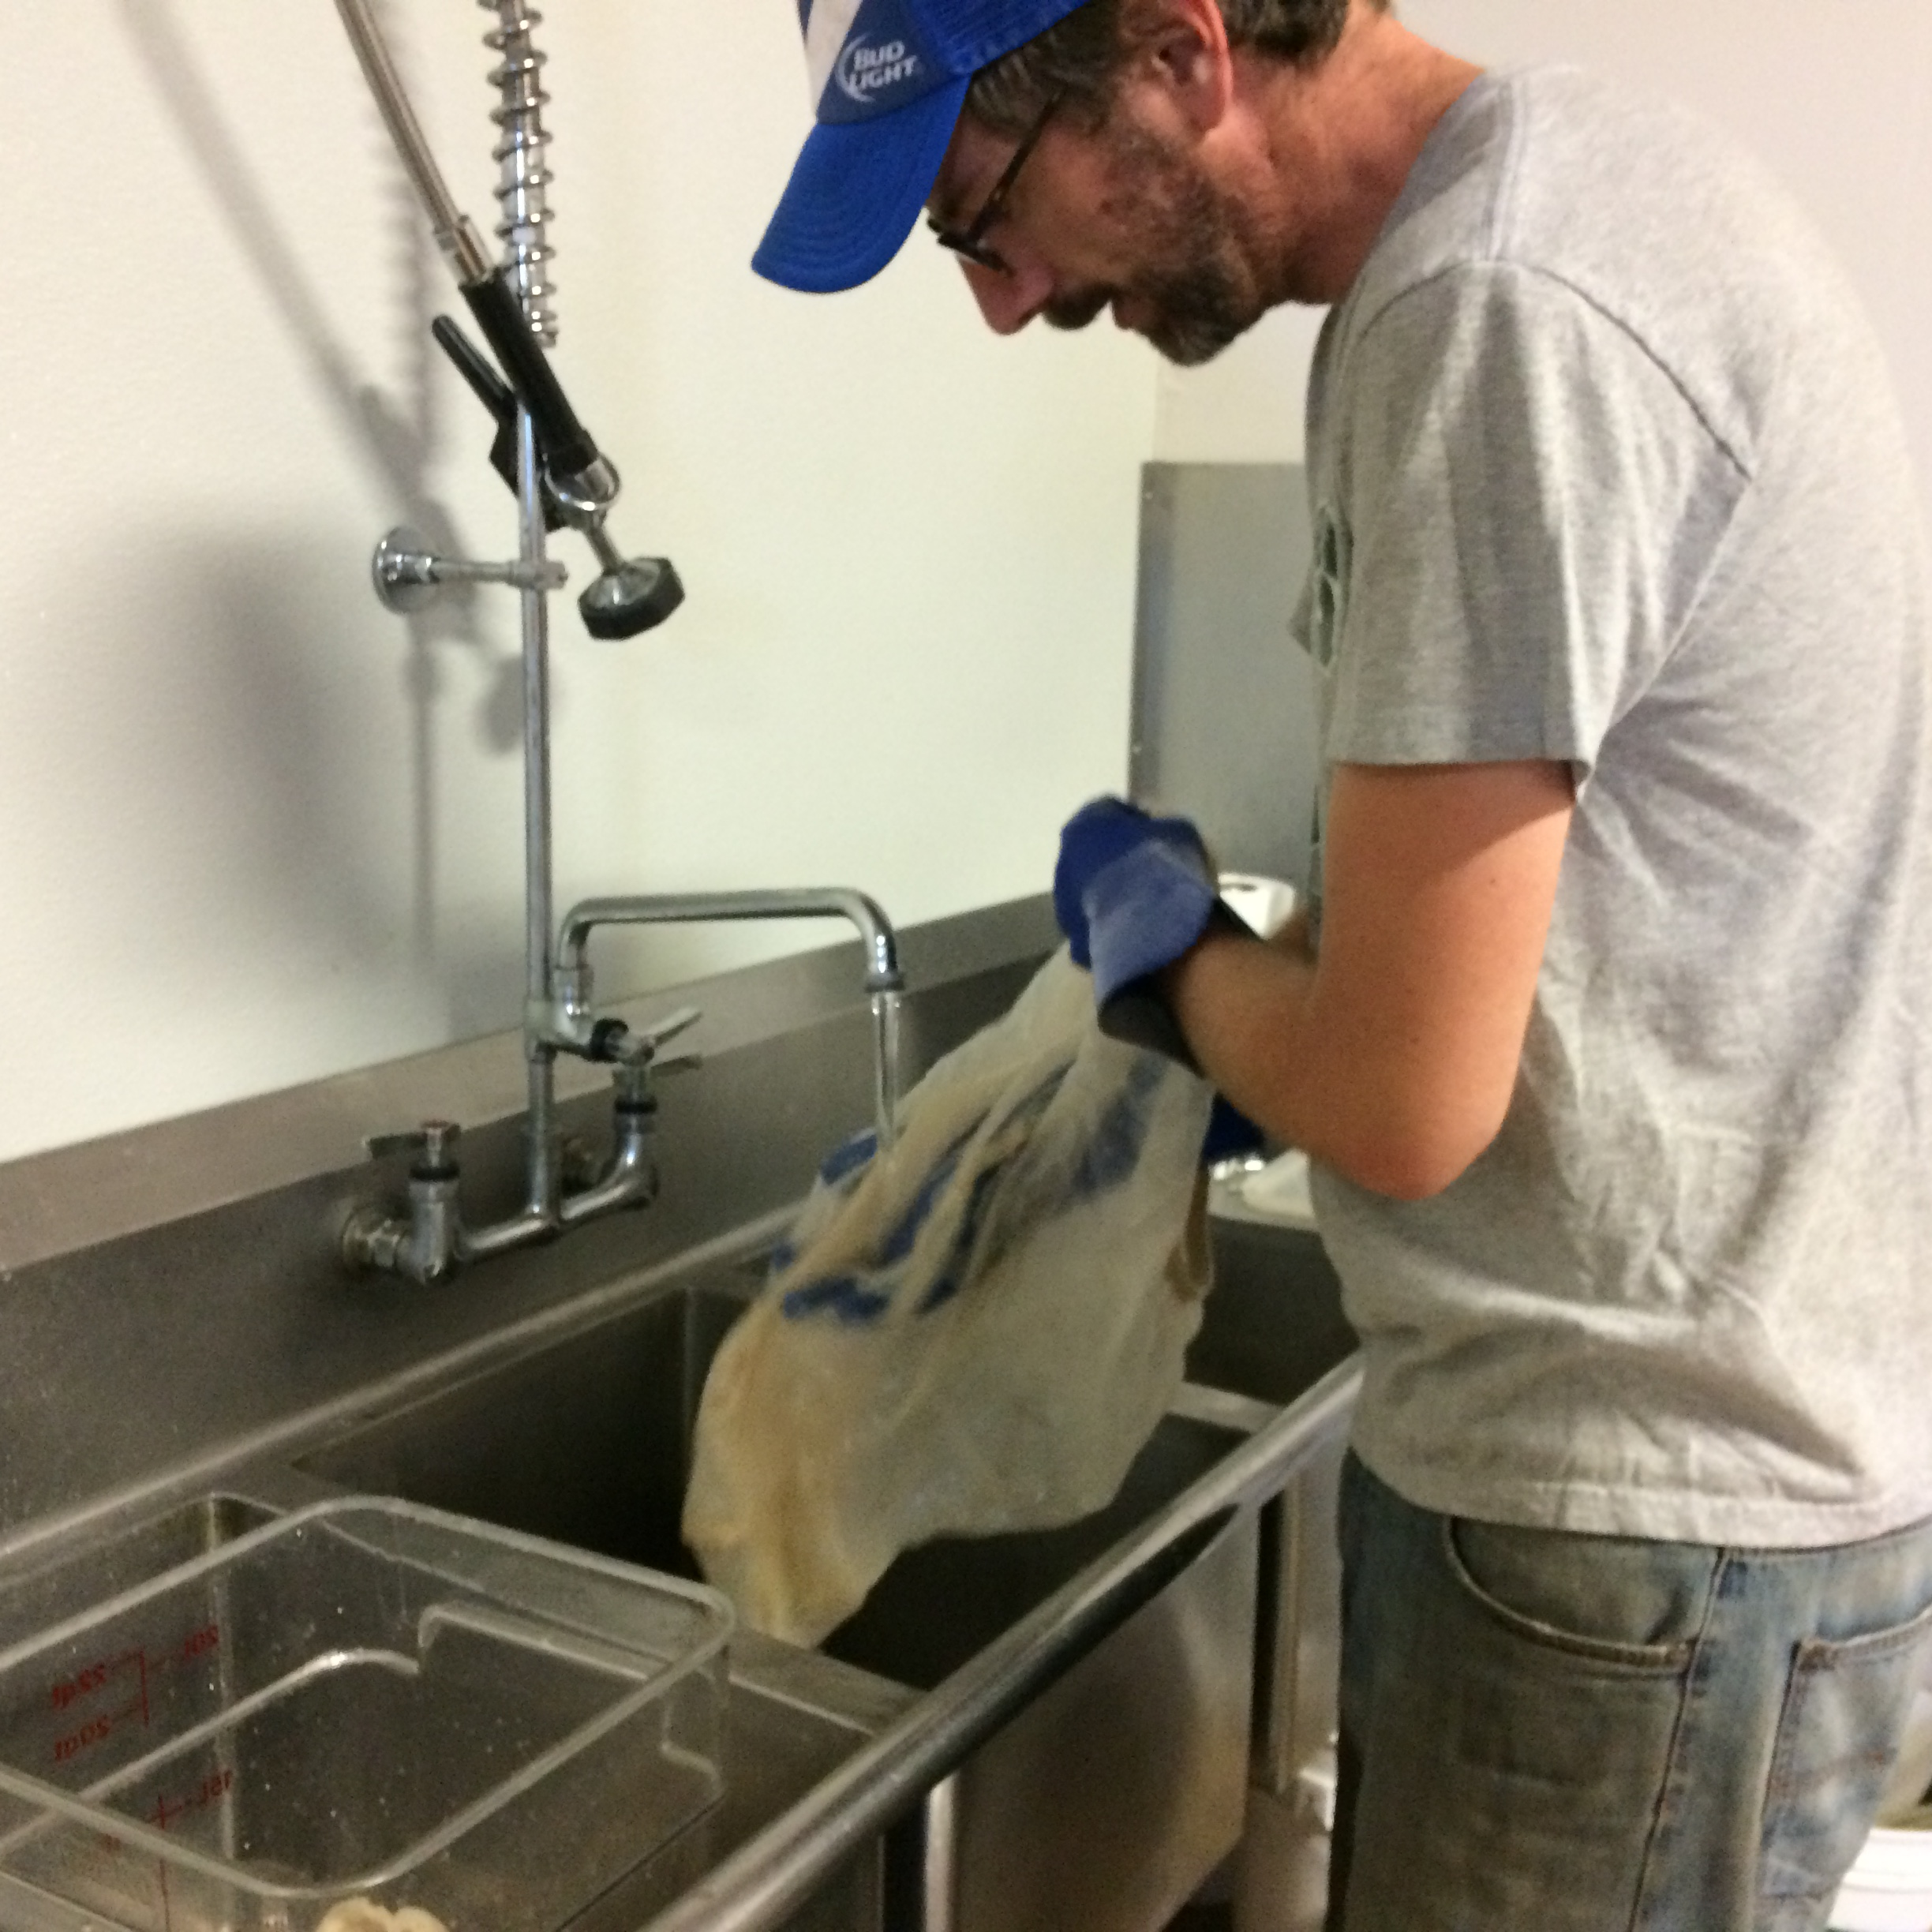
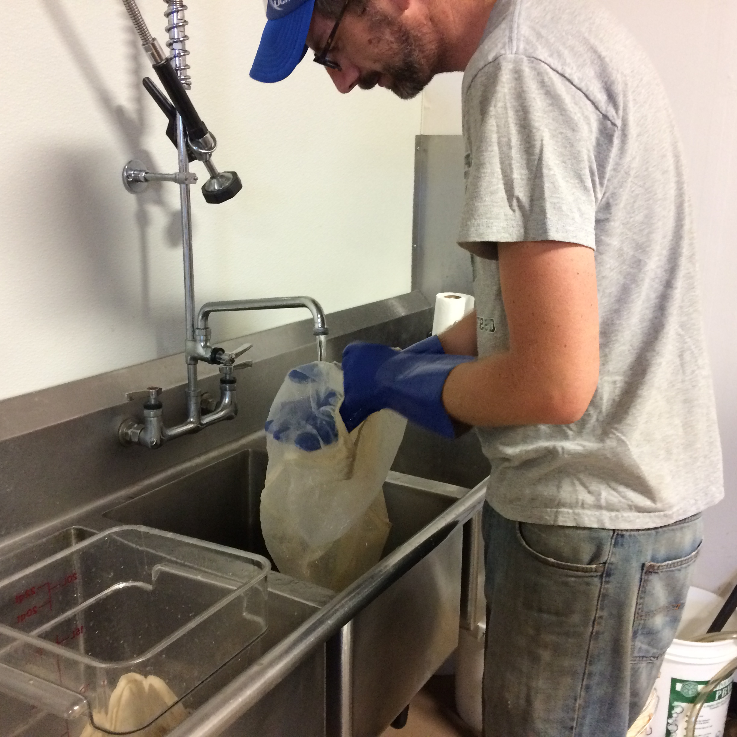
FILTER BAGS: 60 gallons

Slide 12
MISCELLANEOUS: 10 gallons
TOTAL CLEANING WATER USAGE:
250 – 350 GALLONS
100 – 140 % OF PRODUCTION WATER USAGE

Slide 13
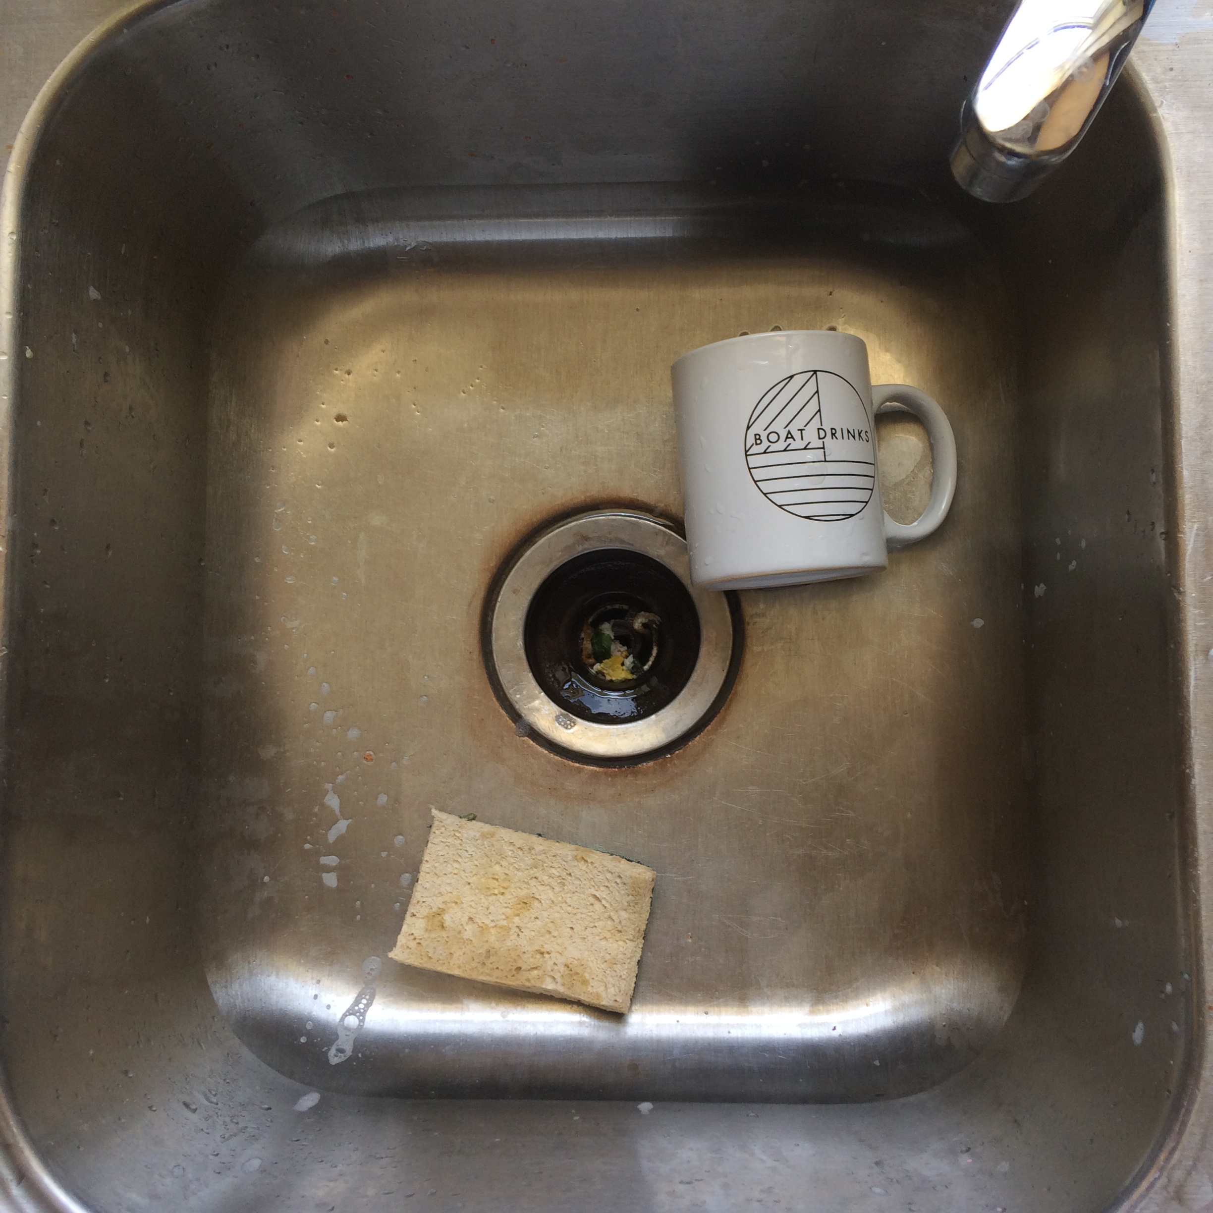

Slide 14
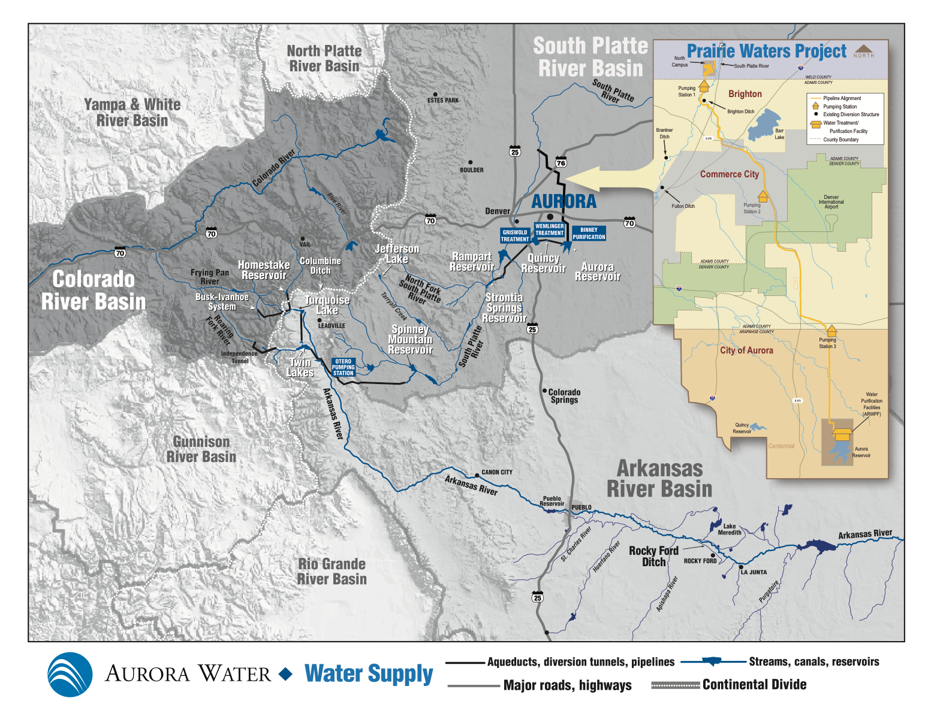

Slide 15

=

Slide 17
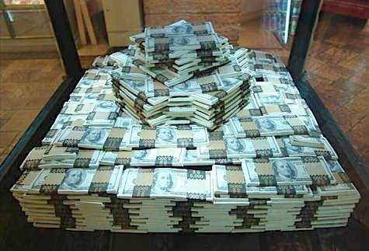
10 million dollars +

Slide 18
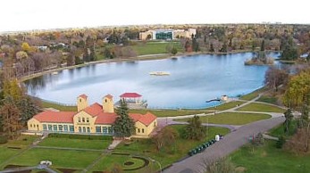
100 million gallons +

Slide 19
FOREST COFFEE TRADING COMPANY
Mark Tebben – Production Coordinator
mark@forestcoffeetrading.com

