Slide 1

Water Markets:
An Opportunity with High Impact
Zach Thode

Slide 2
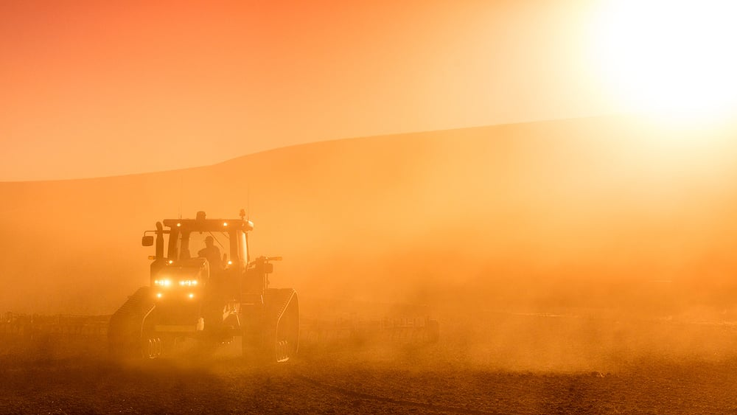
What’s the Problem?
Limited water supply and growing demands
No marketplace to trade water between users
The supply of water for agriculture is not secure now and for the future

Slide 3
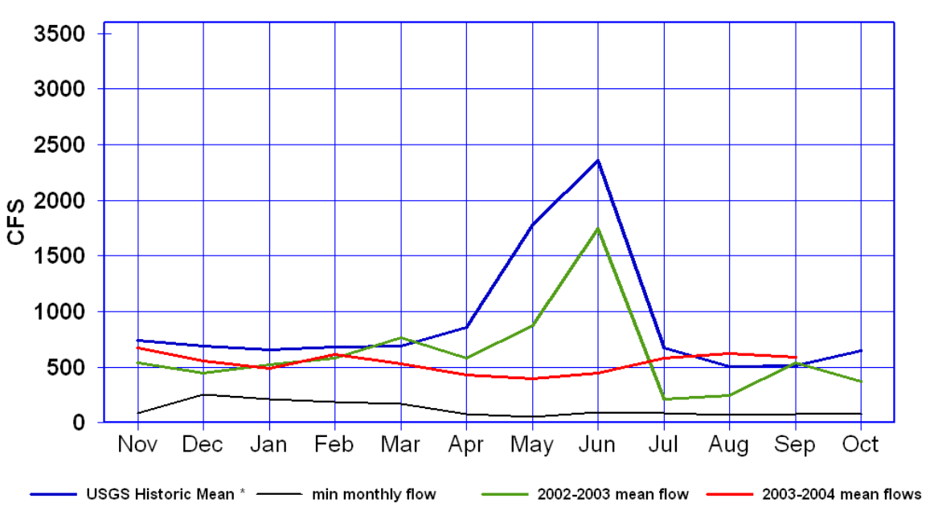
Irrigation water demand and Hydrologic variability
River Flow
Irrigation Demand

Slide 4
Cost of water can range from $30/acre-foot (af) to an average of $75/af to a high of over $100/af
Some years, there is not water available for farmers to lease or purchase (in 2002-03 and 2012)
Rental Water Not Available

Slide 5
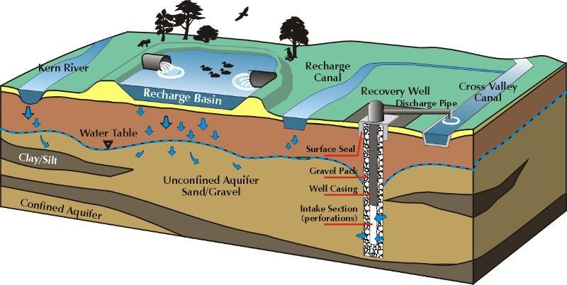
Aquifer Storage and Recovery allows users to treat water, inject it deep into the confined aquifers along the front range, and then extract the same water later
Alluvial aquifers are located along rivers and are always moving, therefore a user can put water into the aquifer that will be used somewhere else

Slide 6
Retiming river flows
Groundwater Bank
H2O
Water flows from depositors to downstream water users
Water Depositor
Money flows from water users to water depositors
$
Water User
Water User
Retiming excess flows in the river for later demands
$

Slide 7
Potential Roadblocks and Problems
Groundwater bank member examples
Irrigators
Municipalities
Recreation/Environmental
Industrial users
State Agencies
Legal
Regulatory
Political
Educational
The Opportunity
Creating a marketplace that enables water users to utilize existing infrastructure to create more water available for future use by retiming excess flows.
The bank could accept deposits of water and market them for increasing demands

Slide 8
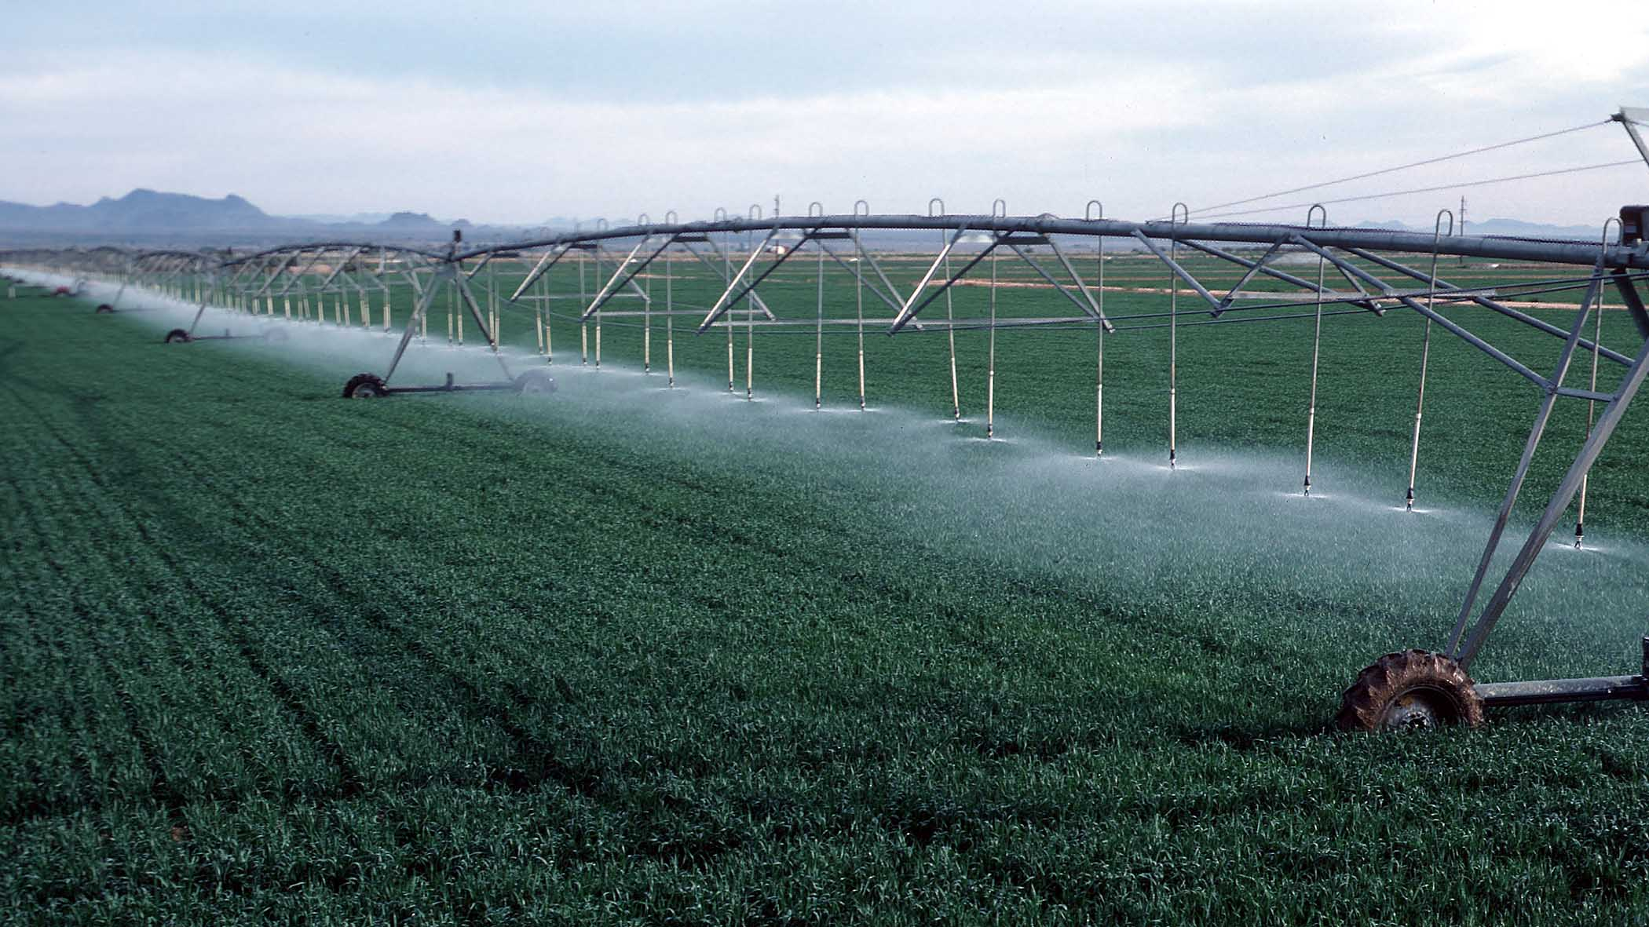
Call to Action
Develop an active water market where users can buy and sell water to fulfill their needs

