Slide 1
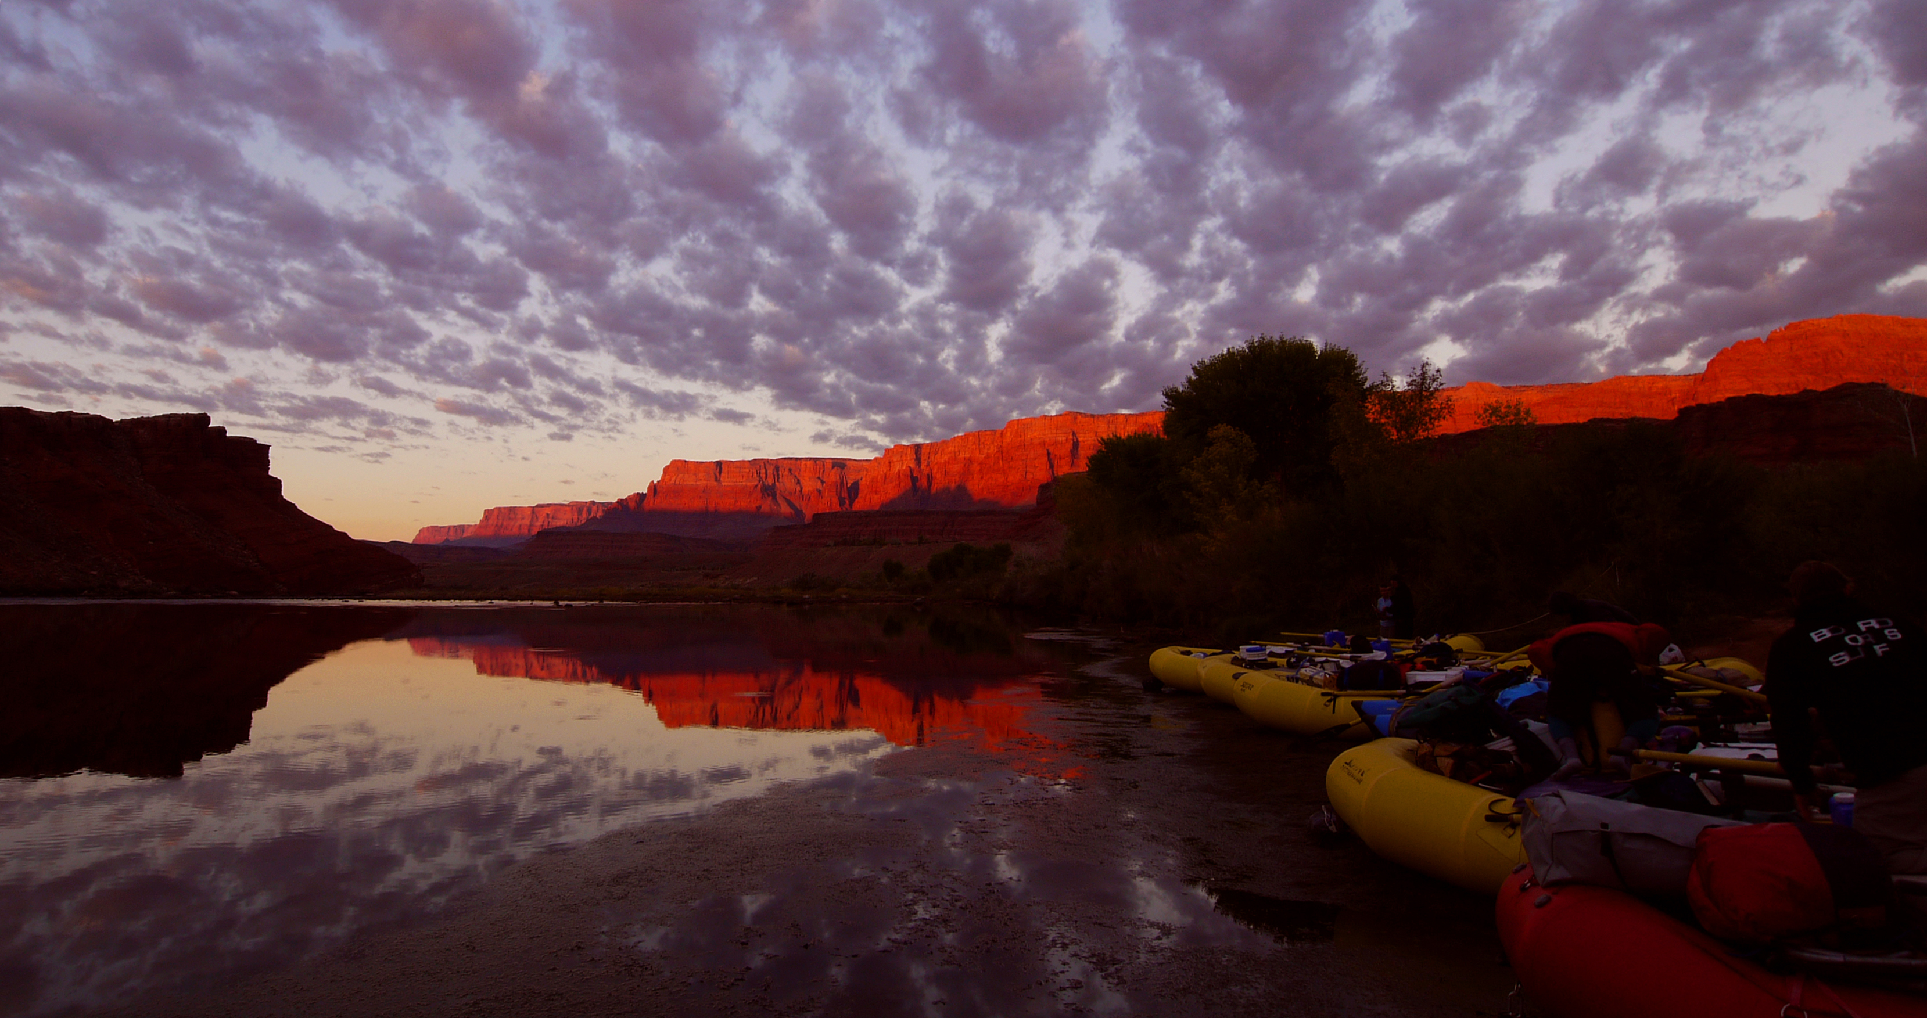
Wood’s High Mountain Distillery
Process and waste water problem

Slide 2
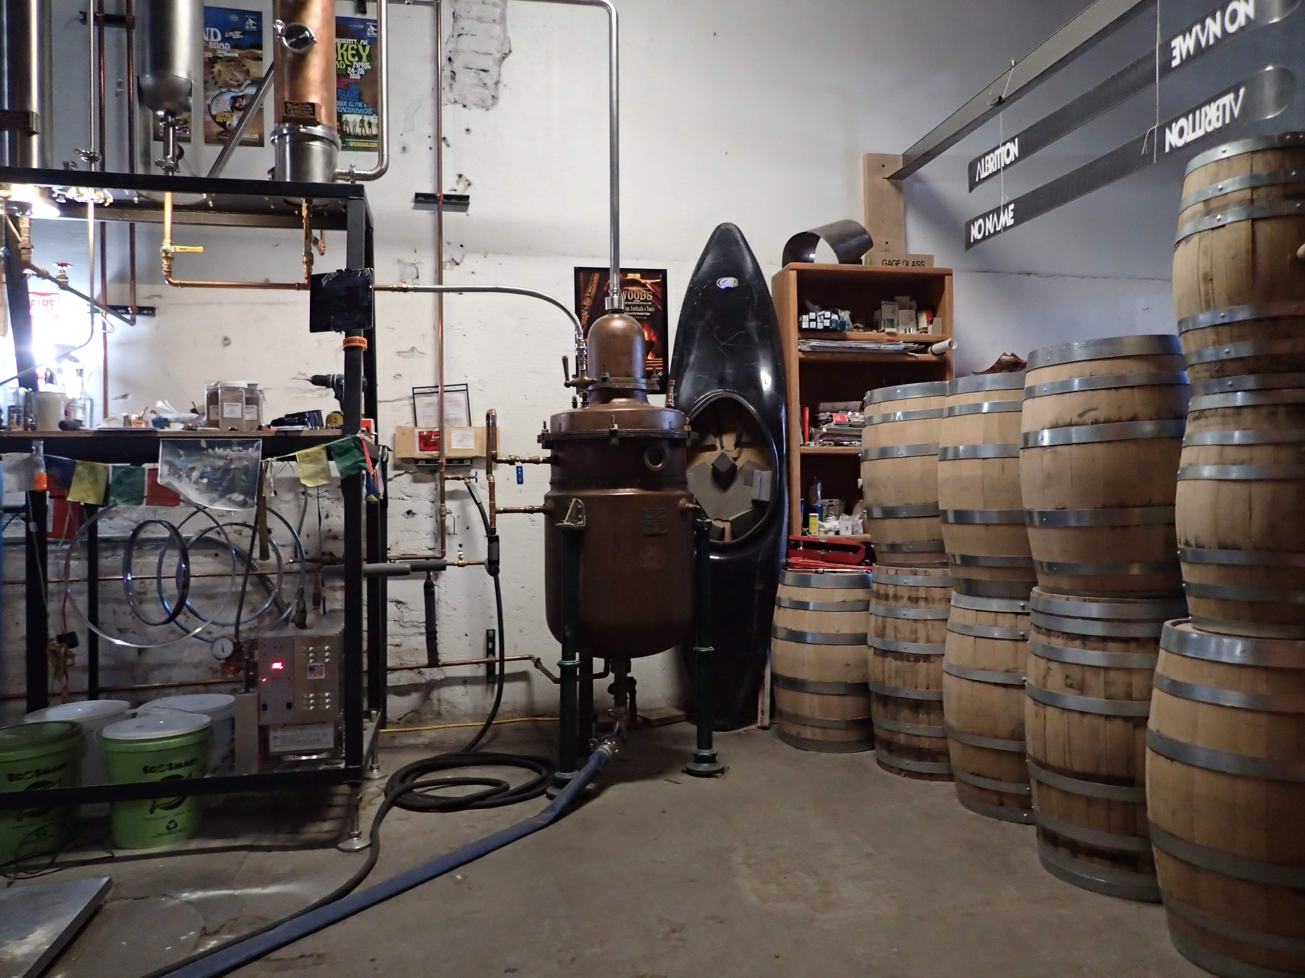
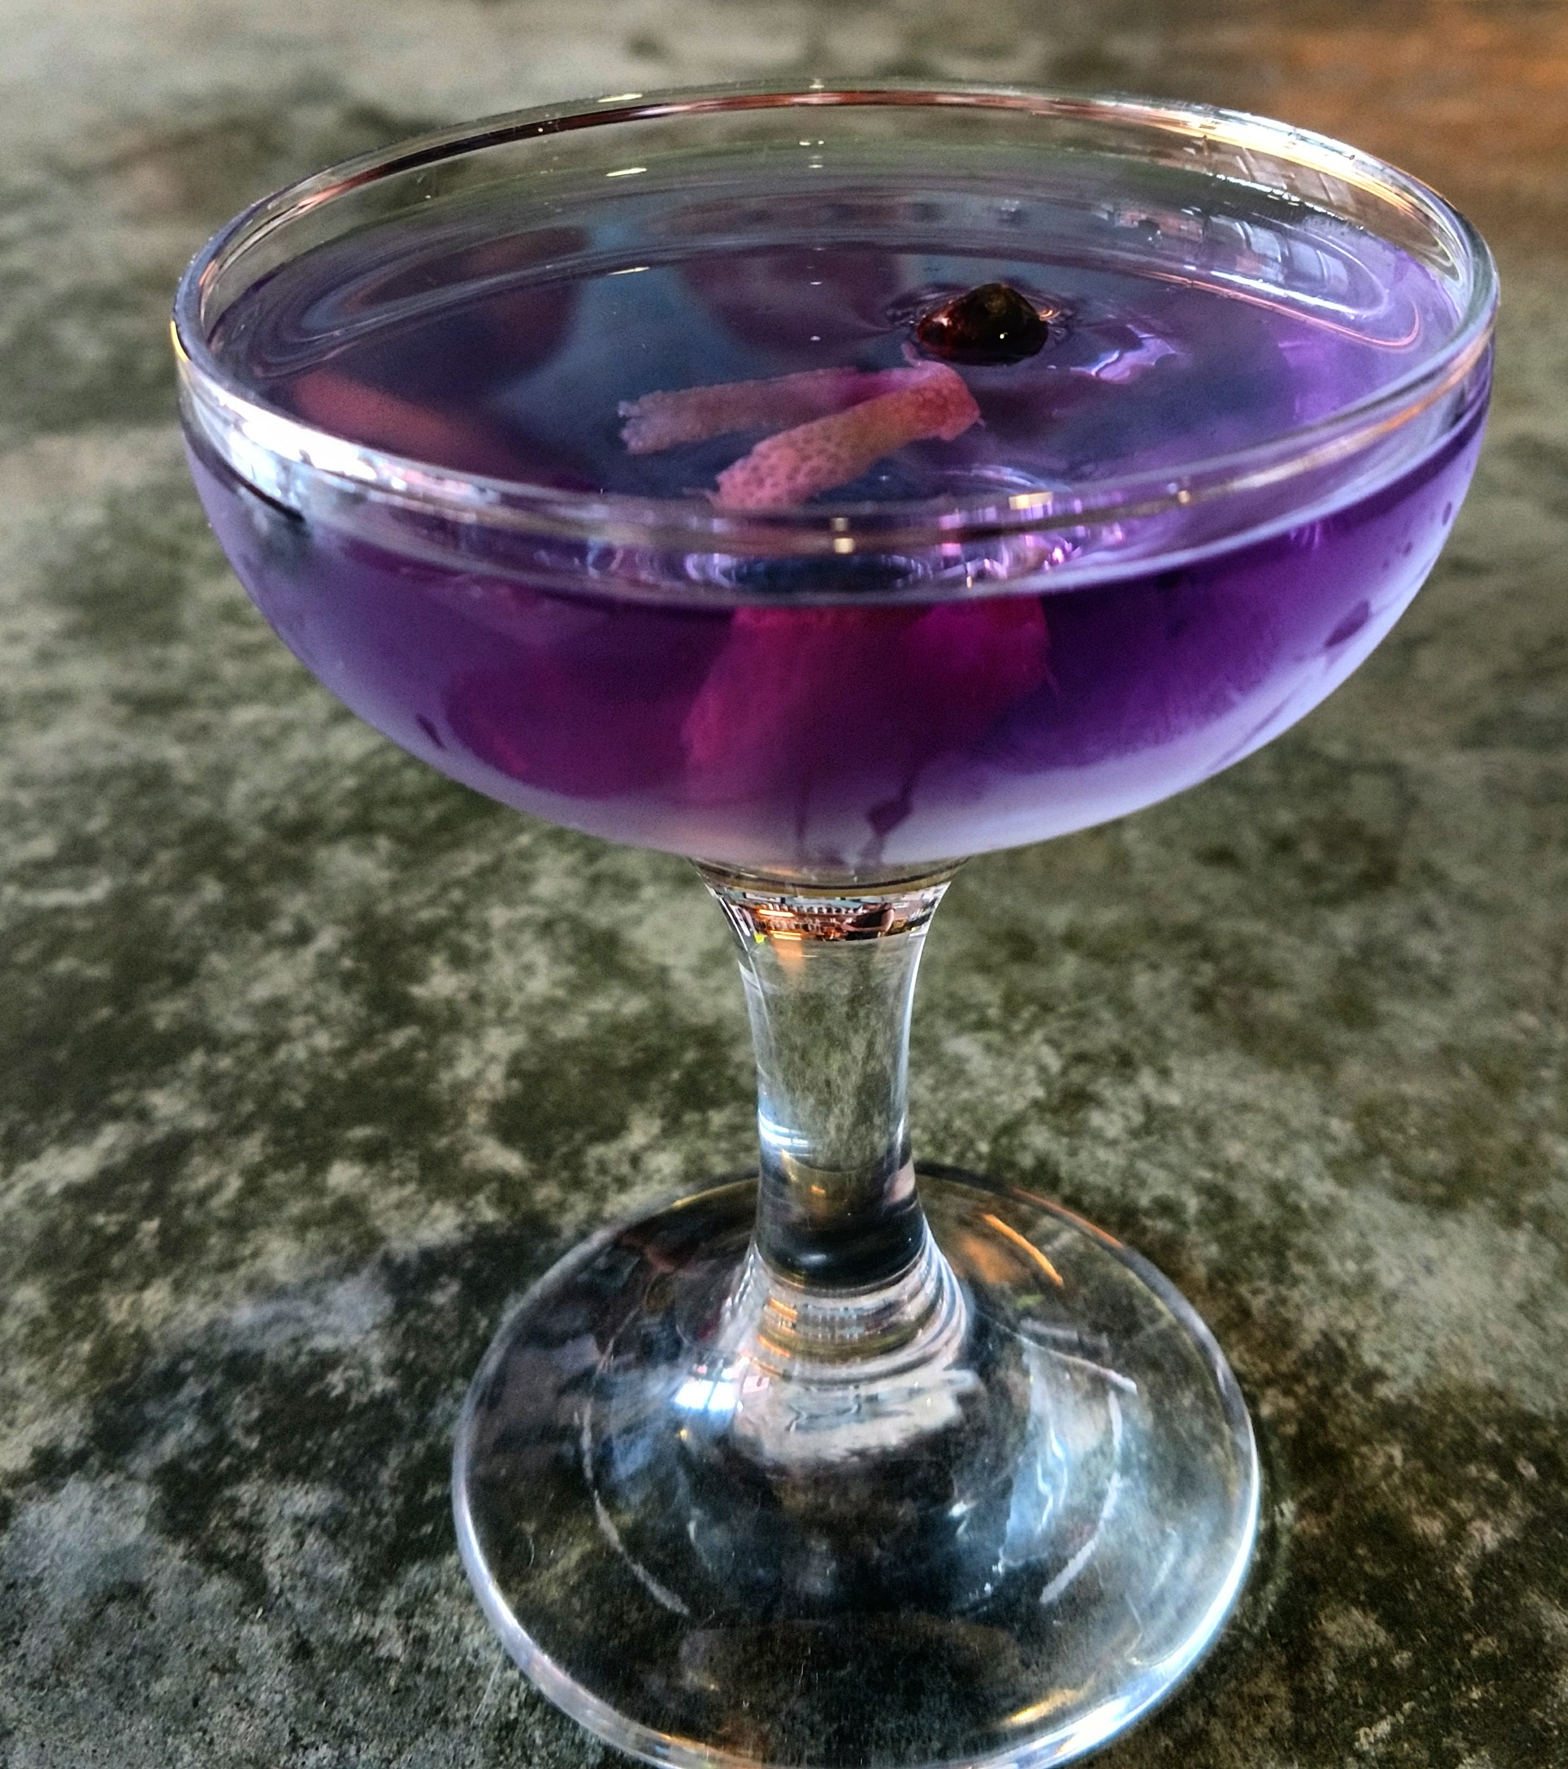
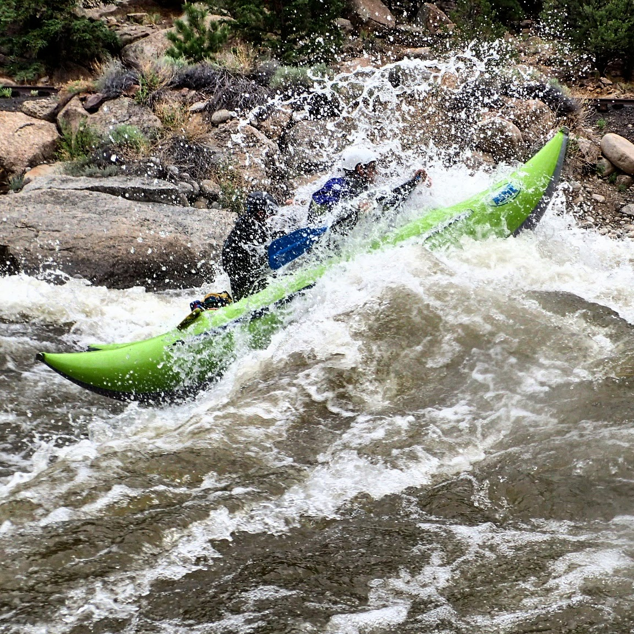
Two problems
Process
Waste water
Hundreds of gallons of clean warm to hot potable water down the drain
Stillage-high bod-high tss-low ph possible alcohol
Cleaning water-Chemicals
Heads &tails High alcohol

Slide 3
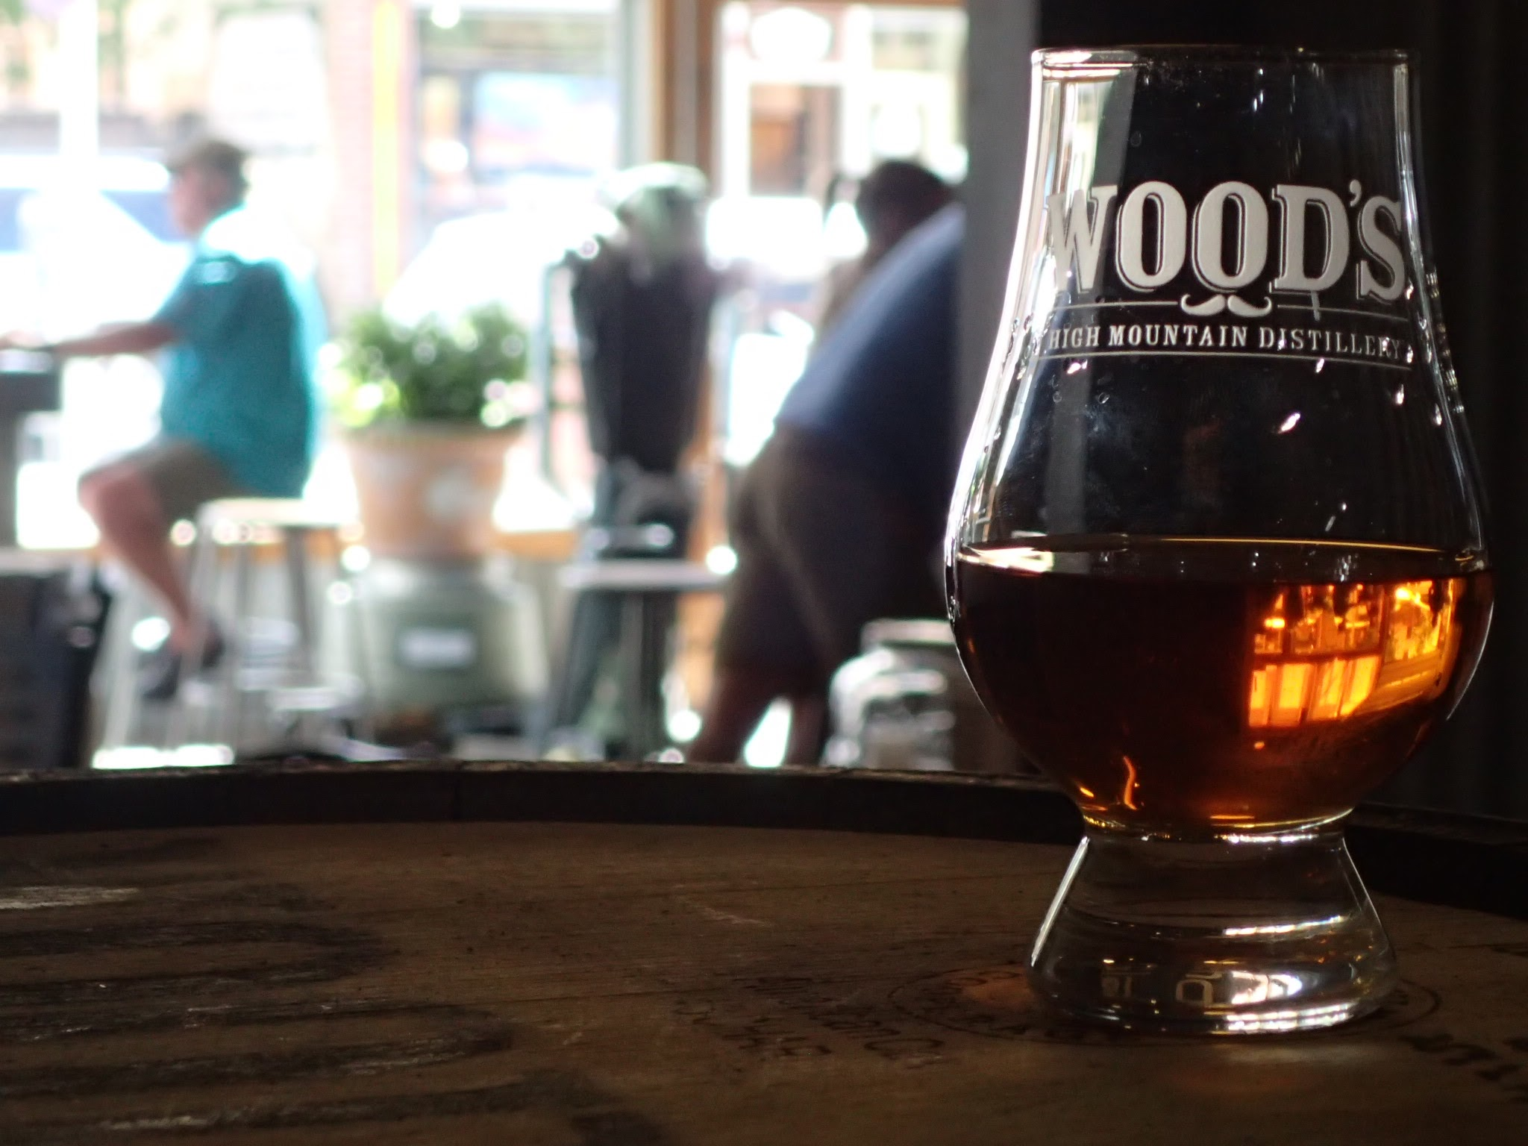
The Market
1400 Craft distilleries in us and growing
Most are small less than 2000 cases (9l)
Lacking or rudimentary treatment
On average Distilleries use about 11 gallons of water to 1 gallon of spirit

Slide 4
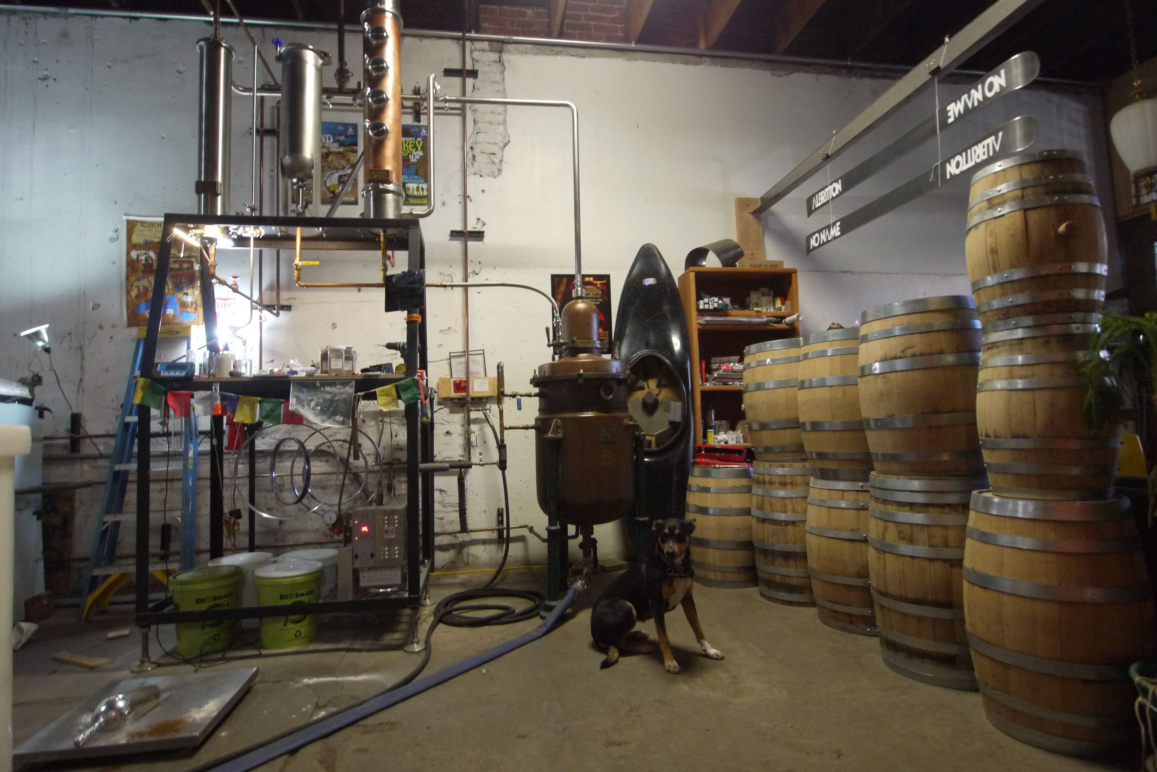
Existing Solutions process water
Use for next mash
Heat exchangers
Glycol chiller instead of water

Slide 5
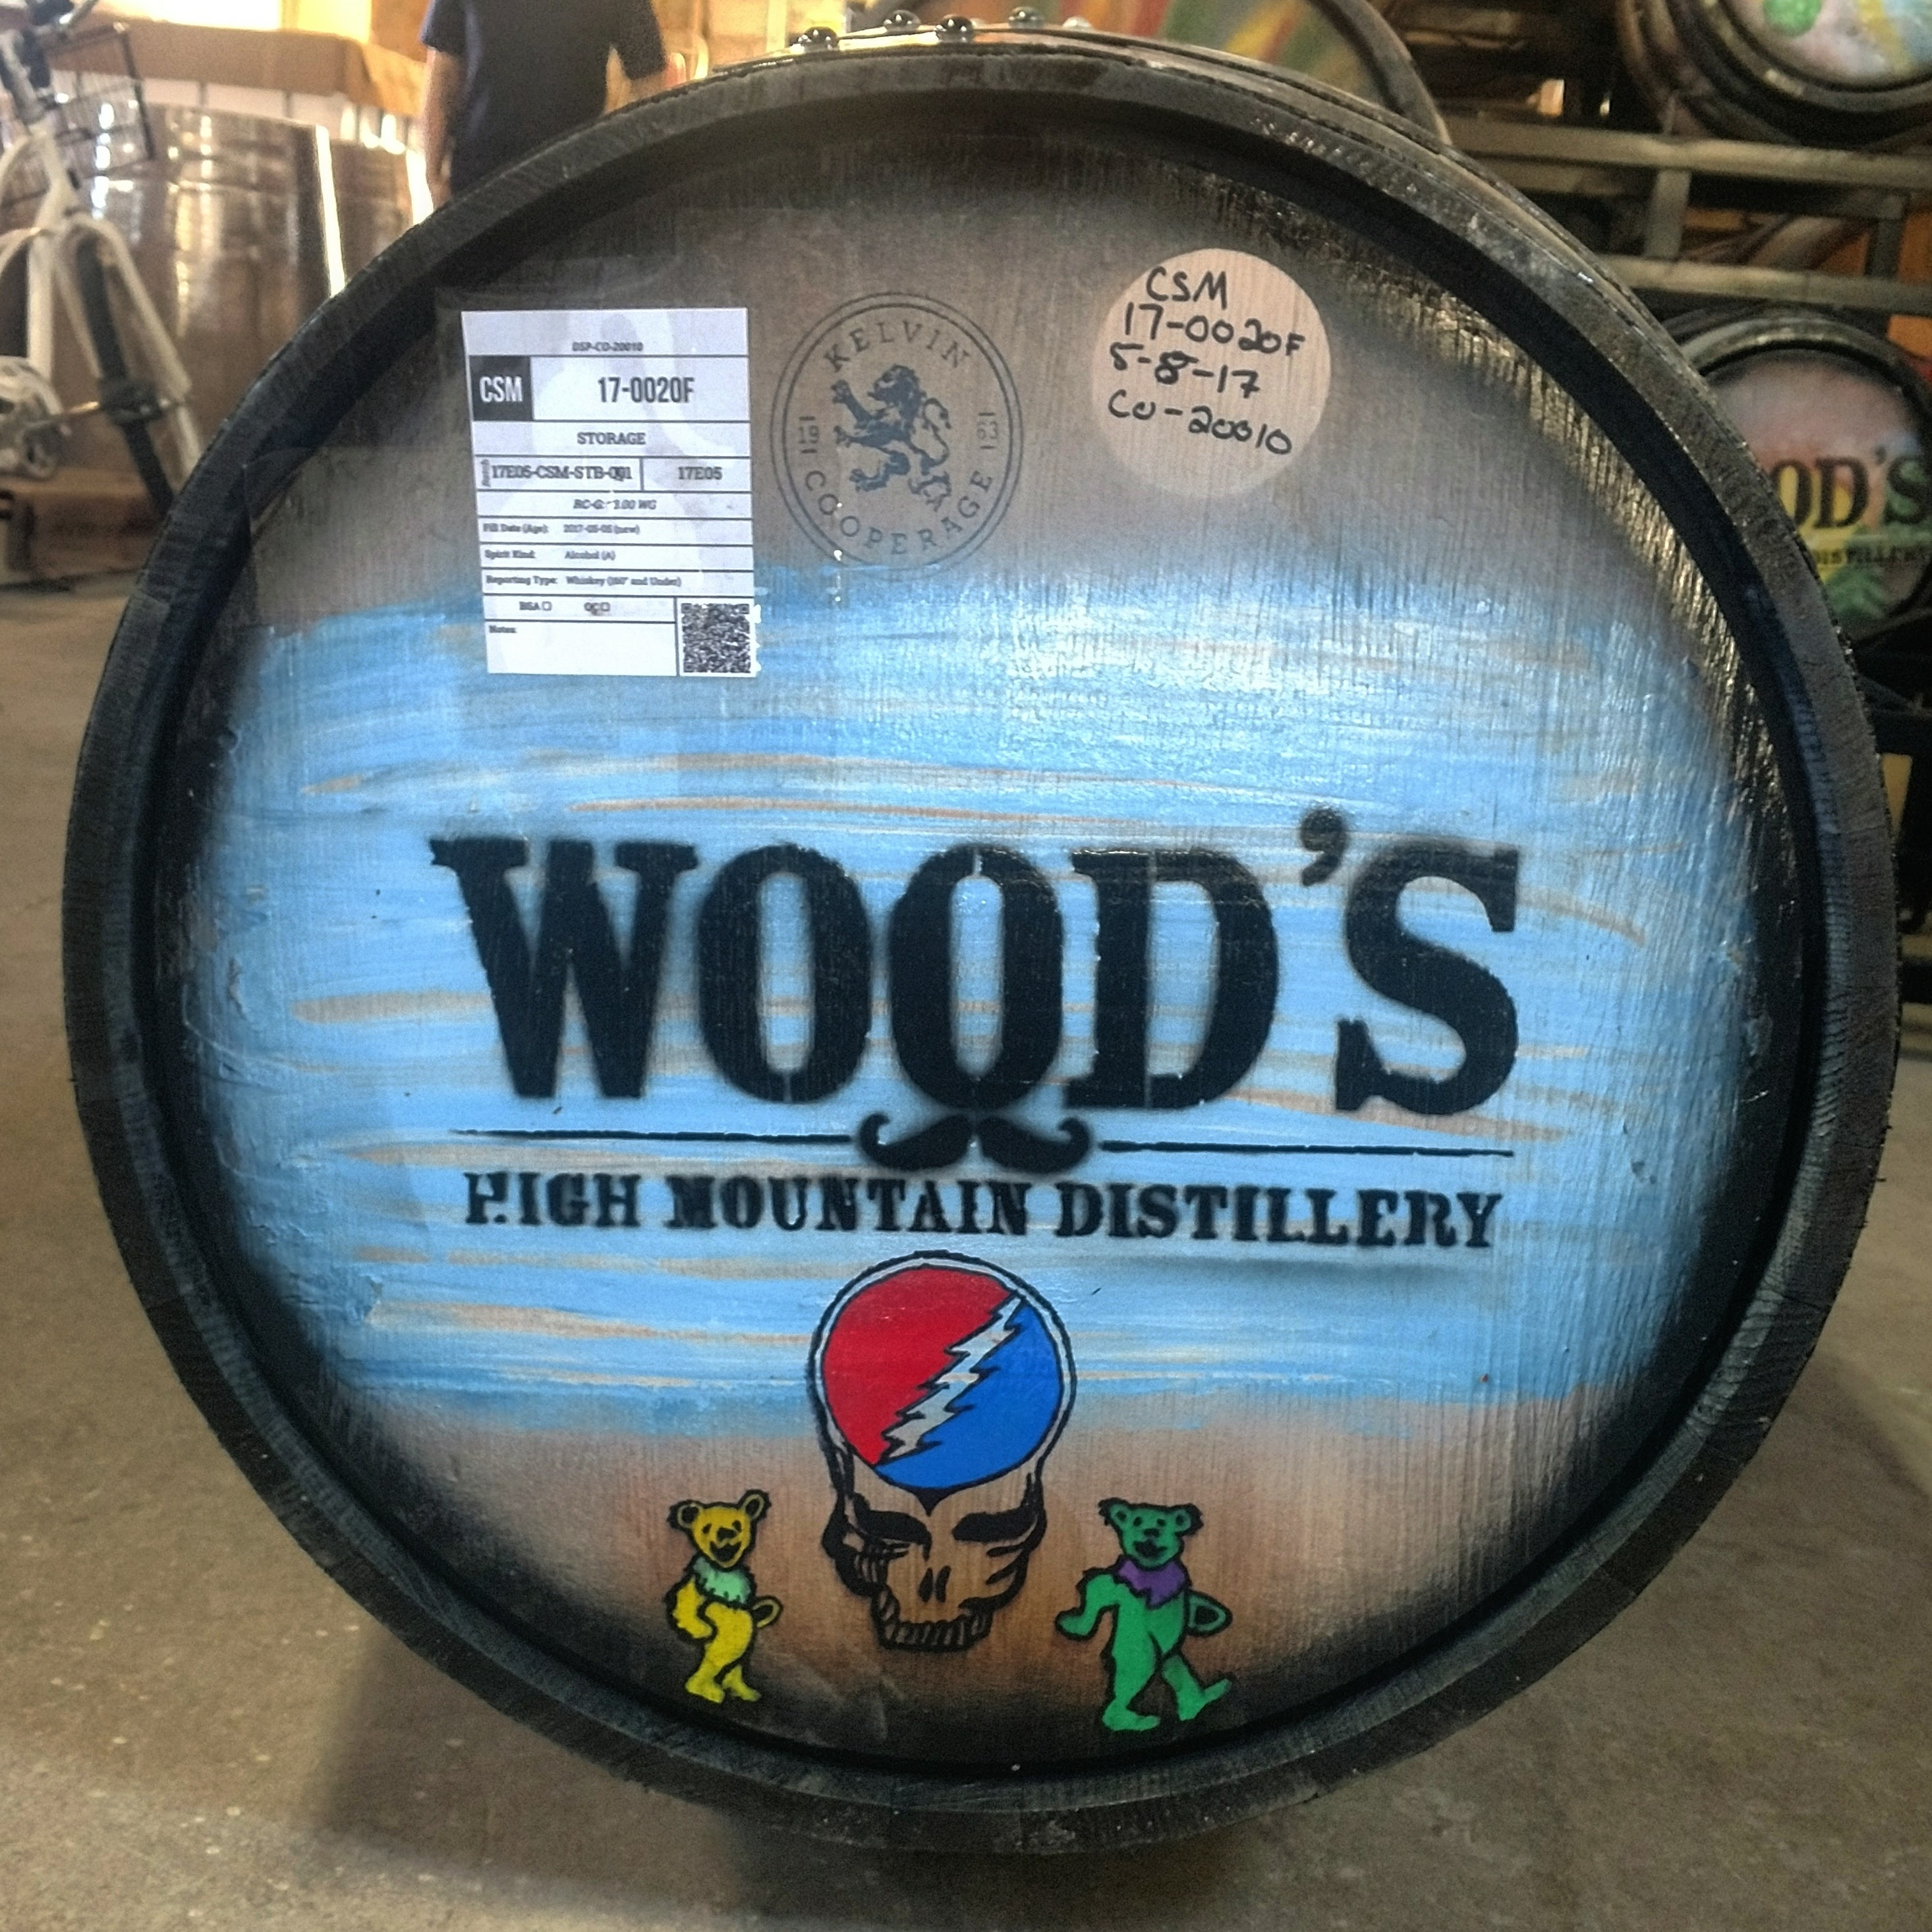
Existing Solutions
Dirty water
Waste water
Sewer
Landfill
Feed
composting
Waste to energy
Solid fuel boiler
Anaerobic digesters
wet gasification

Slide 6
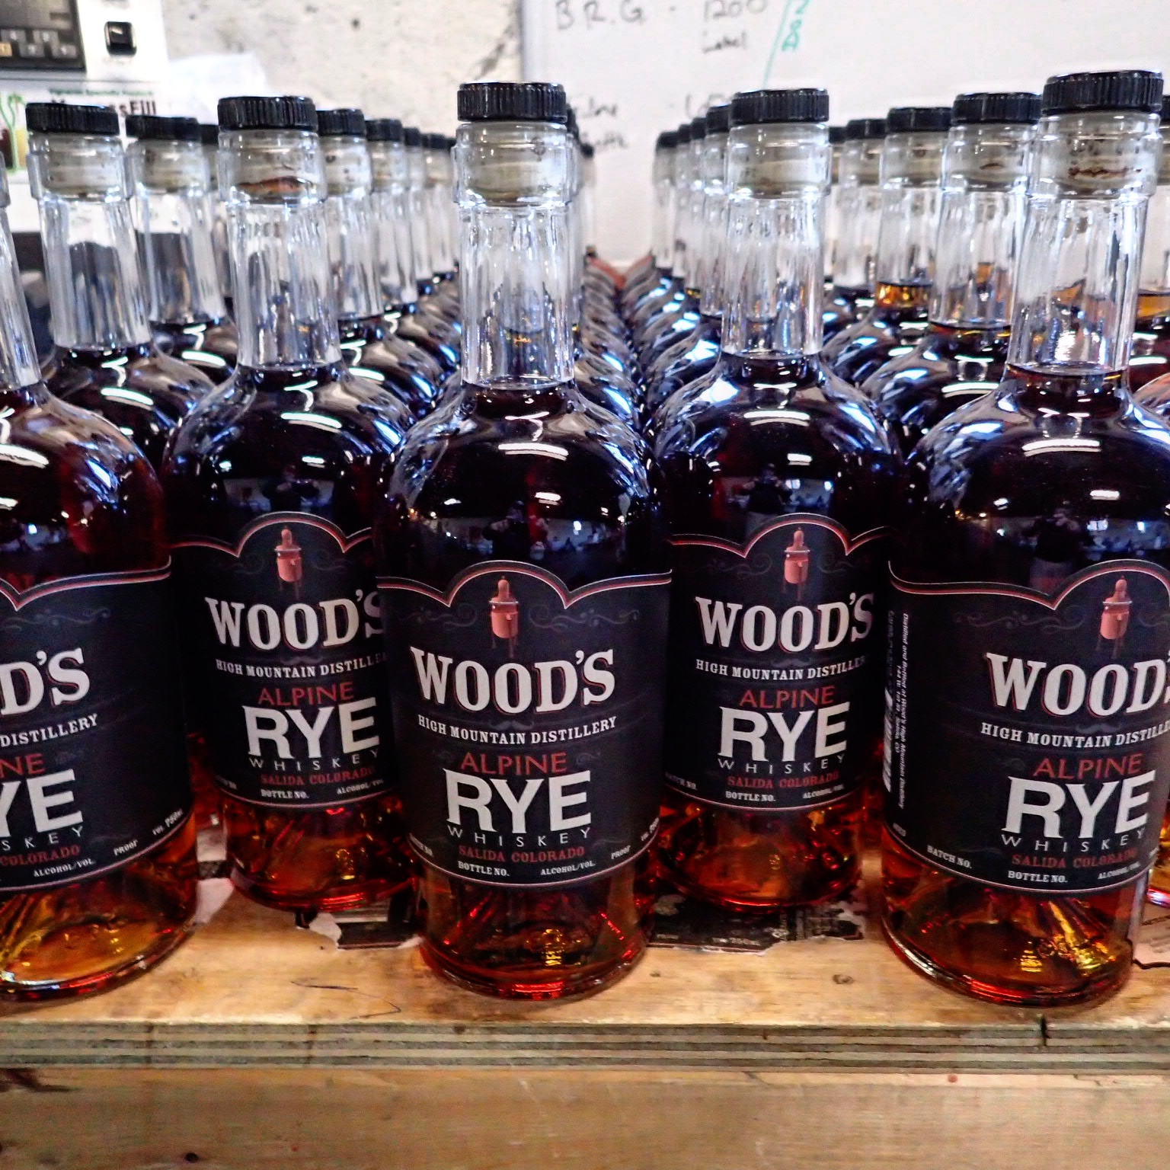
An actual Solution

Slide 7
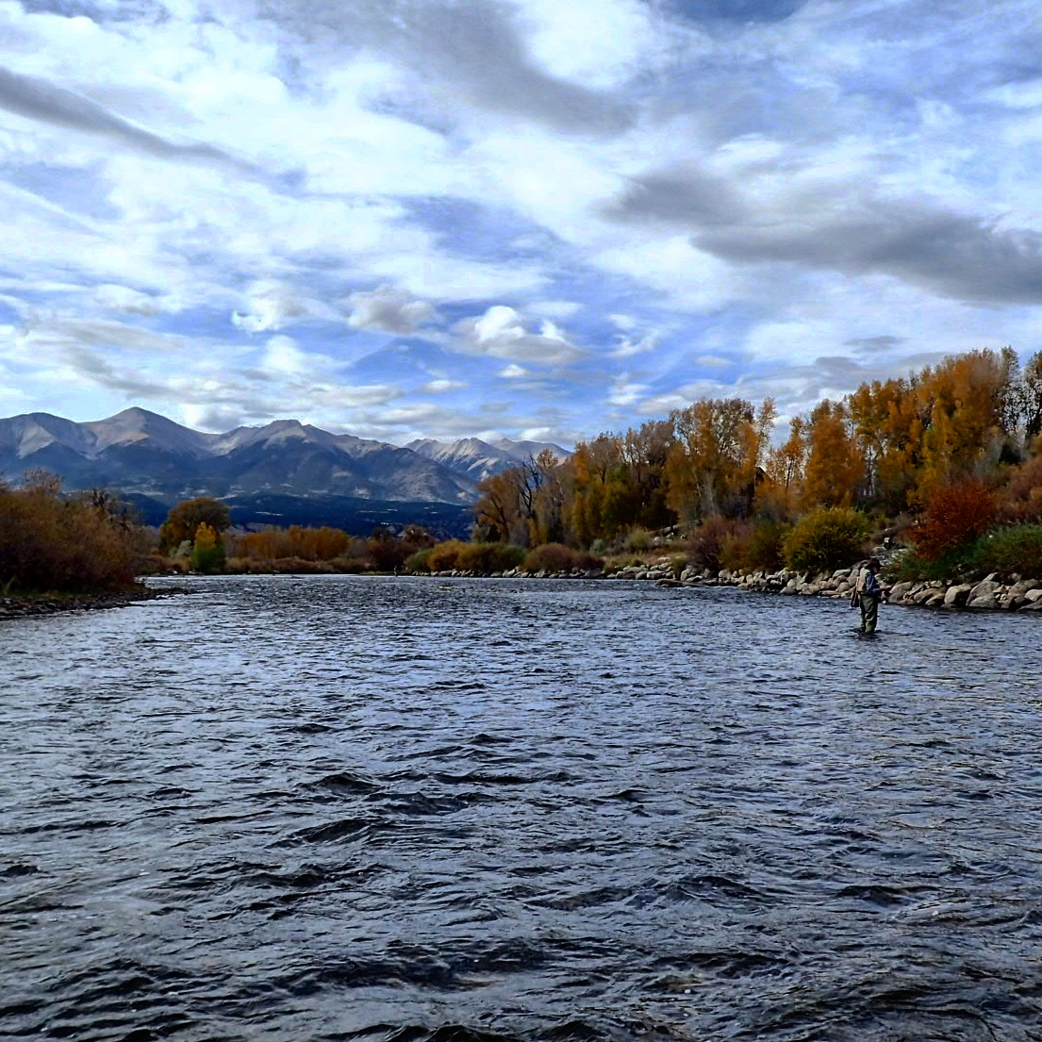
Why solve this? because of this!

