Slide 1
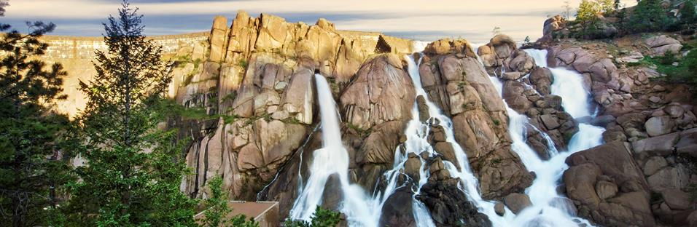
Smart Watering
Greg Fisher – Denver Water

Slide 2
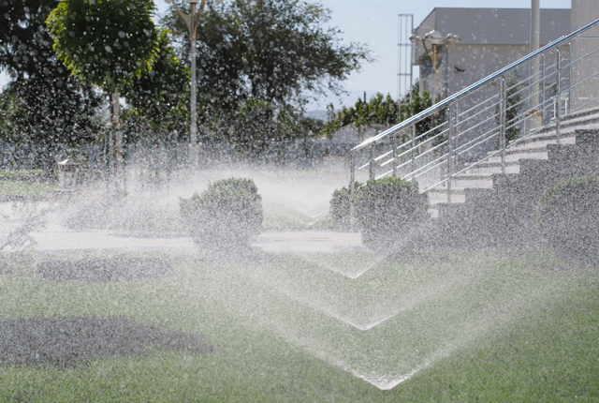
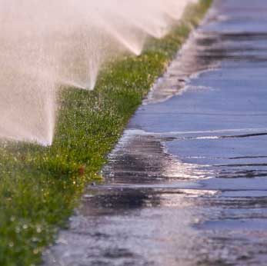
Notes:
My story is about sprinklers and lawn watering and the opportunity to save our customers 10s or even 100s of millions of dollars

Slide 3
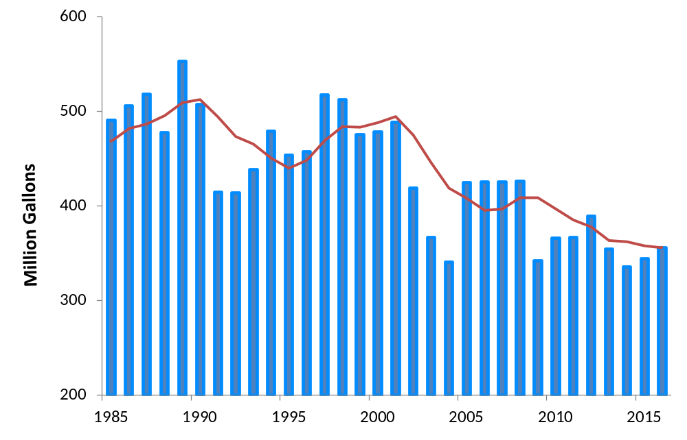
Denver Water Maximum Day Use

Slide 4

