Slide 1

Jennifer Riley-Chetwynd
Nicole Vasconi

Slide 2
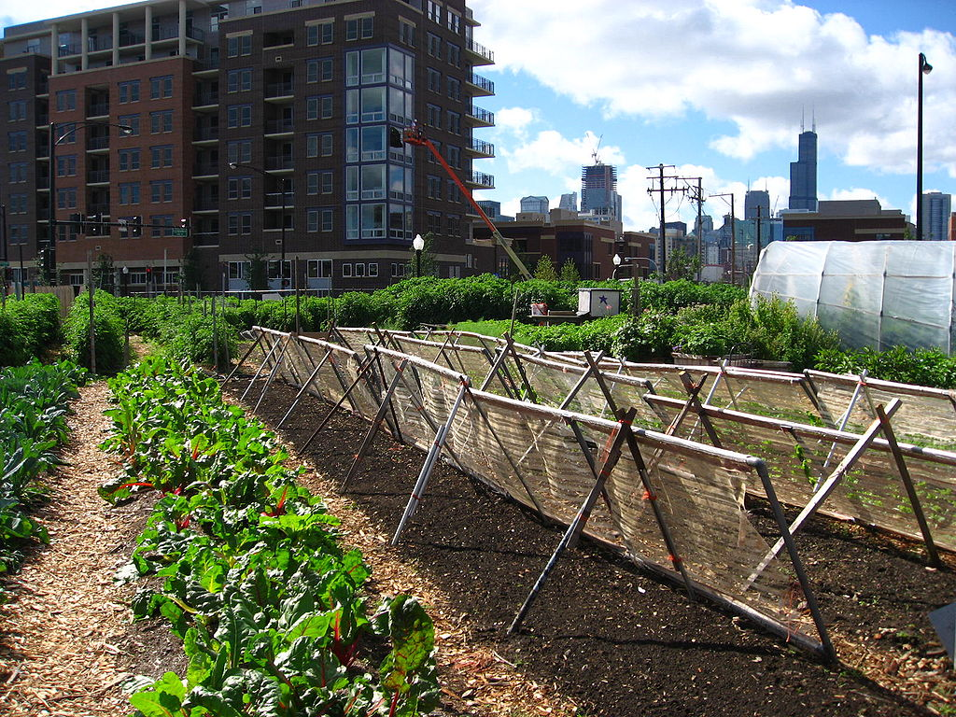
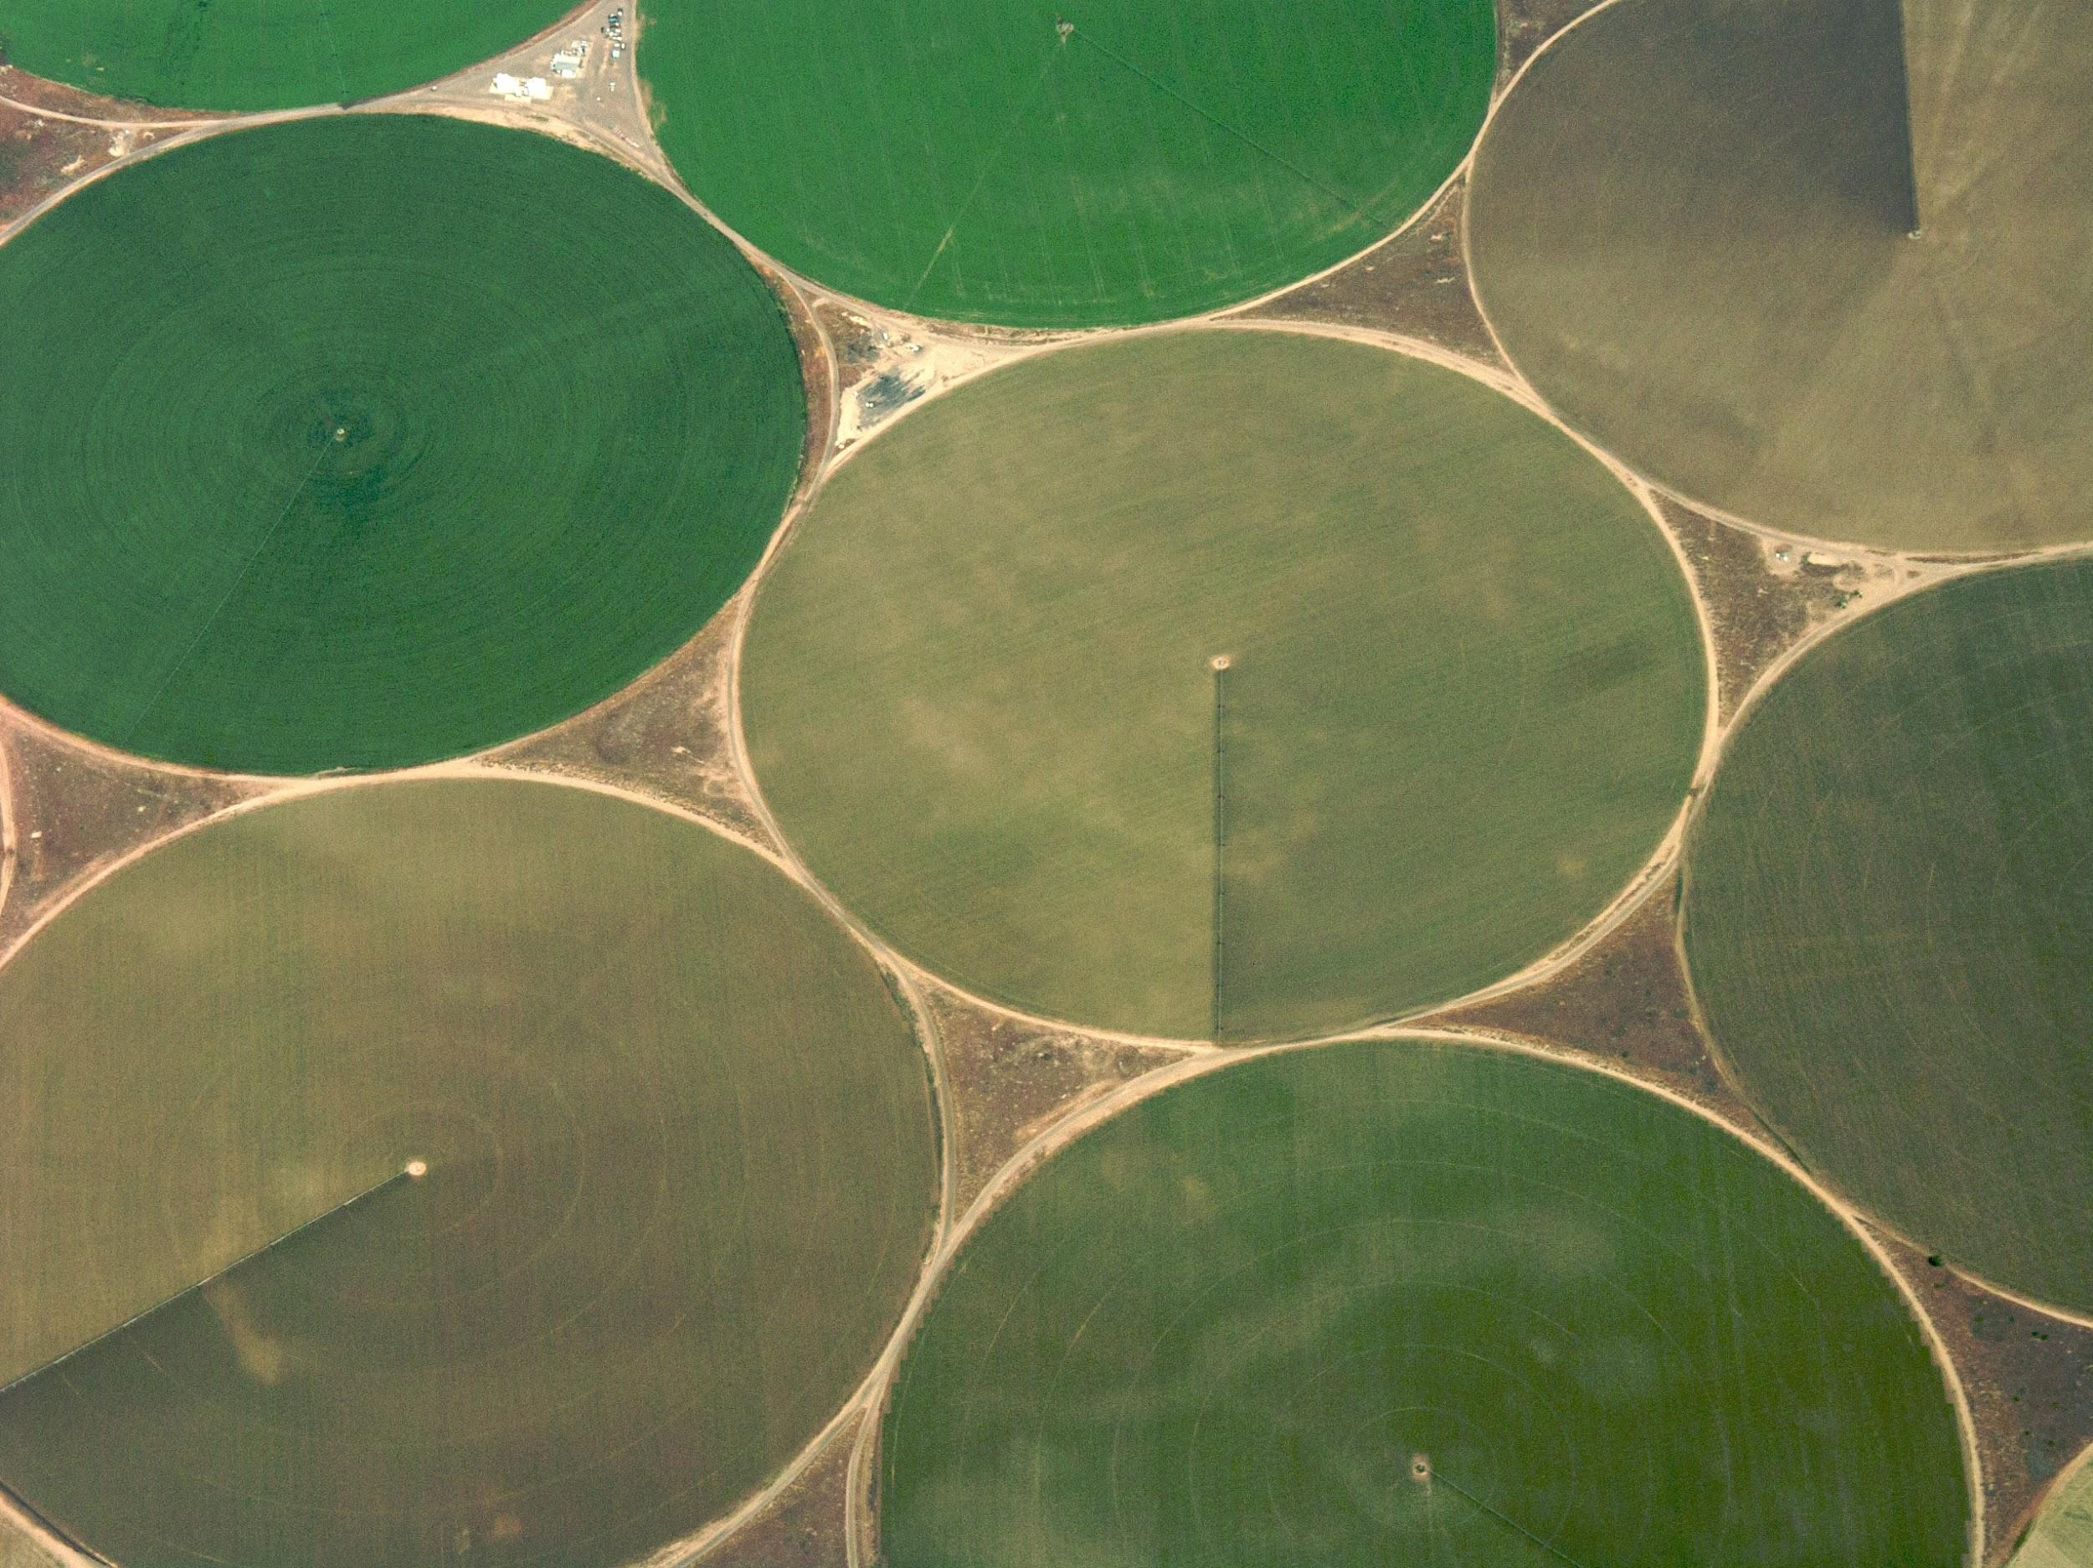
Opportunity = Food

Slide 3
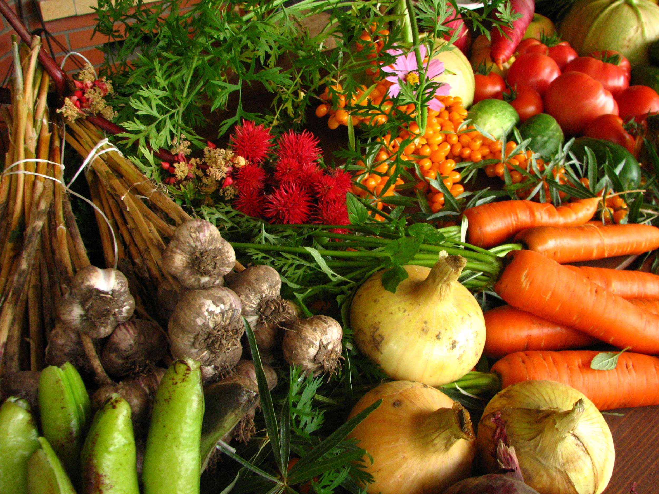
Growing market:
20% global food production = urban
Feeding 800 million people
New York City as example:
        $1 billion produce market
Vertical farming = $5.8 billion
global market by 2022
Sources: Global Urban Farming Market Report 2016-2021; Vertical Farming Market by Growth Mechanism - Global Forecast to 2022

Slide 4
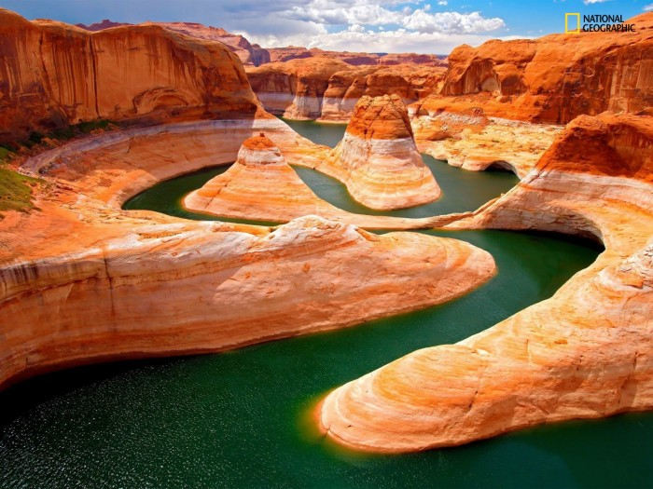
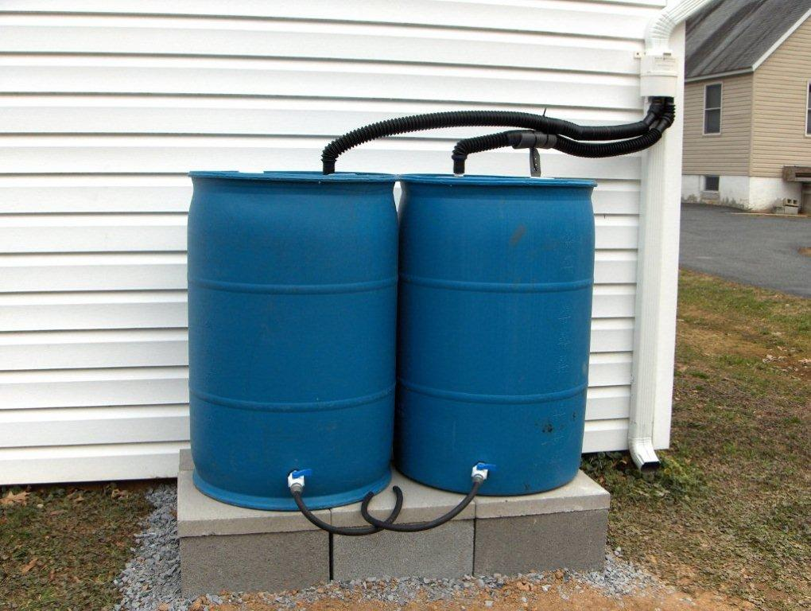
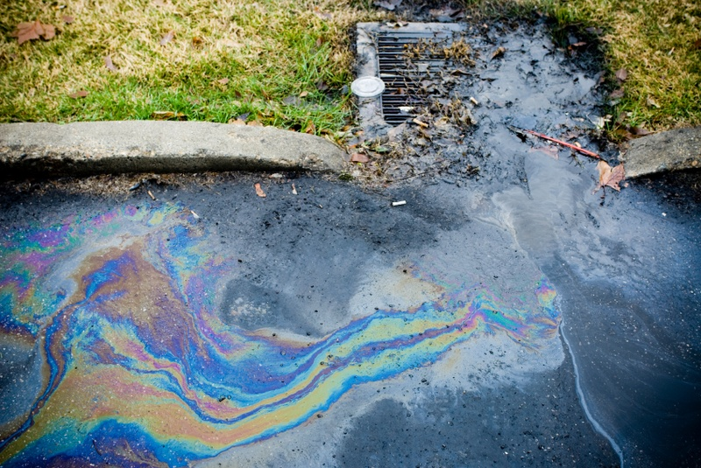
Shrinking resources – land and water

Slide 5
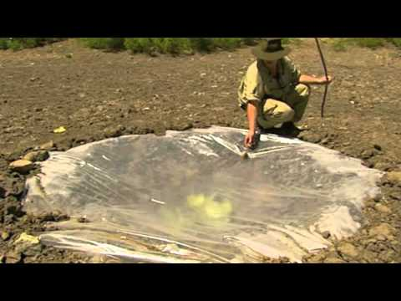
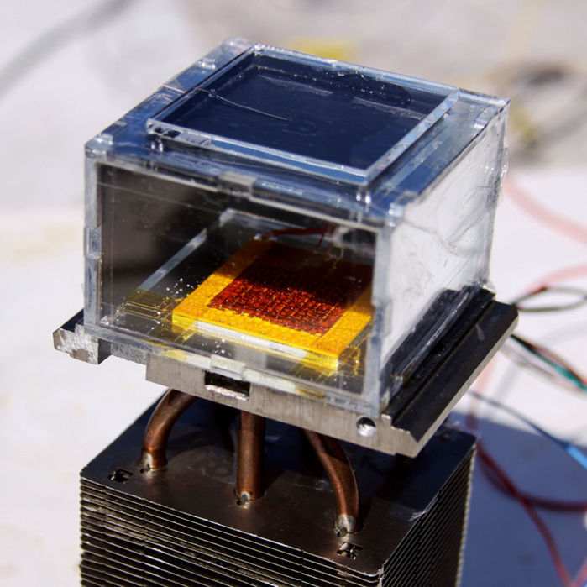

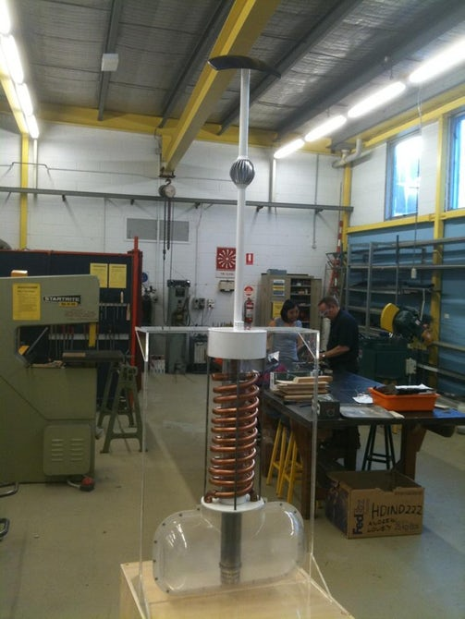
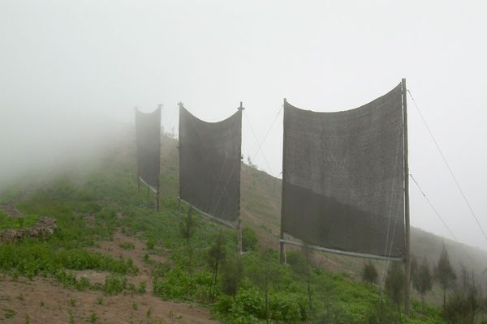
Atmospheric water harvesting: Examples
Image Credit: Ray Mears
Image Credit: Wang Laboratory, MIT
Image Credit: EoleWater
Image Credit: James Dyson Award
Image Credit: FogQuest

Slide 6
Proposal
A small-scale atmospheric water harvester that is
-Easy to use
-Marketable
-Suited for arid and semi-arid climates

Slide 7
Impacts
Environmental
Social
Political

Slide 8
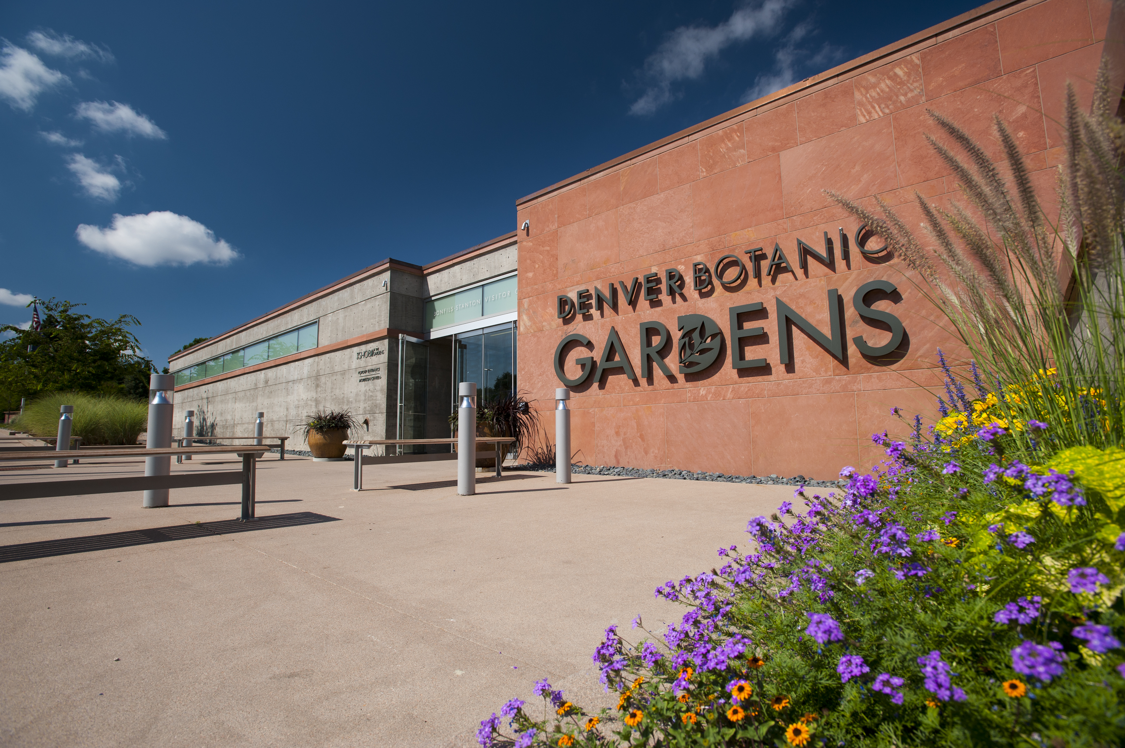
What Denver Botanic Gardens brings to the table
-Two locations
-750 acres
-1.2 million annual visitors
-Connections and access to:
Community partners
500+ North American public gardens
International agriculture and horticultural partners

Slide 9
Your laboratory
Your marketing partner
Your access to local, national and global markets

