Slide 1

Solving the Problem of Water Loss: How Can You Help?
MaryAnn Nason
City of Boulder
Watershed Sustainability & Outreach Supervisor
Notes:
“Solving the Problem of Water Loss”, because, saving water is the cheapest water.

Slide 2
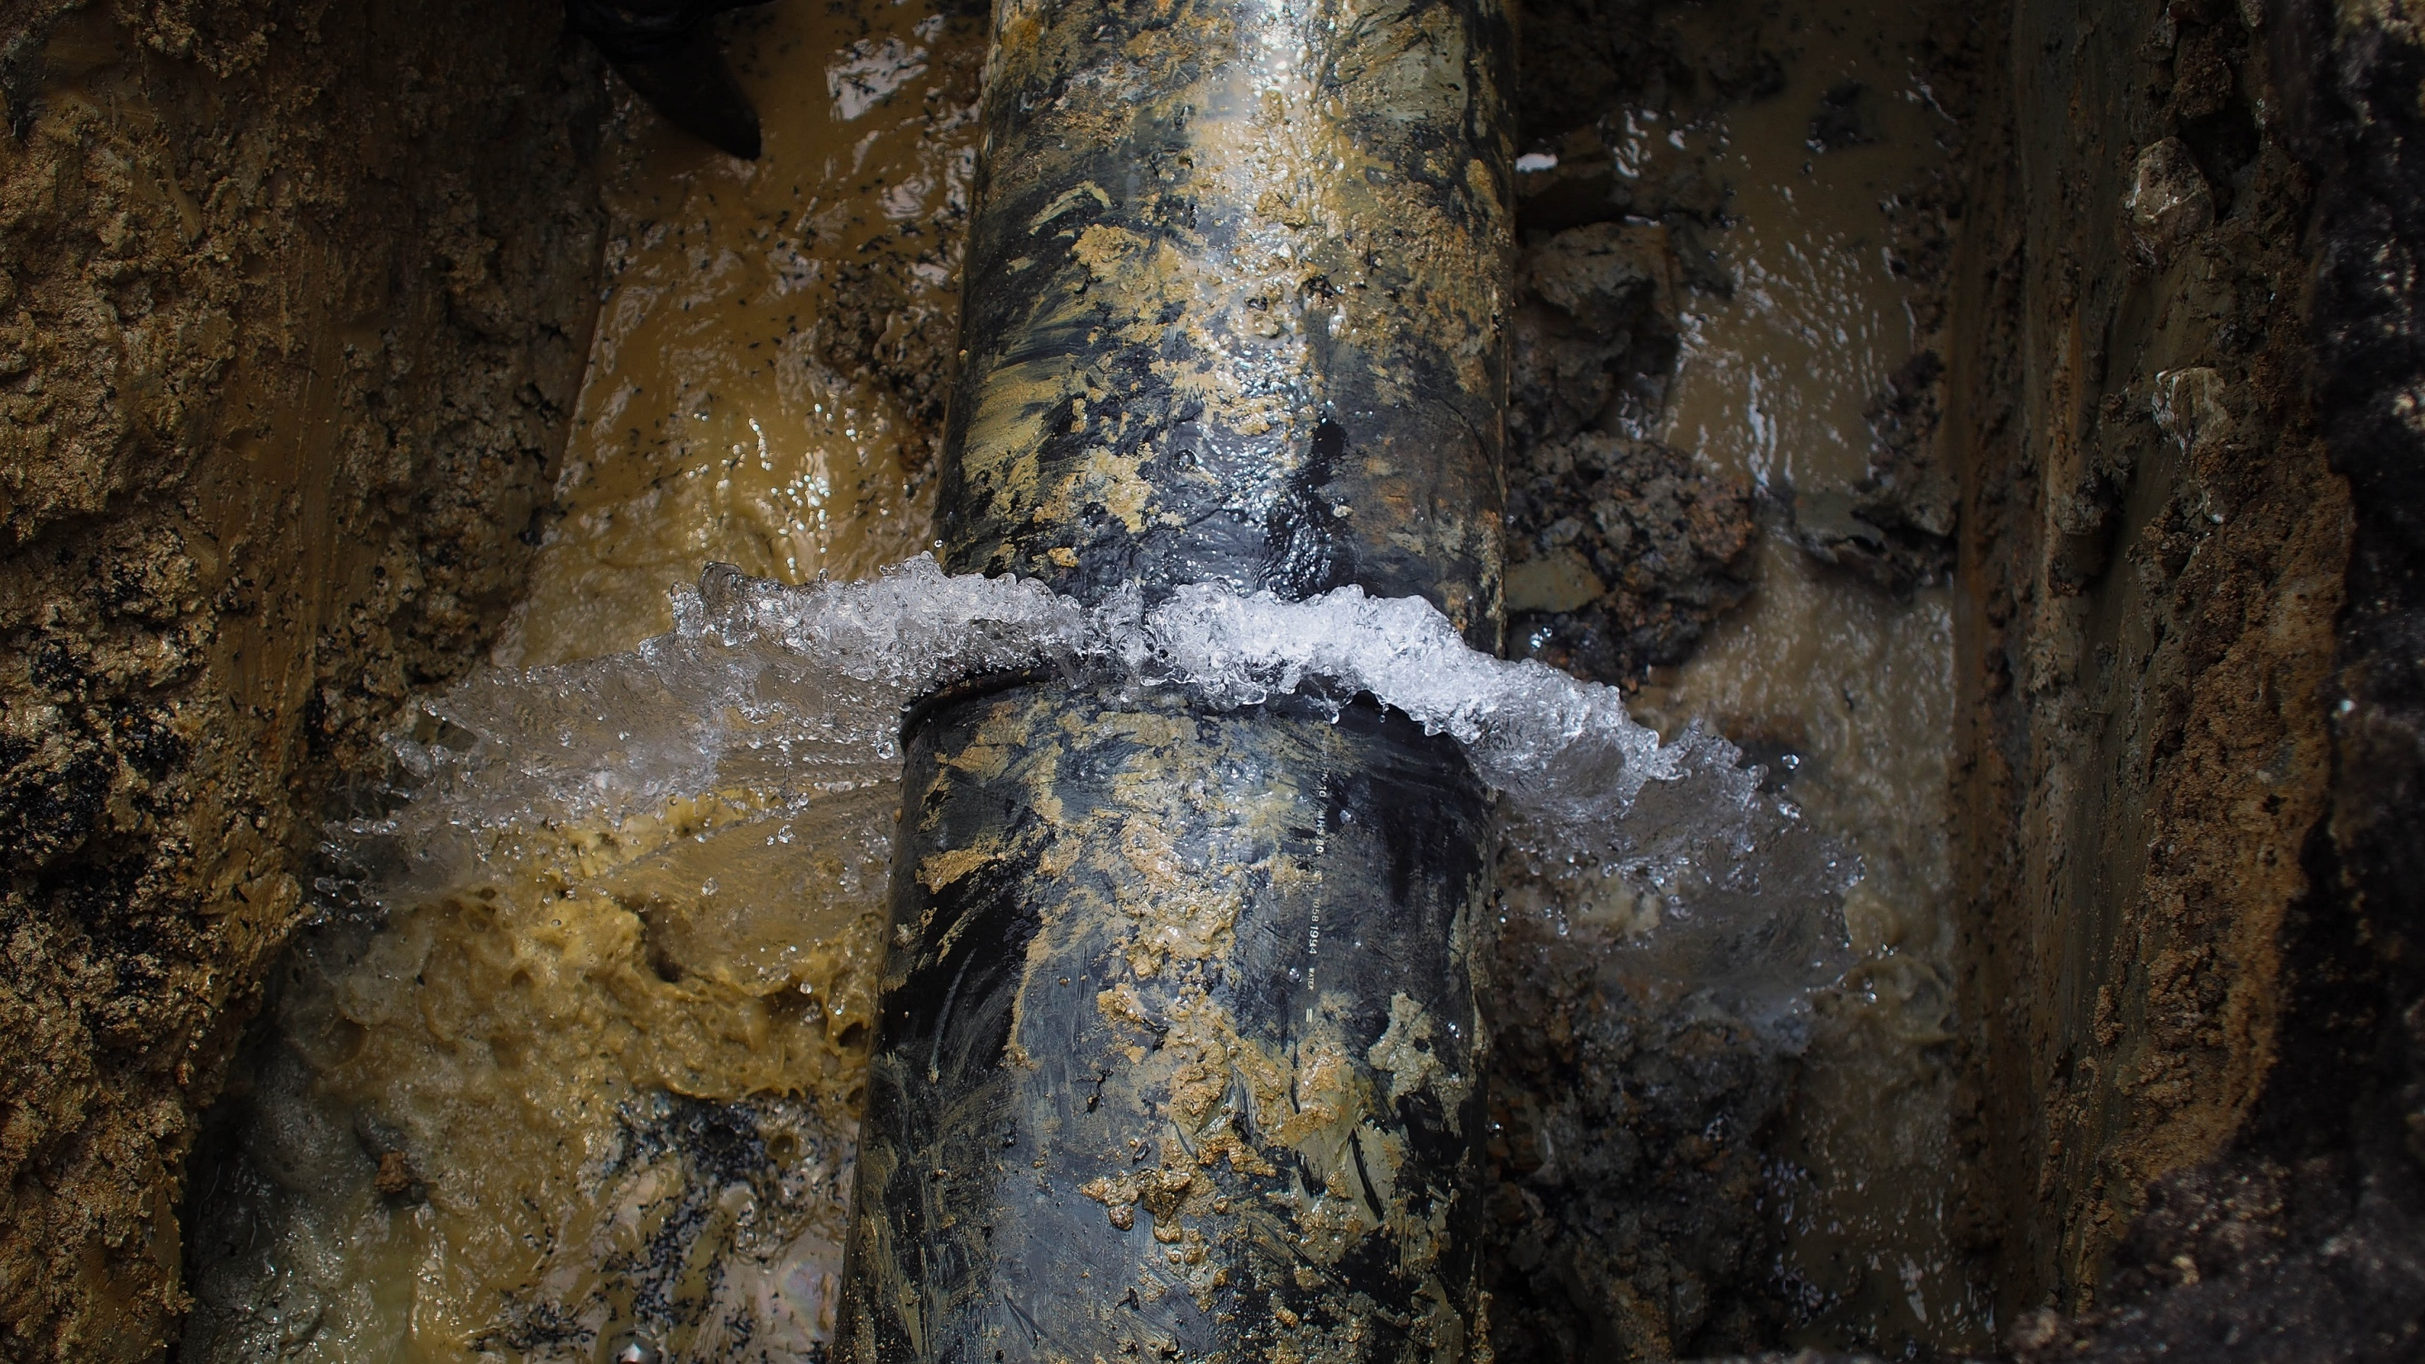
2 minutes
A water main breaks in the U.S. every
Notes:
Every two minutes there is a water main break in the U.S.

Slide 3
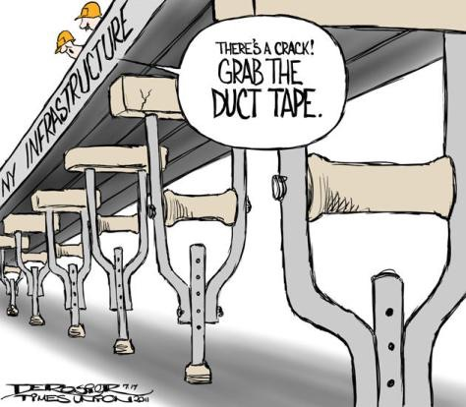
Notes:
U.S. infrastructure is in need of help. Just this year, the American Society of Civil Engineers graded the U.S. water infrastructure as a “D+” or just above failing.

Slide 4
$1 Trillion
in investment over the next 25 years
Notes:
Restore and Expand
Until we catch up

Slide 5
$30,000
Per Acre Foot
$10,000
Per Acre Foot
2015
2011
Notes:
New water supply sources are difficult to come by, demand goes up, so does the cost of water.
current water supply sources go farther, can help
Fixing water leaks can result in big savings. Ex…

Slide 6

Leak
Find the
Notes:
water leaks are a costly problem, and fixing them saves money

Slide 7
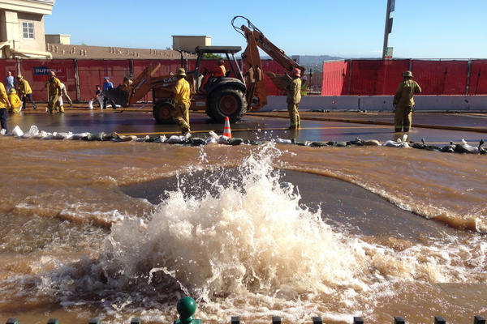
Notes:
Easy to find, ignoring leaks underneath

Slide 8
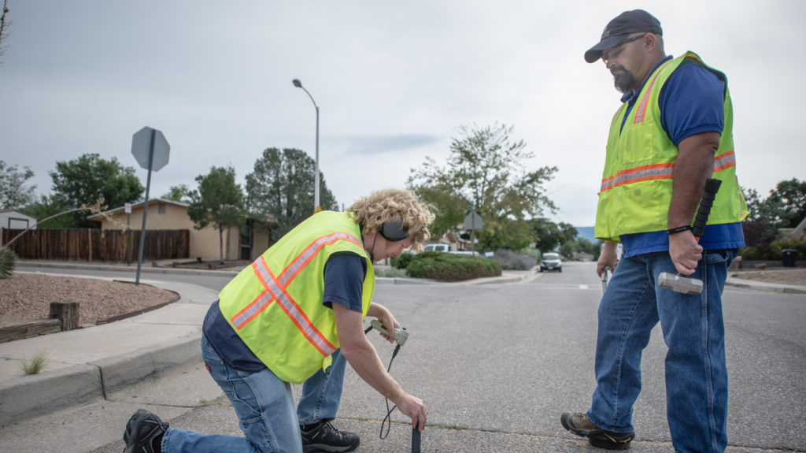
Notes:
Acoustic leak detection tests, they listen for water leaks.
Depending on how big and complex…

Slide 9
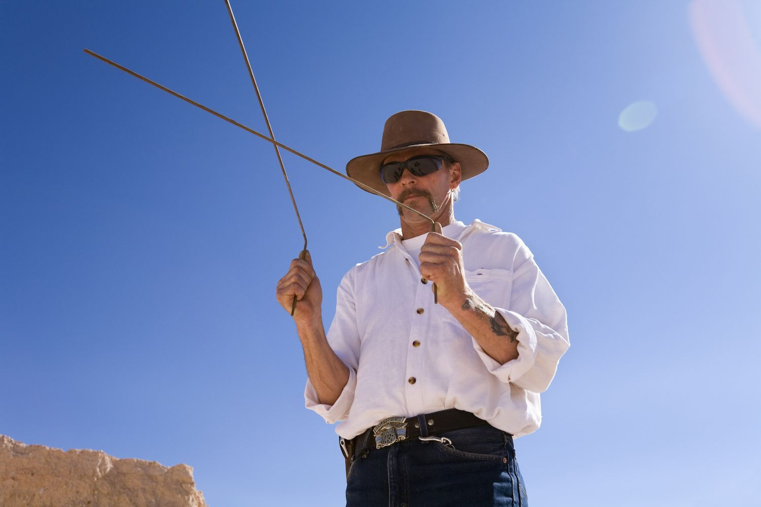
Notes:
Whether it works or not
With the fast pace of technology advancement that we see today

Slide 10
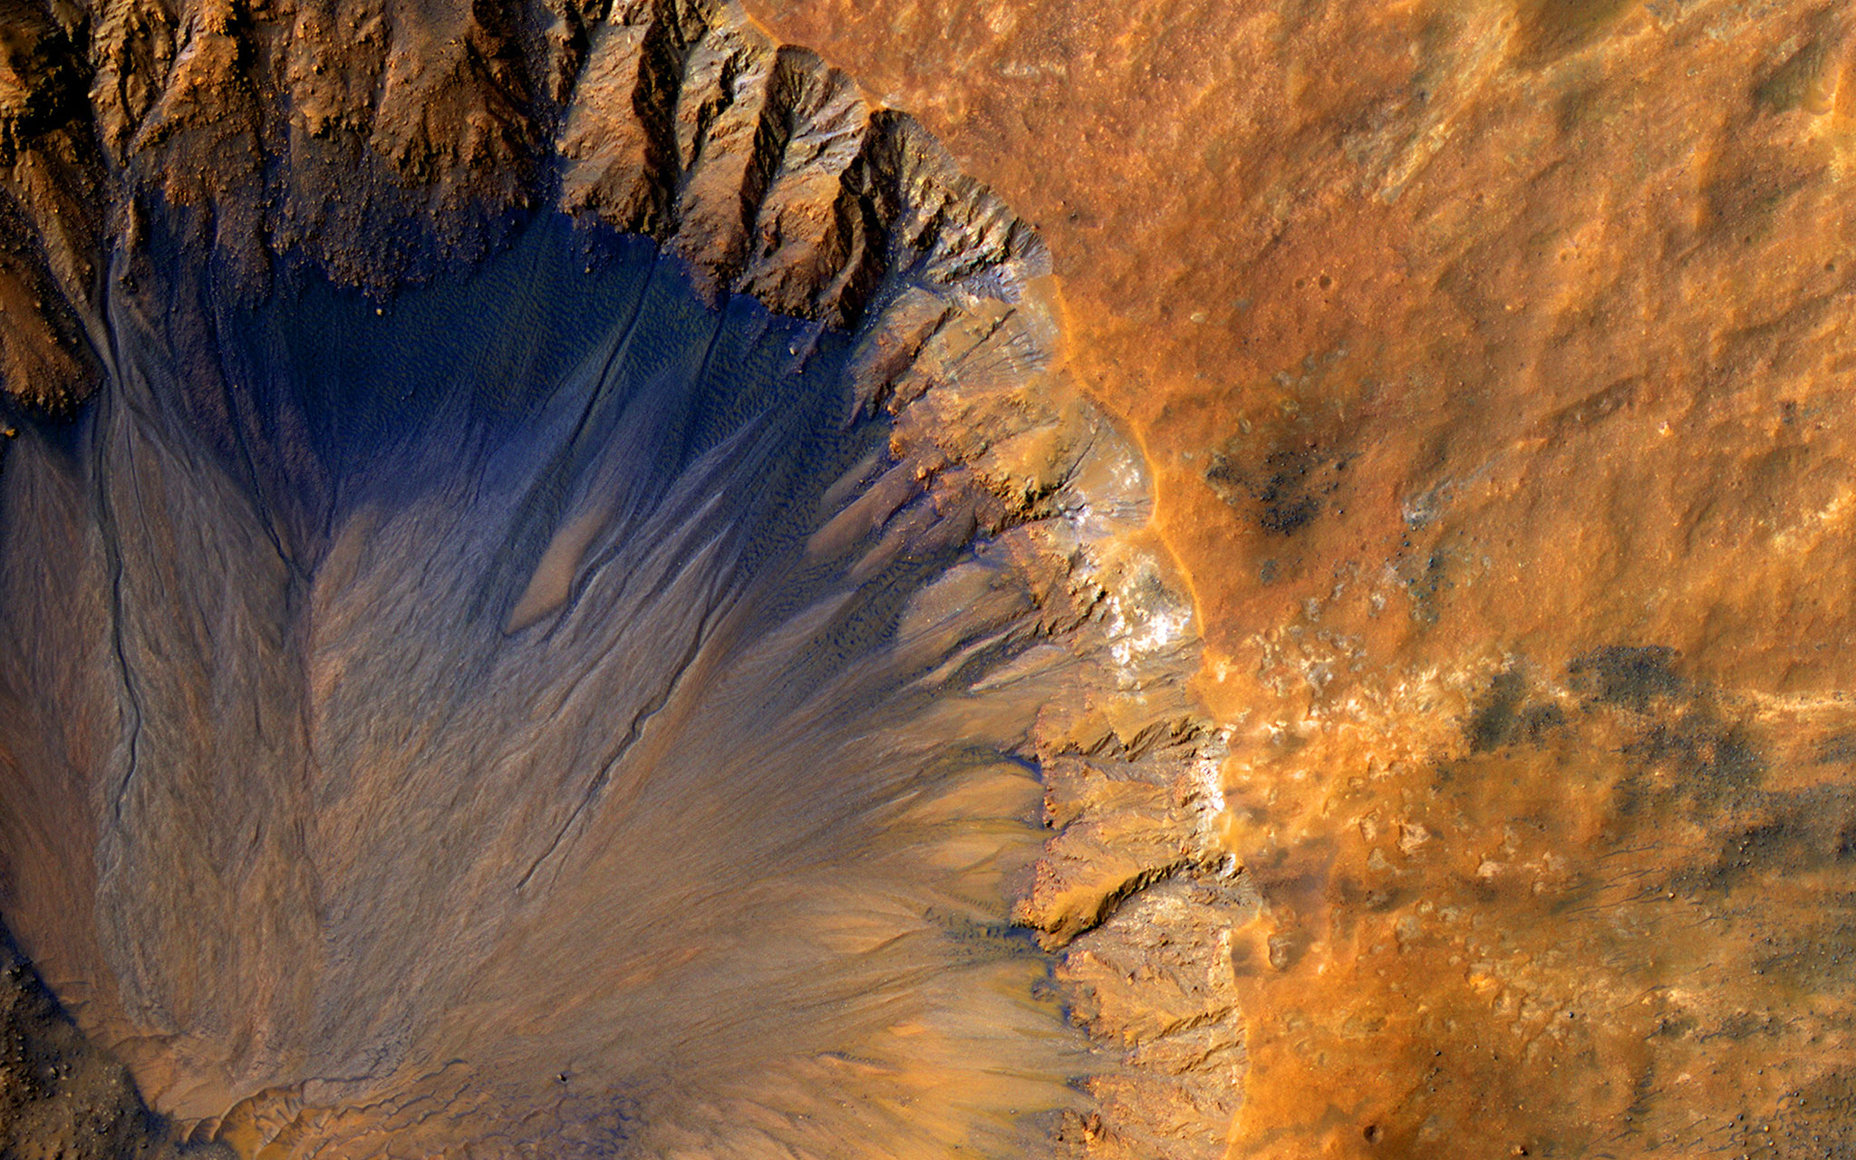
Notes:
strongest evidence yet

Slide 11
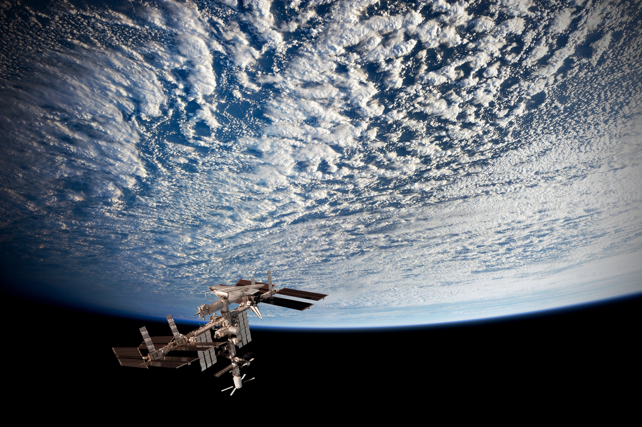
Notes:
Research leads use same satellite imagery technology,
resulting in a map that brings you very close to the source of the leak.

Slide 12

The jury is still out on if it’s
affordable or practical…
Notes:
This a really new company
already they are piloting projects

Slide 13

PROBLEM
Current Solutions Are…
Labor Intensive
Expensive
Time Consuming
Notes:
Current technologies take more time, money and man-power than utilities can afford.

Slide 14
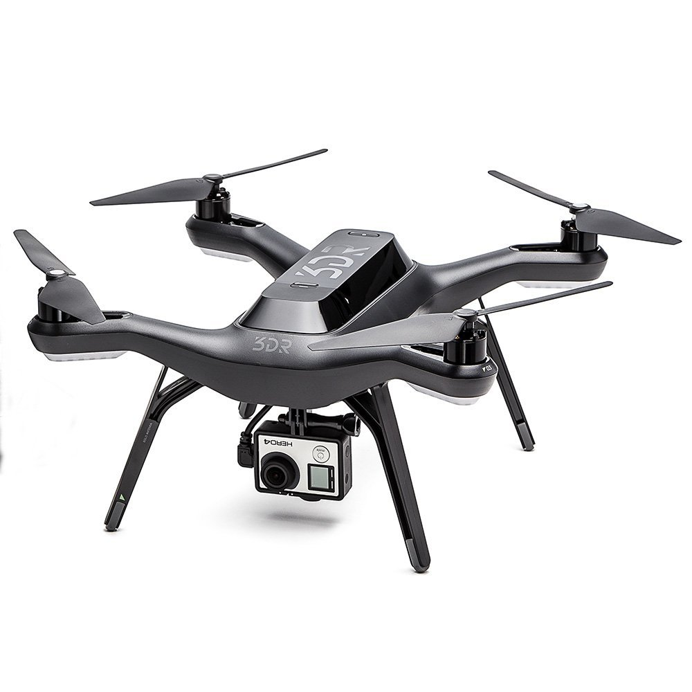
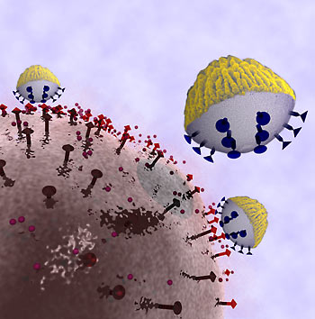

What do we need? Solutions!
Notes:
We need your help exploring solutions.

Slide 15
I invite you...
Notes:
I would love it if you came and talked to me with your ideas on how to advance the field of finding water leaks.
Because again, saving water is the cheapest water (pause).

Slide 16
Help us Solve the Problem of Water Loss!
MaryAnn Nason
City of Boulder
Watershed Sustainability & Outreach Supervisor
nasonm@bouldercolorado.gov
720-467-1131
Notes:
My name is MaryAnn Nason and I run the Water Conservation Program at the City of Boulder and I’m here to talk about “Solving the Problem of Water Loss”, because, saving water is the cheapest water.

