Slide 1


What If?
Devon Buckels, AICP
The Water Connection /
The Greenway Foundation
Partners:
Urban Drainage and Flood Control District
City and County of Denver

Slide 2
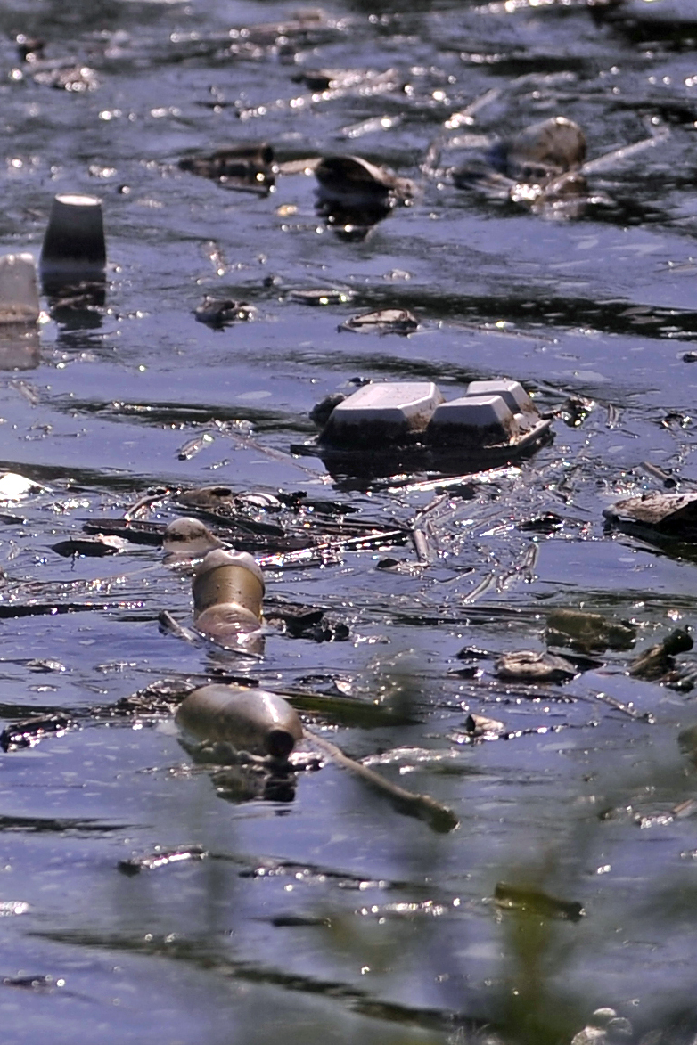
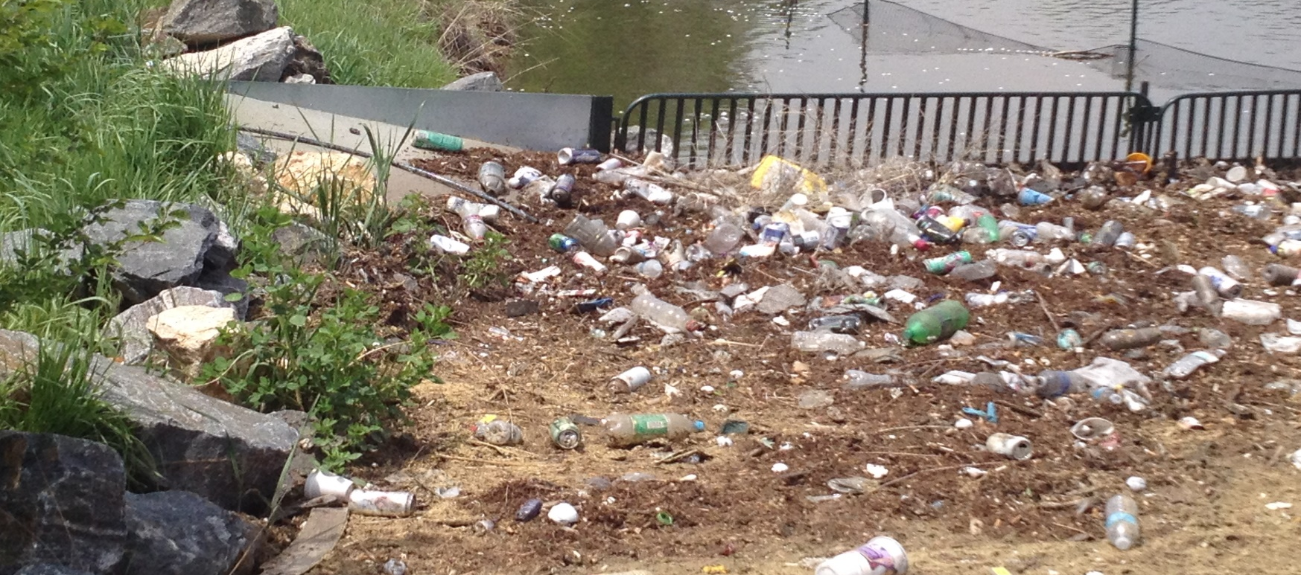
The Problem
Notes:
Westerly Creek (left), Aqua Golf forebay

Slide 3
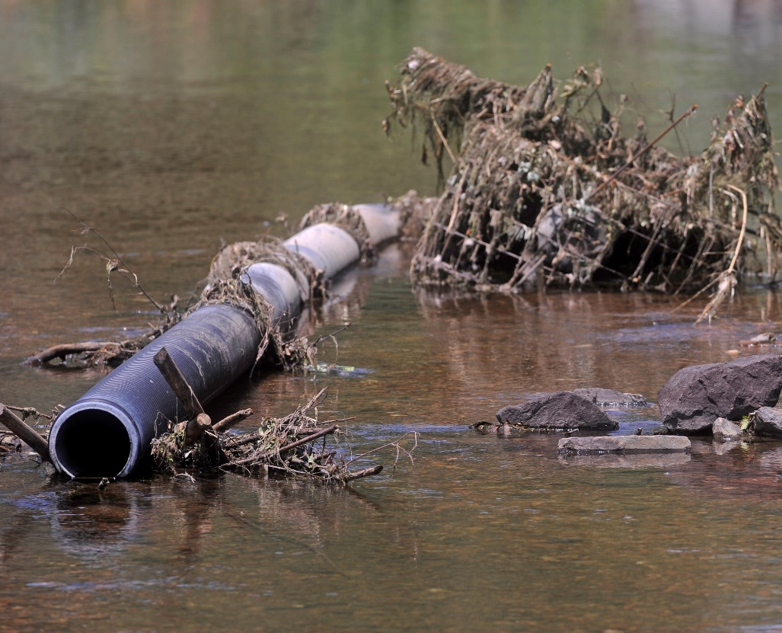
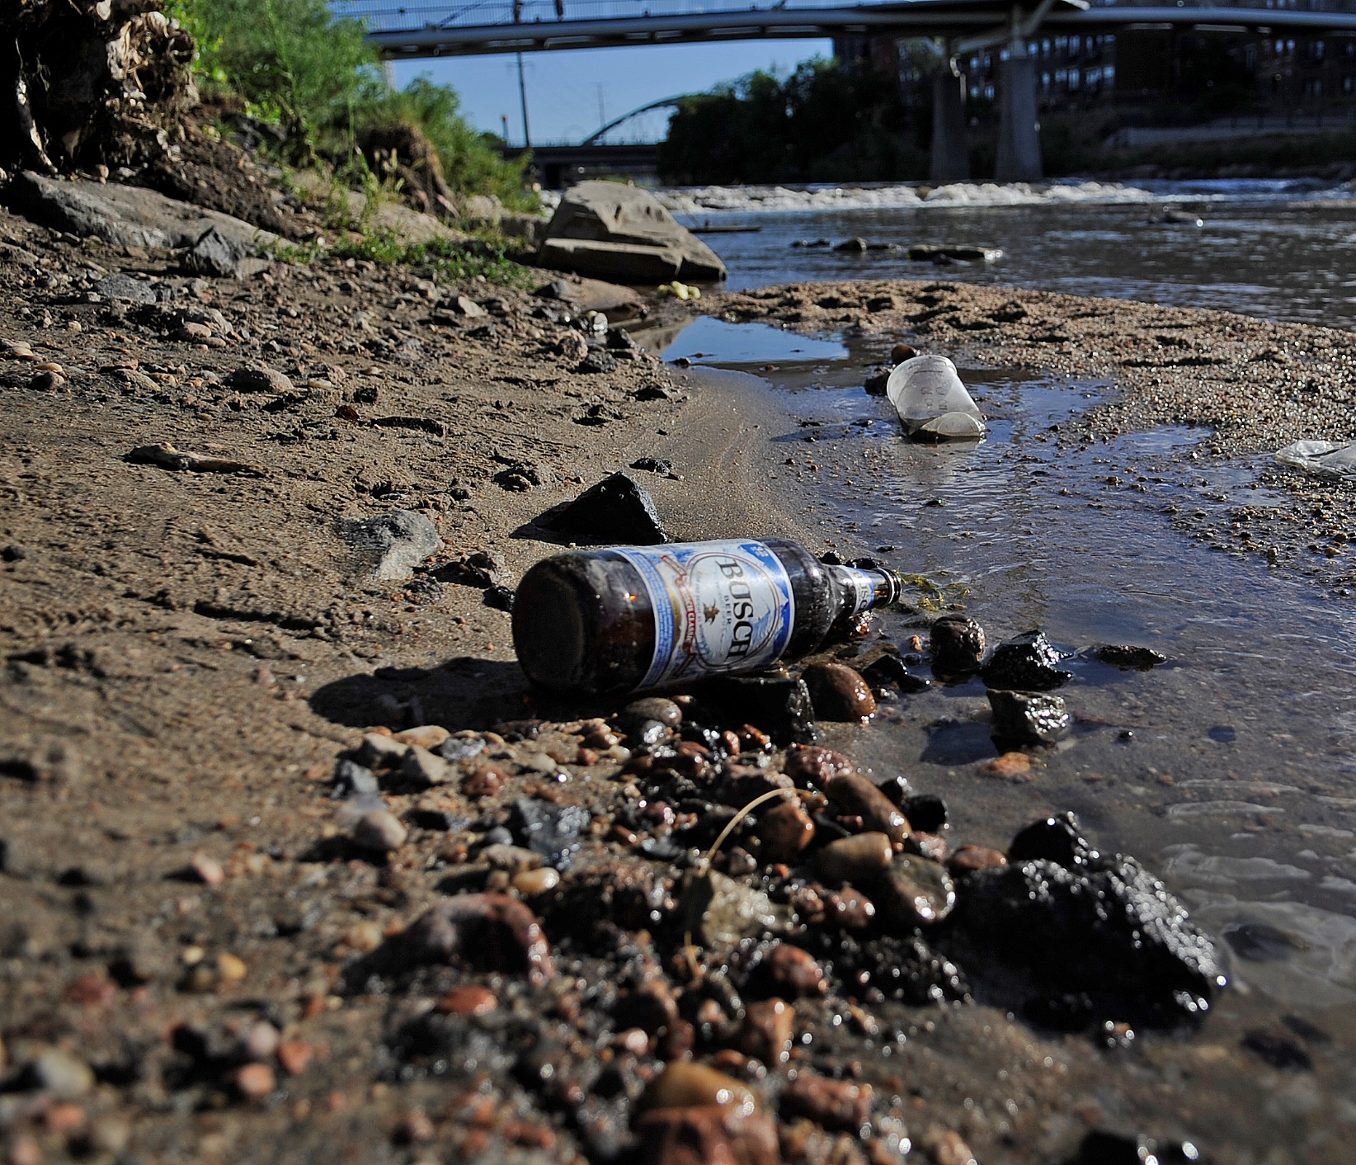
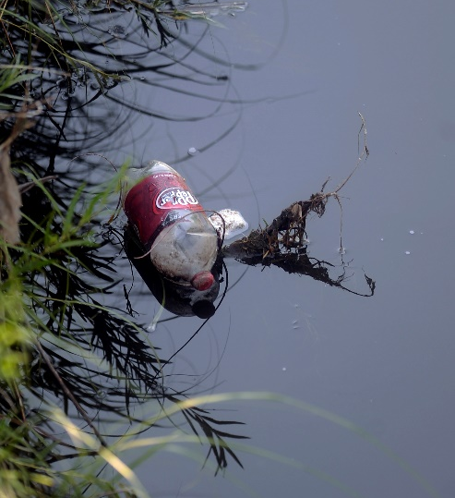
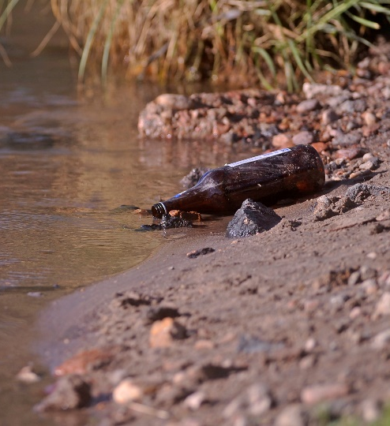
Notes:
Bear Creek (top left), all others South Platte

Slide 4
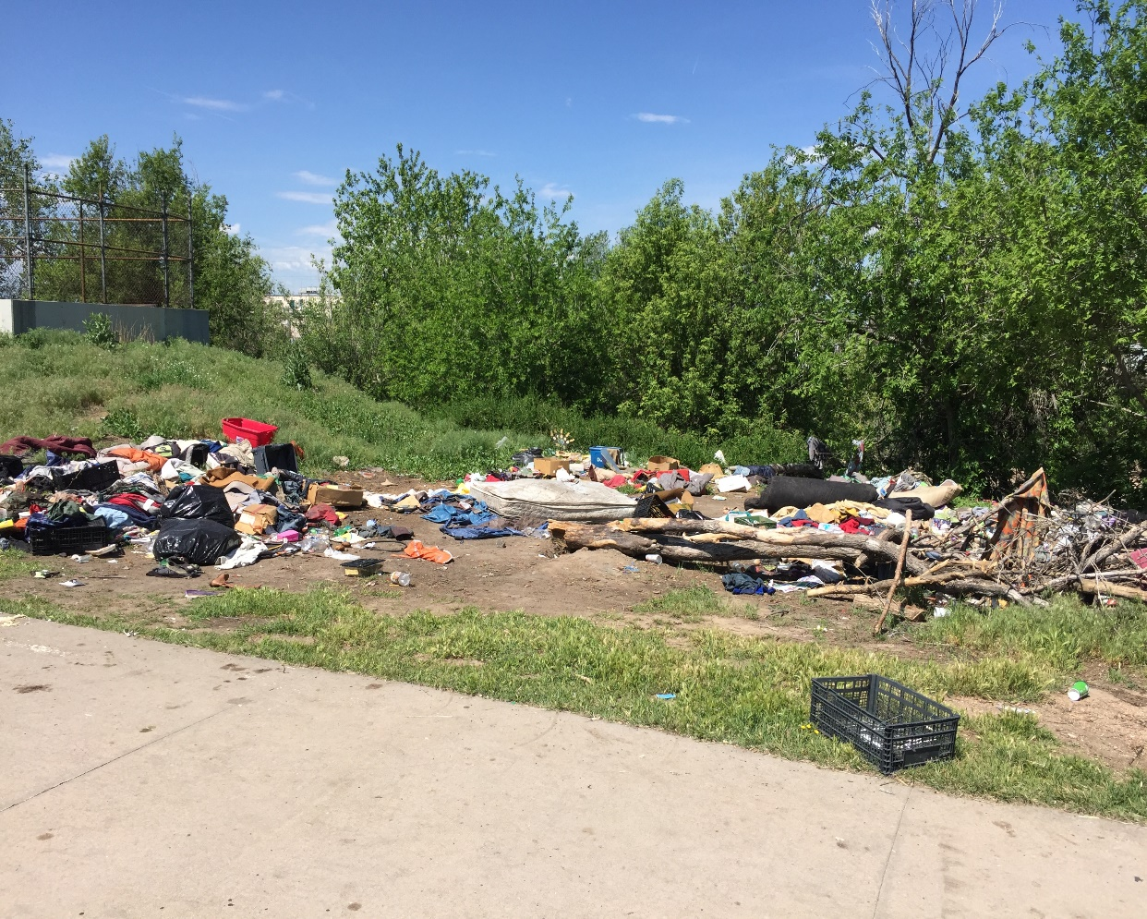
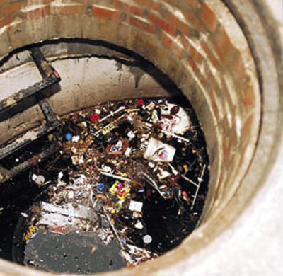

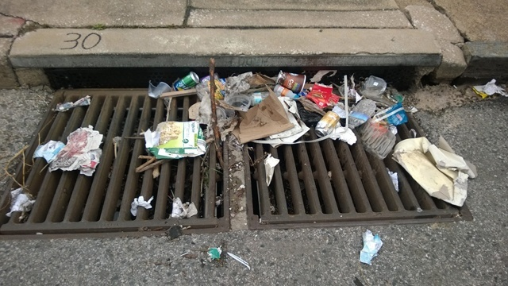
Origins
Notes:
Top left: Burlington Head Gate debris; storm drain clogged with trash, trash in Storm Sewer on its way to waterway

Slide 5
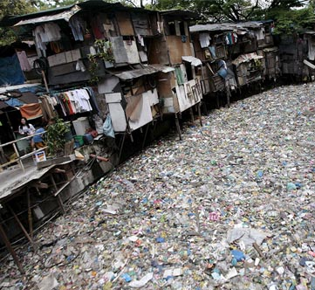
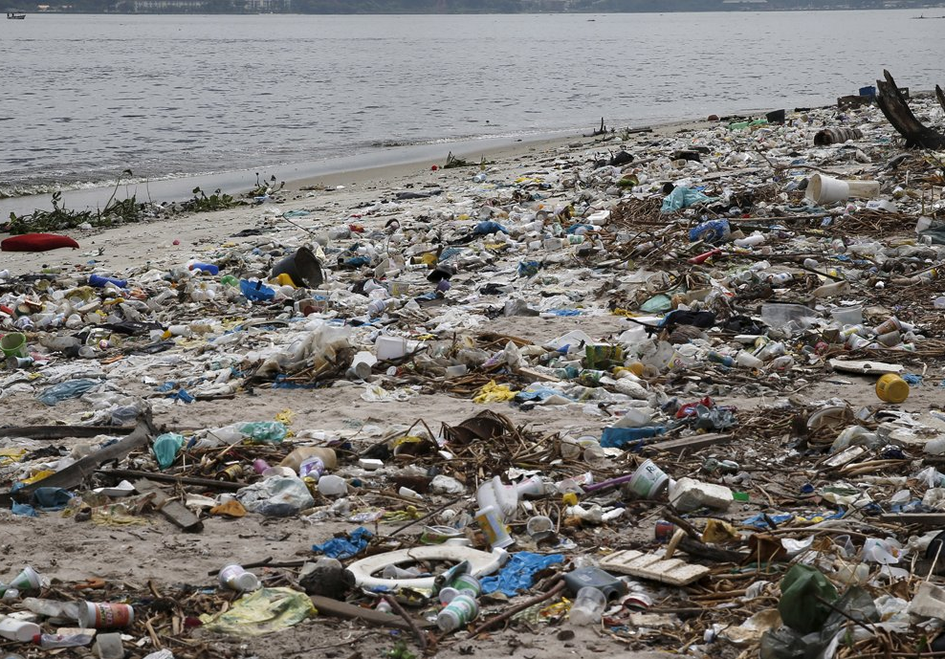
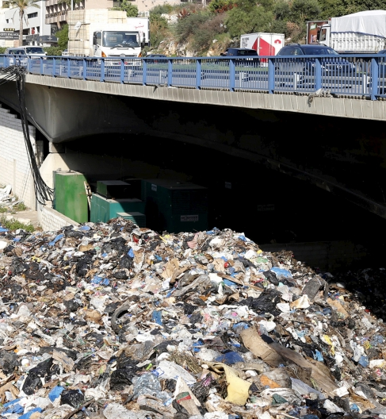
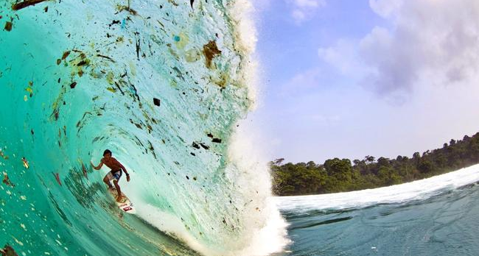
A Global Issue
Notes:
Clockwise from upper left – China, Rio, Beirut, South Pacific

Slide 6
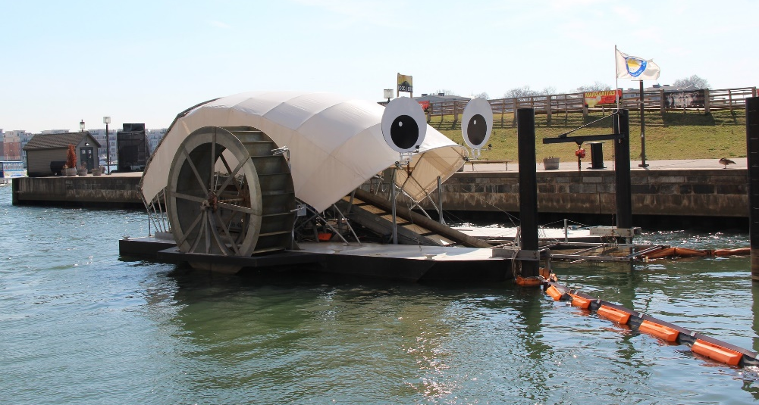
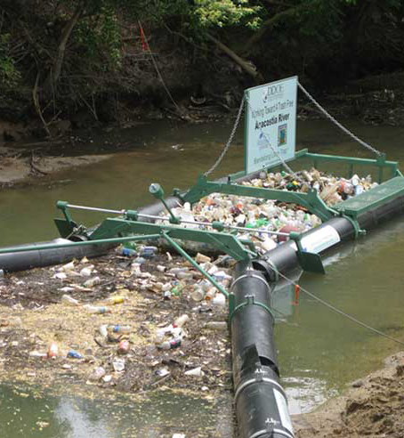
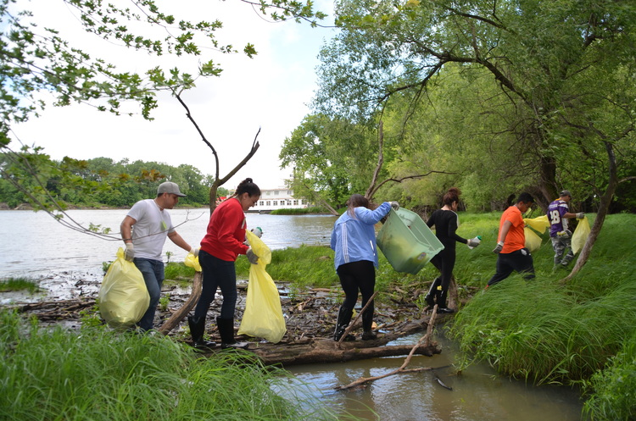
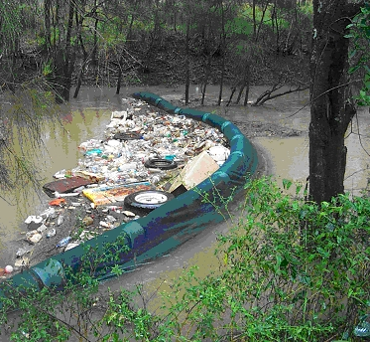
Existing Solutions
Notes:
Clockwise from upper left – Baltimore’s Mr. Trash Wheel, Bandalong in DC, river cleanup in upper Midwest, boom (location unkown)

Slide 7
What If?
What If?

Slide 8

What If?
The Greenway Foundation Thanks our Partners:
Urban Drainage and Flood Control District
City and County of Denver

