Slide 1
TAP-IN source & Cycle
Damian Higham, Recycled Water Specialist
Denver Water

Slide 2
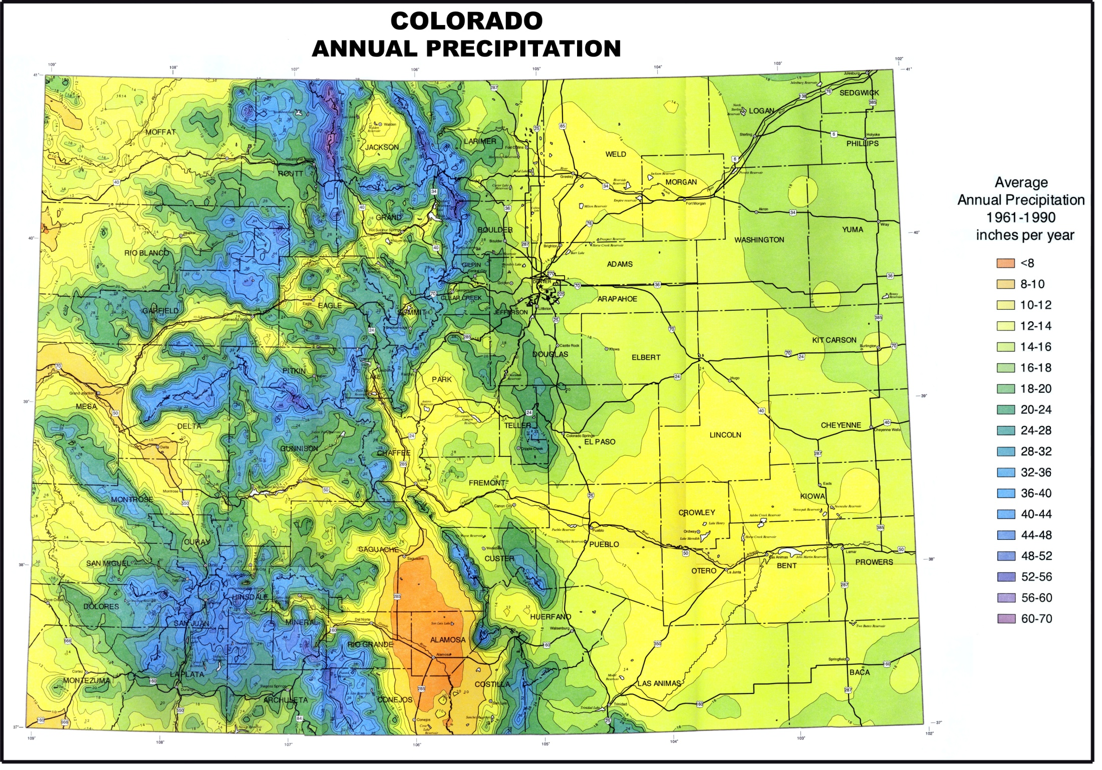
Diversion
80% of the
Water
80% of the Population
Continental Divide
U.S. Department of Agriculture Natural Resources Conservation Service Made in cooperation with Oregon State University
Notes:
Explain TMDs. 50% of DW water comes from west slope, so the scale is huge, CO: 167 B gal. These waters are reusable until evaporation/transpiration take it. Most efficient use is indoor use – 4 gallons per gallon input. This requires PR after first use. Best treatment is RO, which creates brine stream that is expensive to deal with. That’s where you come in – nutrients and salts that could be a resource if separated and utilized.

Slide 3
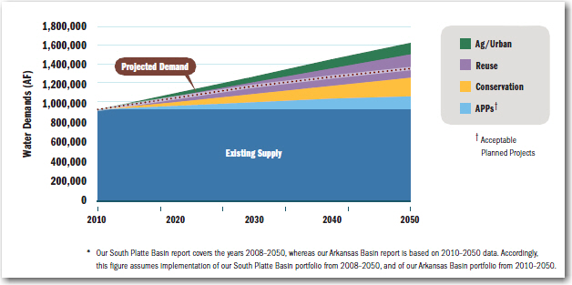
Drivers for Reuse
Western Resource Advocates
Notes:
Population doubles by 2050. One estimate affected by climate change, growth, etc. Explain blue, red line, purple – 1/3 of demand to be met with reuse.

Slide 4


Meeting Demand with Reuse
Non-potable (purple pipe)
  Requires dual infrastructure
  Lots of evaporation
  Regulations increasingly difficult
Potable Reuse (drinking water)
  Uses existing potable infrastructure
  Maximizes the reusable supply
  Minimizes discharges to environment
  Treatment already developed and being used in TX, CA
  Perfect for drought conditions
Notes:
Explain potable reuse: taking wastewater and treating it to the point of usability as a drinking water source.

Slide 5
Water Cycle Opportunities
  Water becomes wastewater with the addition of:
    Nutrients – sanitary waste
    Salts – laundry detergents, water softeners
    Metals – piping, industrial processes
  Utilities across the country are moving towards potable reuse
  Reverse Osmosis creates lots of brine for disposal
  Inland disposal requires shipping, drying or deep-well injection
  Solution would be green, desirable, used world-wide
Notes:
Wastewater becomes wastewater with addition. Can we subtract and reuse?

Slide 6
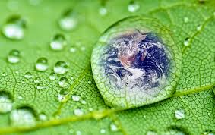
Bottom Line?
Water-wastewater paradigms are starting to shift
Utilities around the world need your help to close the loop and turn water, salt and nutrients from wastes to resources and make the future more sustainable and cost-effective

Slide 7
Contact Information
Damian Higham
Denver Water
Recycled Water Specialist
303.628.6537
damian.higham@denverwater.org

