Slide 1






INTEGRATING WATER INTO THE COMPREHENSIVE PLAN
Breaking Down Silos:
Integrating Water into Land Use Planning
Presented by:
John Nolon, Land Use Law Center
Mac Cummins, Planning Manager, City of Westminster

Slide 2
Why We Are Here
Takeaways: Leave here knowing…
The importance of the comprehensive plan.
The relationship between water conservation and the comprehensive plan.
The process of changing the plan and the boards responsible: how water planners can be involved.
Options for amending the plan to include water conservation.
Many of the best practices for water conservation that can go in the comprehensive plan.
Notes:
The trainer can save some time by incorporating the remarks in this note in the slide entitled Overview of the Comprehensive Slide. Some repetition of these points can’t hurt, but the trainer should decide the point at which the critical importance of the plan is outlined: here or with the Overview slide.
Notes: Start by letting participants know about the critical importance of the comprehensive plan. It is basically responsible for what is developed on the land and what is preserved. At this point, we are not going into specifics but rather interesting the participants in this training program, which requires that they know, particularly if they are water planners, the relevance of the comprehensive plan.
Zoning, which creates land use patterns, must conform to the comprehensive plan and comprehensive plans deal with future infrastructure needs, including water infrastructure. The comprehensive plan and conforming zoning will determine how many people live and work in a community in the future, which, in turn, will determine future water demand. Water planning focusses on providing the resources and infrastructure to meet future demand. This demonstrates why the two arenas of planning must be coordinated.
The process of amending the comprehensive plan to include water conservation is a public one and provides many opportunities for planners to involve all key stakeholders and constituents and achieve some consensus on how to balance supply and demand.

Slide 3
Agenda
12:00 – 12:05 Welcome
12:05 -12:25 Introduction to Comprehensive Planning and Water Conservation
12:25 – 12:45 Best Practices for Water Conservation Planning
12:45 – 1:00 Question & Answers

Slide 4
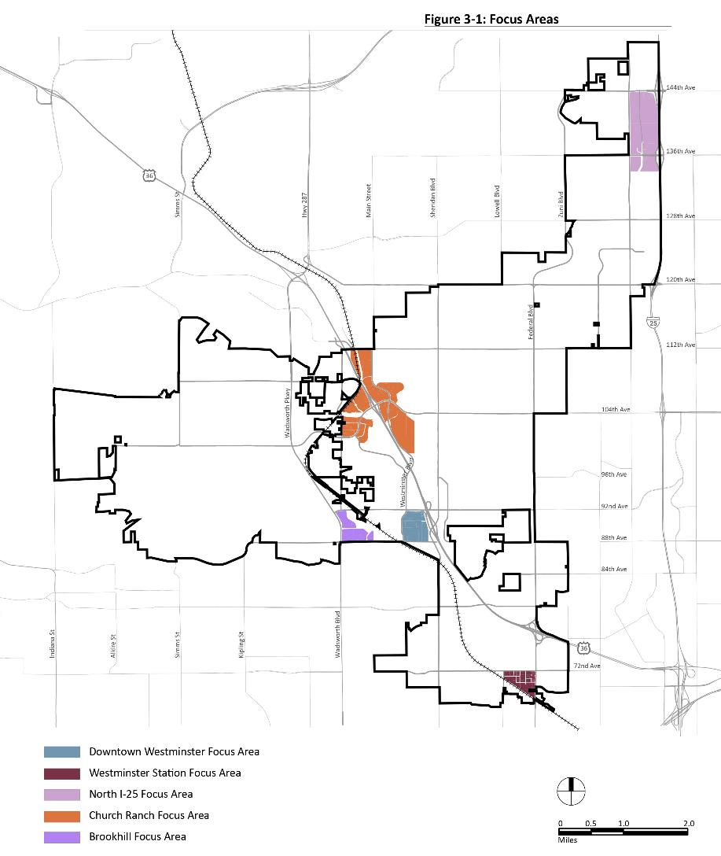
The Land Use System
Notes:
This is a transitional slide that lets the trainer guide the group from the who is in the room discussion to the overall topic of the day.
The trainer can add comments about the importance of the land use system or the components of the system or tell one or two personal stories about involvement with the system.

Slide 5
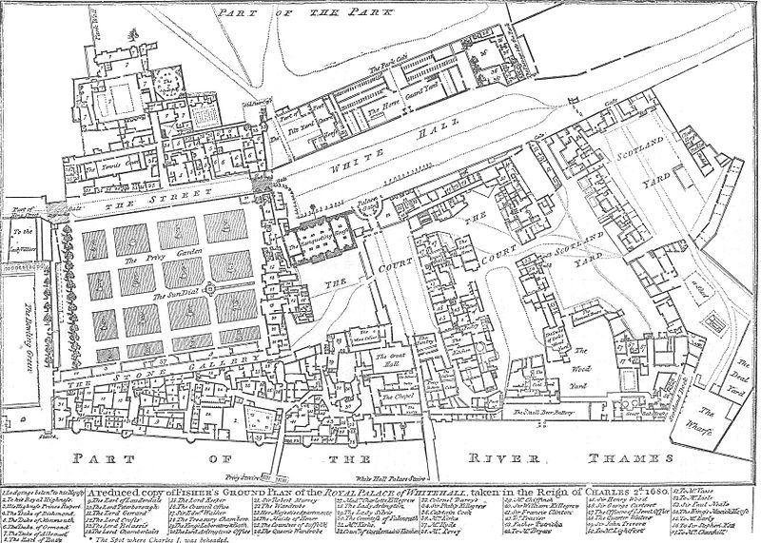
The Land Use System
State Delegation of Powers
Comprehensive Plan establishes community’s vision
Zoning must conform to comprehensive plan
Comprehensive plan can focus on water conservation
Notes:
State legislature delegates the power to adopt land use plans as well as zoning and land use regulations to local jurisdictions, including cities and counties.
Adopting a comprehensive plan provides an opportunity to develop strategies for water conservation in a more general way than discussing specific regulations. There is no requirement that a robust participation process be used, but many planners do where they are trying to build consensus and avoid future debates on important issues.
Adopting or amending the comprehensive plan allows localities to think of and select land use types and best practices that are more water conserving and then to incorporate them into binding regulations.
Depending on who is in the room, participants may need to know more or less about the land use system. By questioning them about what they know in slide 4 (Who’s in the Room), the trainer can get an idea of the knowledge base of most of the participants. See the resource guide for this comprehensive training module for full information on the land use system. One excellent way to decide how much time to spend on each best practice is to encourage the participants to ask questions about the practices they don’t understand or have greater interest in. This applies to each slide in this PowerPoint. The best learning occurs in an interactive training session where to trainer is speaking to what the trainees want and need to know.

Slide 6
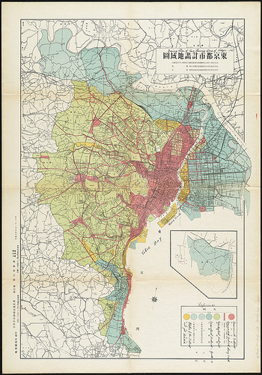
Overview of Comprehensive Planning
Plans contain long term goals, short term objectives, strategies, implementation techniques (or best practices)
They are adopted by local planning commissions; most Colorado communities are required to adopt a plan
Plans are visionary and advisory. In most cases they do not regulate directly
Since zoning, which determines land use types and densities, has to conform to the plan, the plan will have a critical effect on future water use
Notes:
Perhaps the most significant land use power that the state legislatures delegate to local governments is the authority to adopt comprehensive plans and conforming zoning laws. Through these codes and the intensity of development allowed within each district.
See these notes which are also found under the Why are we Here slide above:
Start by letting participants know about the critical importance of the comprehensive plan. It is basically responsible for what is developed on the land and what is preserved. At this point, we are not going into specifics but rather interesting the participants in this training program, which requires that they know, particularly if they are water planners, the relevance of the comprehensive plan.
Zoning, which creates land use patterns, must conform to the comprehensive plan and comprehensive plans deal with future infrastructure needs, including water infrastructure. The comprehensive plan and conforming zoning will determine how many people live and work in a community in the future, which, in turn, will determine future water demand. Water planning focusses on providing the resources and infrastructure to meet future demand. This demonstrates why the two arenas of planning must be coordinated.
Some basics: most Colorado communities must adopt comprehensive plans, which are often called master plans. Colorado statutes say this about the plan. It is for the purpose of “guiding and accomplishing a coordinated, adjusted, and harmonious development of the municipality and its environs which will, in accordance with present and future needs, best promote the health, safety, order, convenience, prosperity, and general welfare” of the citizens. Note how broad this purpose is; this emphasizes, again, the importance of the plan.
There is no legal requirement for planning commissions to submit their plans to their municipal councils for adoption , but most do, in part because it is the council that must adopt zoning that conforms to the plan.
Plans can be written so that water conservation objectives and strategies appear throughout the plan or there can be a stand alone water conservation or water element or both.

Slide 7
Central Point
For the Comp Plan to support water conservation, it must contain water conserving objectives
The Comp Plan should contain zoning and land use strategies to achieve those objectives
Water providers and experts are a necessary component of comprehensive planning
Notes:
Throughout these slides use a “Need to Know” message. Each time it is possible to explain how land use planners have a need to know what water planners know, use this phrase.

Slide 8
Coordinating Water and Land Planning
Step-by-step Understanding of the Process of Amending the Comprehensive Land Use Plan
Identifying the Land Planning Staff and Stakeholders
Identifying the Water Planning Staff and Stakeholders
Integrating Inputs Throughout the Process of Amending the Comprehensive Plan
Notes:
Other than the required public hearing, there is no legislated or common process of amending the comprehensive plan.
There are very few limitations on what the process can be, so there is no difficulty setting up a process that ensures that water planners and stakeholders are involved throughout the process.
When the water agency is a municipal agency within the city or county doing the land use planning, it is a straight forward process of getting the water staff involved in providing goals, objectives, strategies, and implementation techniques for the comp plan amendment.
When one or more outside water suppliers are responsible, more work will need to be done to identify the proper staff and leaders of the water district and seeing that the process accommodates their schedules and time limitations.

Slide 9
Infrastructure
Comprehensive Plans include future infrastructure plans
Need to know from water planners what the water infrastructure needs to be
Notes:
Throughout these slides use a “Need to Know” message. Each time it is possible to explain how land use planners have a need to know what water planners know, use this phrase.

Slide 10
How to Include Water Provisions
Adopt a comprehensive water element
  This approach has the advantage of giving you the opportunity to involve the relevant stakeholders in a non-ideological process of water conservation, broadly, or
Add water conservation provisions throughout the plan, or
Do both
Notes:
Throughout these slides use a “Need to Know” message. Each time it is possible to explain how land use planners have a need to know what water planners know, use this phrase.

Slide 11
Water Conservation Overlay Zones
With the input of water planners and stakeholders, the Comp Plan can designate overlay areas where water conservation is critical
The plan can call for the adoption of a Water Conservation Overlay Zone, with specific regulations that limit water consumption and water pollution
Notes:
Throughout these slides use a “Need to Know” message. Each time it is possible to explain how land use planners have a need to know what water planners know, use this phrase.

Slide 12
Case Study: San Jose, CA
Plan clearly defines growth areas and areas for conservation. This strategy emphasizes land use types that are more water conserving
New development is emphasized in growth areas and is to create mixed-use, walkable places
Clustering development and other techniques avoid environmental impacts in conservation areas
New development in conservation areas is not to require significant increases in infrastructure
Notes:
For more information see the Integrating Water Efficiency into the Comprehensive Master Plan guide for Colorado communities. I has a 3 page description of this case study. The San Jose plan in its land use component focuses on land use patterns that concentrate development in mixed-use, in-fill, higher density areas and deemphasize it in conservation areas. In the growth areas, per capita water use will be much lower than in large lot single-family home neighborhoods. By limiting the later through the conservation area strategies, water conservation is assured. In conservation areas, development should be clustered where possible. This technique converts large lots, which use much water for landscaping, into smaller lots which use less water for this purpose.
The plan also contains a stand alone chapter called “Water Supply, Conservation, Recycling, and Quality and incorporates water conservation features into other parts of its comp plan. It is a true hybrid plan in terms of water conservation.
Note that this plan does not provide for other landscape water conservation techniques or interior smart water fixtures; it focuses mainly on how the land use pattern can conserve water. It also has many provisions for protecting water resources from pollution, which, indirectly, maintains the existing water supply.

Slide 13
Case Study: San Jose, CA
San Jose plan is a hybrid
It contains a stand alone water component: Water Supply, Conservation, Recycling, and Quality
It also incorporates water conservation methods in other chapters of the plan
Notes:
This is an important point. Water conservation goals and objectives, water supply and quality issues, recycling, landscaping and fixture best practices fit well in a stand alone water conservation component of the plan, but, like San Jose, the practices that involve creating water conservation land use patterns need to be linked or contained within the land use component of the plan.

Slide 14
Case Study: Take Away
Land use plans can follow one of three patterns:
Incorporate water efficient land use patterns into the land use chapter
Contain a discrete and separate water conservation element
A combination of 1 and 2: Hybrid
Notes:
To fully take advantage of the opportunity to reduce per capita water consumption, localities should amend the land use component of their comp plans to achieve water conserving patterns that involve less on site landscaping and types of buildings for smaller households; provide for landscaping that is water conserving; and specify that all exterior and interior fixtures will be water smart. It is not likely that option 2 above will deal with water efficient land use patterns, which will almost always have to be in the land use component of the plan. So, the hybrid approach, like San Jose’s, is the recommended model.

Slide 15
Goals and Objectives
Water conservation goals and objectives:
The plan should contain data indicating what the per-capita water consumption is
It should then create a goal of reducing that per-capita number significantly, such as by 50%
One objective is to plan for new development in defined growth areas to accomplish this goal
Another is to call for water conservation through the landscaping practices and fixtures that are less water consumptive
Notes:
This practice illustrates goal and objective setting. The long term goal will take some time to achieve but it creates a target for the community to focus on. The objectives can be accomplished in a shorter-term by adopting land use regulations that help to achieve the goal. Since focusing new development in defined growth areas, usually areas with infrastructure in place or able to be extended, and ensuring that new development is denser with smaller lots, the water conservation goal is partly achieved.
Similarly, establishing an objective of ensuring that landscaping practices use less water because the plants, soil, and irrigation systems are water conserving can move the community closer to this goal.

Slide 16
Best Practices
Three different best practice categories:
Those that affect land use patterns
Those that affect landscaping practices, including exterior fixtures
Those that affect interior fixtures
Notes:
This is a transition slide. It begins the training session on best practices. Trainers should look at the matrix of implementation techniques in the training guide to see a full list of best practices and pick any that are of interest to them that are not discussed in the following slide, which cover the techniques contained in the materials.

Slide 17
Best Practices Affecting Land Use Patterns
Identify land uses that create patterns that are water conserving.
Compact, mixed-use development
Higher density development
Single-family homes with smaller lots
Clustered residential subdivisions
Multi-family housing
In-fill development
Notes:
Here we are incorporating into the comprehensive plan the kinds of strategies and implementation techniques that planners want to be incorporated into the zoning code and subdivision regulations. These will come up again in the zoning module, but it important to emphasize the need for them here since zoning must conform to the comprehensive plan.
There is a matrix in the guide for this topic that has check marks next to zoning and subdivision provisions that can be mentioned in the comprehensive plan.

Slide 18
Best Practices
Additional Practices that Affect Land Patterns
Innovative zoning techniques, such as floating or overlay zoning or bonus density zoning
Green infrastructure
Notes:
This and the following slides are based on material taken directly from the training guide for this training program, including example case studies. See the text regarding these practices from the manual if there are any questions about what each practice is or the fuller story about each case study.

Slide 19
Example: Higher Density, Sustainable Buildings
Castle Rock’s plan calls for high-density development in interchange districts… “to integrate water conservation and water quality design into proposed land use plans.”
Aurora’s plan integrates water conservation in its Building Urban Activity Centers section: sustainable buildings “require less water and energy.”
Notes:
This and the following slides are based on material taken directly from the training guide for this training program, including example case studies. See the text regarding these practices from the manual if there are any questions about what each practice is or the fuller story about each case study.

Slide 20
Example: Clustering
Chico, California general plan includes a goal “to conserve water resources and improve water quality.” As an action to support this goal it calls for “avoiding impacts to groundwater recharge areas through…clustering of development.”
Larimer County’s plan calls for smaller lot sizes by requiring 80% open space preservation achieved through clustering.
Notes:
This and the following slides are based on material taken directly from the training guide for this training program, including example case studies. See the text regarding these practices from the manual if there are any questions about what each practice is or the fuller story about each case study.

Slide 21
Best Practices: Infill Development
Colorado Spring’s land use chapter calls for infill development projects acknowledging their efficient use of public infrastructure including water and wastewater.
Aurora’s plan calls for infill development to create neighborhood livability and allowing the phased extension of existing water lines in the most cost-affective manner.
Notes:
This and the following slides are based on material taken directly from the training guide for this training program, including example case studies. See the text regarding these practices from the manual if there are any questions about what each practice is or the fuller story about each case study.

Slide 22
Further Examples
The Southern California Association of Government’s model plan calls for “greater emphasis on multi-family housing to help reduce per-capita water consumption.”
Aurora’s plan calls for green infrastructure including tree planting, xeriscaping, community gardens.
Notes:
This and the following slides are based on material taken directly from the training guide for this training program, including example case studies. See the text regarding these practices from the manual if there are any questions about what each practice is or the fuller story about each case study.

Slide 23
Landscaping Best Practices
Identify landscaping practices that are water conserving as strategies and implementation techniques.
Xeriscaping
Soil quality and turf requirements
Allowable plants
Tree size requirements
Irrigation system efficiency requirements
Water loss limits
Notes:
This and the following slides are based on material taken directly from the training guide for this training program, including example case studies. See the text regarding these practices from the manual if there are any questions about what each practice is or the fuller story about each case study.

Slide 24
Landscaping Fixture Best Practices
Identify landscaping fixture practices that are water conserving as strategies and implementation techniques.
Irrigation system efficiency requirements
Rain sensors
Water harvesting
Fixture efficiency standards
Positive shut offs
Notes:
This and the following slides are based on material taken directly from the training guide for this training program, including example case studies. See the text regarding these practices from the manual if there are any questions about what each practice is or the fuller story about each case study.

Slide 25
Water Conserving Fixture Best Practices
Identify interior fixtures that can be made more water conserving:
Green plumbing
Water reuse
Low-flush toilets
Low-volume interior faucets
Smart meters
Notes:
These practices may require amendments to building and plumbing codes, but the comprehensive plan can highlight the need for them as part of its water conservation plan. This empowers local legislatures, where they have power to do so, to amend these codes and local chief executives to call for such amendments at the county or state level as the law requires.
In the plan itself, it is helpful to have metrics that show how much per capita water use can be reduced by adopting these interior fixture conservation measures.

Slide 26
Water Conservation -Best Practices
WATER CONSERVATION IN THE LAND USE SYSTEM
Water Conservation Measures | Comp Plan | Zoning Regulations | Subdivision Regulations | Site Plan | Building Code | Plumbing Code
LANDUSE
Urban growth boundary | 
Denser development(more homes/acre) |  |  |  | 
Cluster development (reduce lot size) |  |  |  | 
Mixed-use development |  |  |  | 
Mixed housing types |  |  |  | 
Compact mixed use |  |  |  | 
EQUIPMENT
Green plumbing code |  |  |  |  |  | 
Indoor fixture efficiency standards |  |  |  |  |  | 
Reuse of water |  |  |  |  |  | 
Smart meters |  |  |  |  |  | 
Sub metering multifamily units |  |  |  |  |  | 
Incentives | 
LANDSCAPE
Landscape codes matched to land use type |  |  |  | 
Landscape plan requirements(xeriscaping) |  |  |  | 
Soil quality requirements |  |  |  | 
Plant list/Allowable plants |  |  |  | 
Tree size requirement |  |  |  | 

Slide 27
Westminster City Council Strategic Plan Objective:
“Westminster is the next Urban Center of the Colorado Front Range”

Slide 28
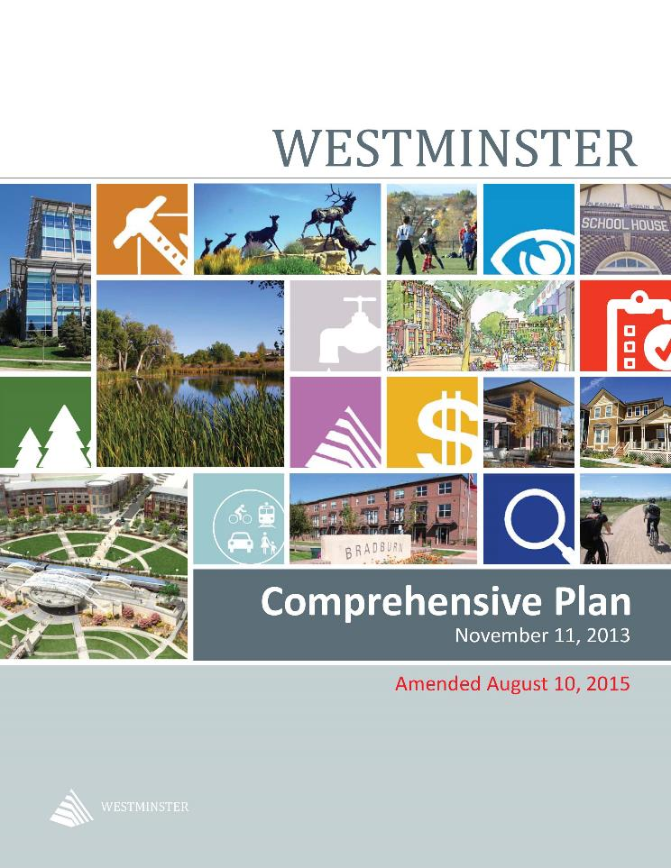
City of Westminster 2013 Comprehensive Plan

Slide 29
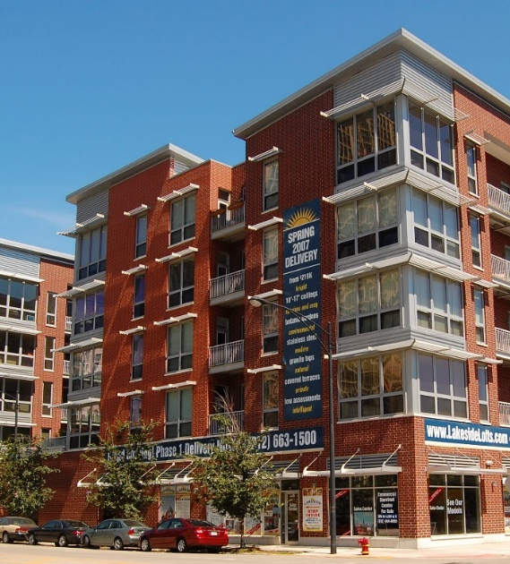
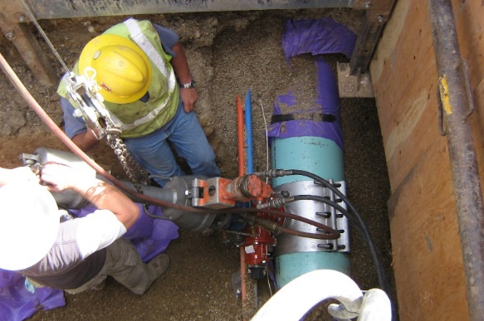
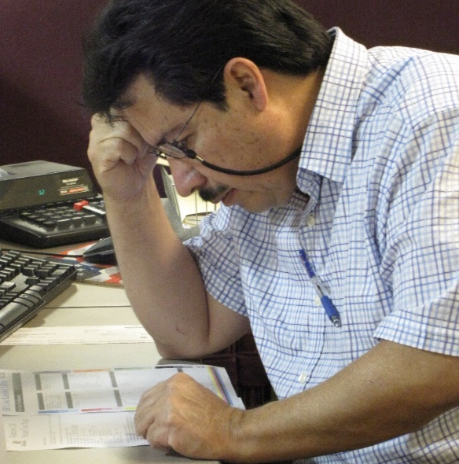
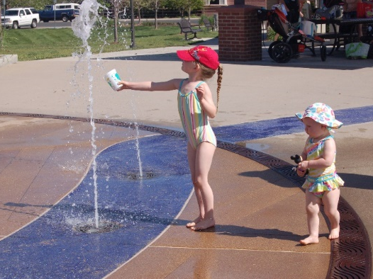
Relationship between Land Use Planning and Water Planning
Consistent Coordination & Communication
Landscape Code
Inspections Process
Post Occupancy Permit Inspections
Audits
Right Pricing of Utilities
Comprehensive Plan & Comprehensive Water Supply Plan updates

Slide 30
Municipal Water Supply Planning
Land Use Plan
What is Worst Case?
Estimate Future Demand for Water
Calculate Future Water Supply for Average, Wet, Dry Years
Compare Demand to Supply Projections
Recommend rebalancing land use and water supply if needed
City policy decisions made on land use and water supply.
Estimate Future Water Supply “gap”
Plan and implement strategy to close the “gap”
Drought Resilience?
City Council Policy
Computer Modeling
Engineering Analysis
Notes:
Give you an idea of how cities approach water supply planning
Speak to what others usually do and how we approach planning

Slide 31
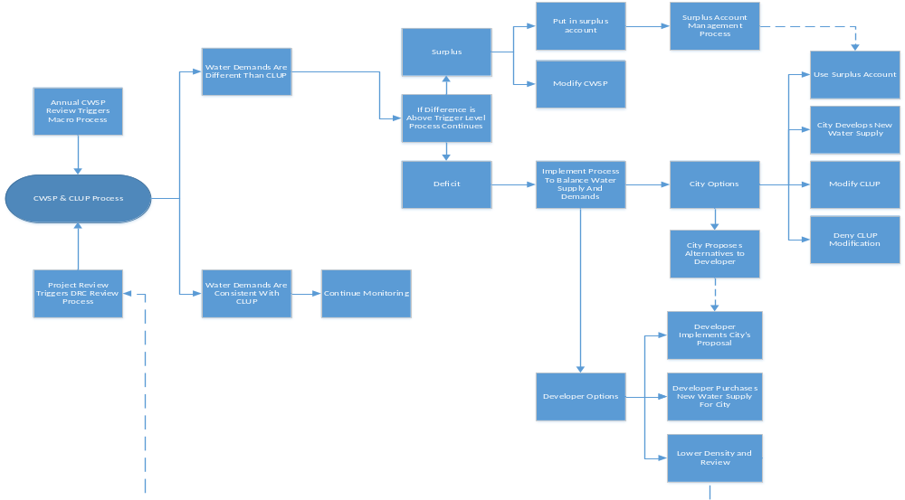
Westminster Water/Land Use Decision Flow

Slide 32
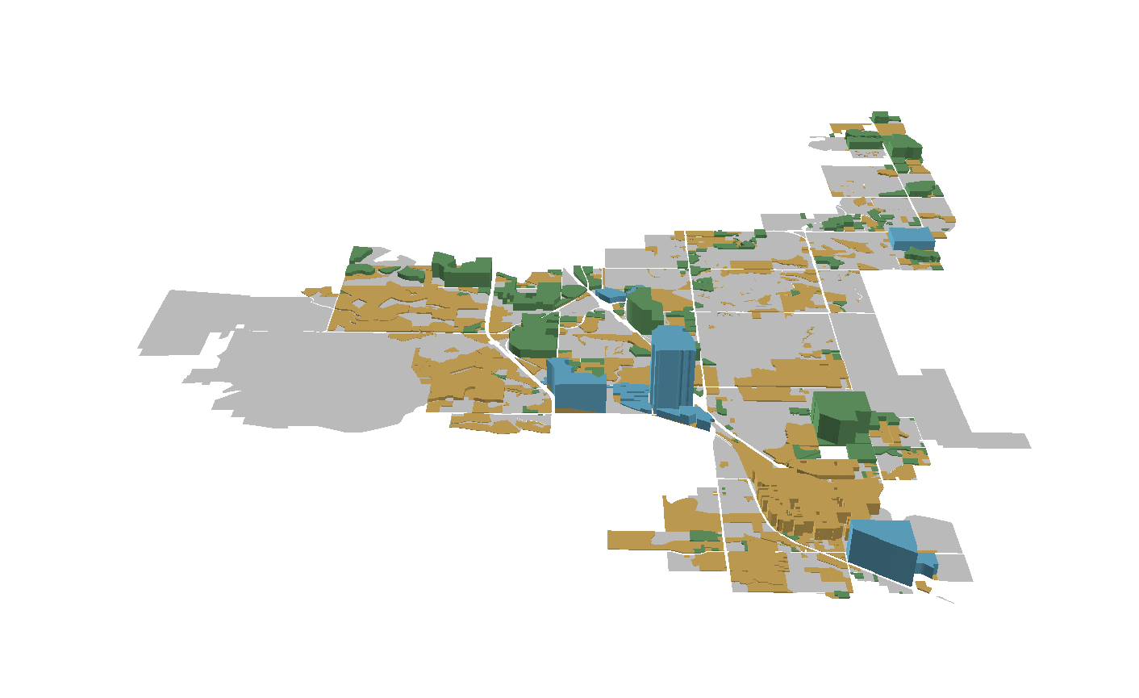
Total Changes to Projected Future Water Demand
North I-25
Church Ranch
Brookhill
Downtown
New Development
Redevelopment
Underutilization
Comprehensive Plan Focus Area
Westminster Station

Slide 33
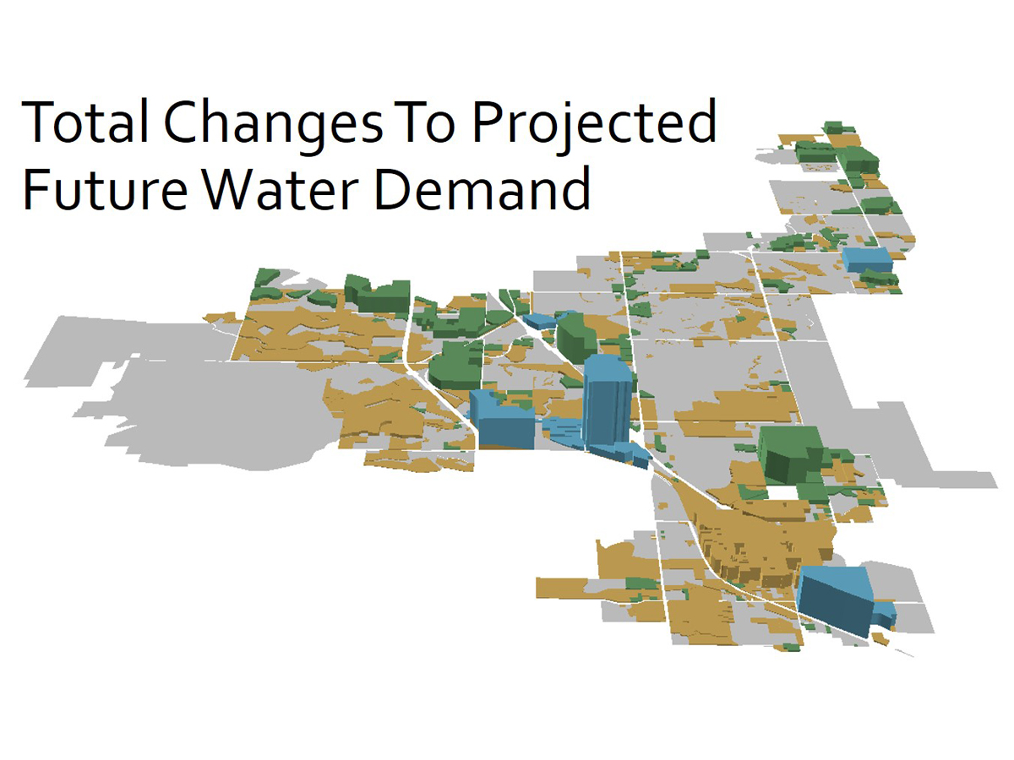
By implementing the Comprehensive Water Supply Plan, we can support this vision of the future of the city.
Notes:
In closing,
If we complete planned capital projects, the Comprehensive Water Supply Plan can support this vision of the city.
We love to talk water and appreciate the opportunity to be here this evening.
Thank you.

Slide 34
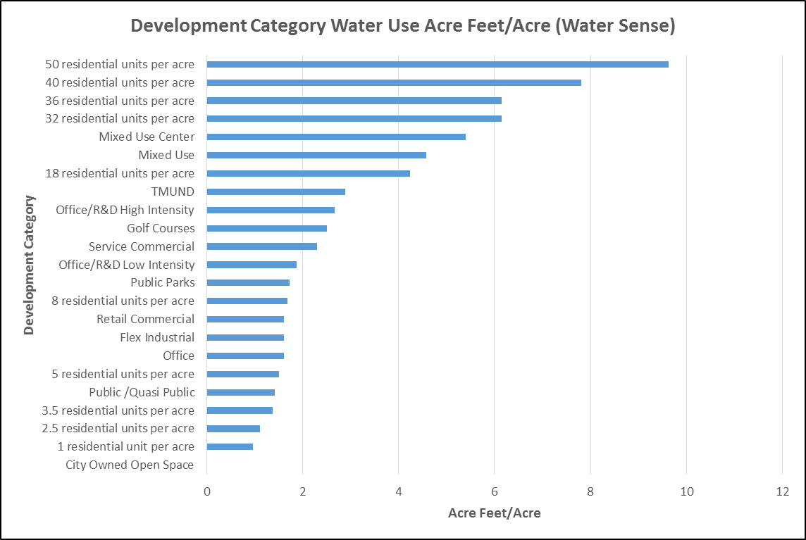

Slide 35
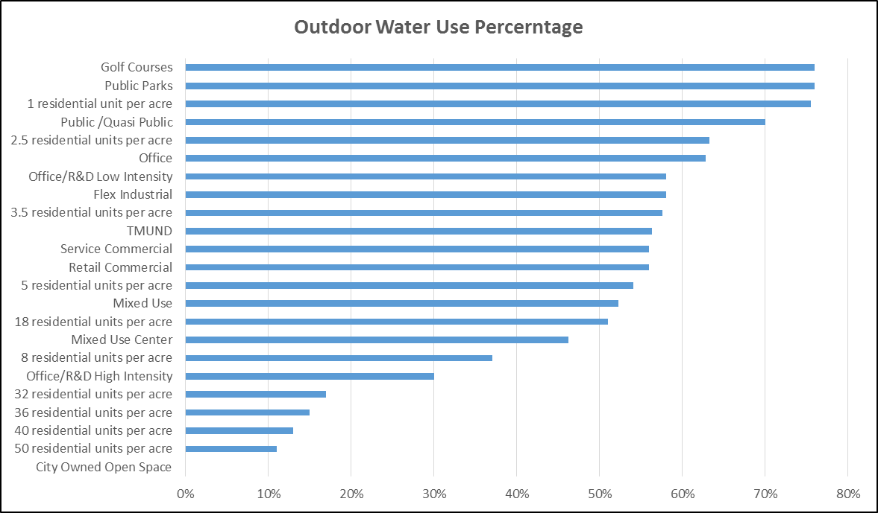

Slide 36
Density of Development Drives Water Use
Traditional Single Family vs. Current
Weatherstone
2.20 AF/acre
0.18 AF/Person
Bradburn
3.10 AF/acre
0.09 AF/Person
More dense = higher water use per acre, less per person

Slide 37
Municipal Water Supply Planning
Land Use Plan
What is Worst Case?
Estimate Future Demand for Water
Calculate Future Water Supply for Average, Wet, Dry Years
Compare Demand to Supply Projections
Recommend rebalancing land use and water supply if needed
City policy decisions made on land use and water supply.
Estimate Future Water Supply “gap”
Plan and implement strategy to close the “gap”
Drought Resilience?
City Council Policy
Computer Modeling
Engineering Analysis
Notes:
Give you an idea of how cities approach water supply planning
Speak to what others usually do and how we approach planning

Slide 38
Questions?

Slide 39
Next Steps & Upcoming Trainings
Visit: http://cwcb.state.co.us/WATER-MANAGEMENT
Contact: kevin.reidy@state.co.us
Upcoming Webinars
November 1, 2016(changed from Oct. 25th) Integrating Water Efficiency into the Zoning Code

